Slide 1
Laurence Rouïl
User requirements of EIONET Air Quality National Reference Centres and of EEA towards the GMES Atmosphere Services (MACC)

Slide 2
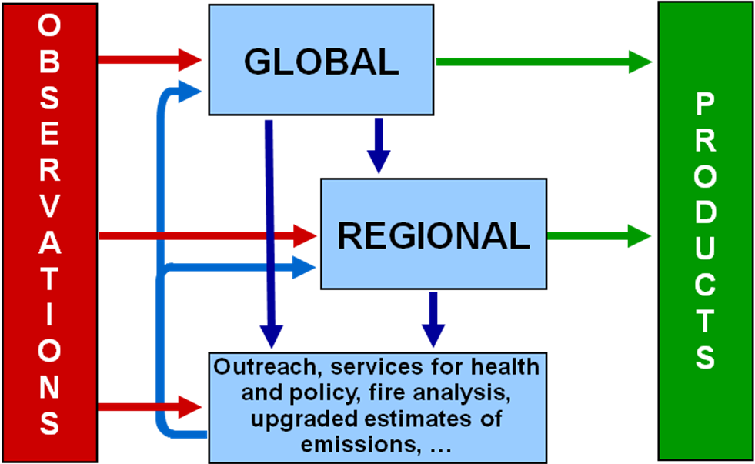
The future GMES Atmosphere Service (GMES AS) - http://www.gmes-atmosphere.eu/
MACC (monitoring Atmospheric Composition and Climate) and MACC2 are FP7 projects that aim at building up the pre-operational infrastructure that will host the GMES AS in 2014.
Provision of global and regional atmospheric composition forecasts , analyses (NRT) and a posteriori re-analyses.
Information based on in-situ and satellite data assimilated in state-of-the-art and routinely evaluated models
User-oriented and operational issues: delivery of NRT and archive data « by request »
Notes:
Introduction générale: Mentionner que les modèles sont opérationnels et que les services sont user-oriented.

Slide 3
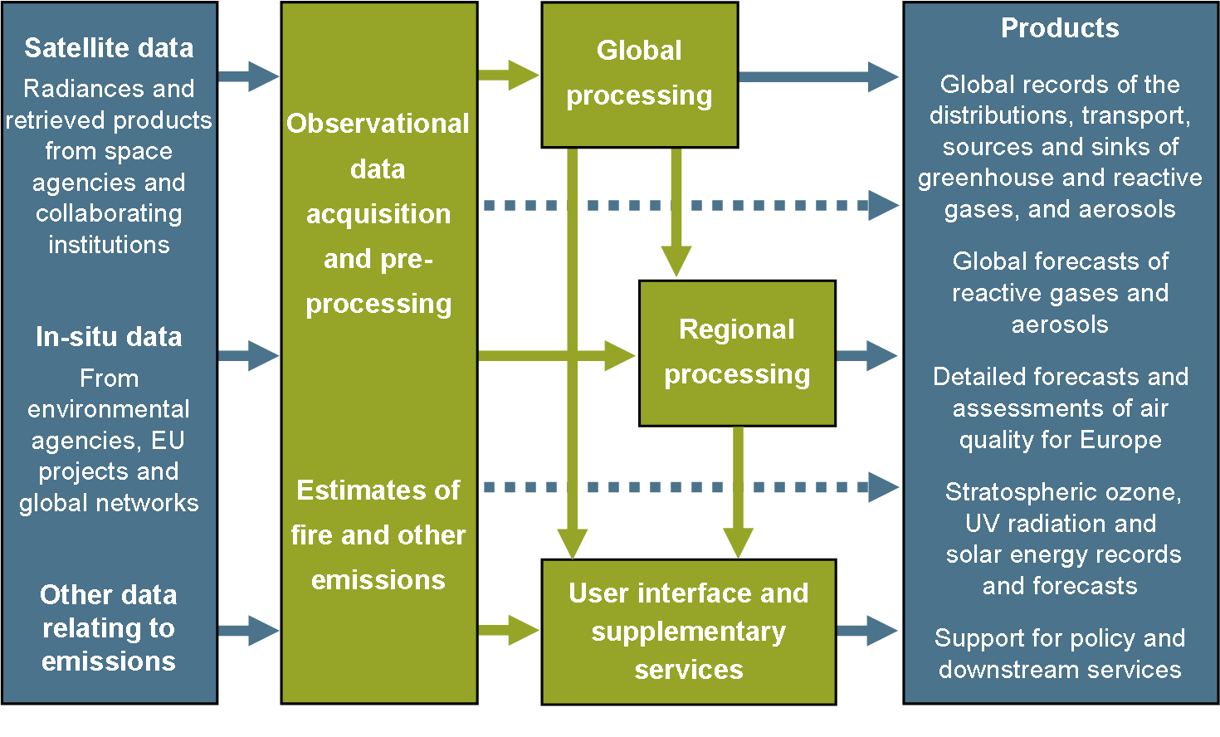
Detailed set-up of the MACC-MACC2 projects
Notes:
Mentionner que les données d’entrée : observation in-situ sont assurées par la coordination de l’EEA (projet GISC) et les données satellites par l’ESA.
L’évaluation des émissions et les inventaires sont des composantes des services.
Certains services sont dédiés au support pour la prise de décision politique et font plus particulièrement l’objet de cette presentation;

Slide 4
EIONET and EEA’s needs and how can MACC/MACC2 fullfil them
According to the Directive on ambient air quality and cleaner air for Europe (2008/50/EC) focus on NO2, O3, PM10 and PM2.5
Actions | Related questions | Potential GMES AS contribution (Y/N)
Reporting observations from the regulatory network | QA/QC Integrated indicators calculation (on various temporal scale) | N N
Reporting on regulatory air pollutant concentrations and exposure to PM2.5 | Mapping Trends analysis to assess exposure reduction | Y Y
Reporting on the exceedances of regulatory threshold | Integrated indicators related to the exposed population and the territories Mapping Contribution of the transboundary contribution and communication with other Member states Identification of local sources responsible for the event Contribution of natural sources (dust, sea salts, volcano ash) | Y Y Y Y Y
Reporting on action plans in pollution episode situation and on a long term perspective | Evaluation of the impact of short term actions Evaluation of the impact of long term action plans Trends analysis to assess the impact of emission reductions on ambient concentration | Y Y Y
Public information | General information on pollution events Indices calculation Warning message for sensitive population Forecasting Near real time analysis of pollution events | Y N Y Y Y

Slide 5
Added-value of the GMES AS for the EIONET community
A set of new and extended data gathered and interpreted for providing in near-real time consistent information on atmospheric composition and its impact at the global and regional scales.
Availability of data being inaccessible so far, but very useful to understand some pollution events (forest fires, dust events … )
Operational services set to be directly re-used by the environment agencies, national authorities : operational delivery and quality control
High quality maps of indicators based on the combination of observation and modeling data (data assimilation) and on the ensemble approach
Uncertainty evaluation of the delivered results established through the routine validation process
Access to research networks and expertise which are sometimes difficult to catch for end-users.

Slide 6
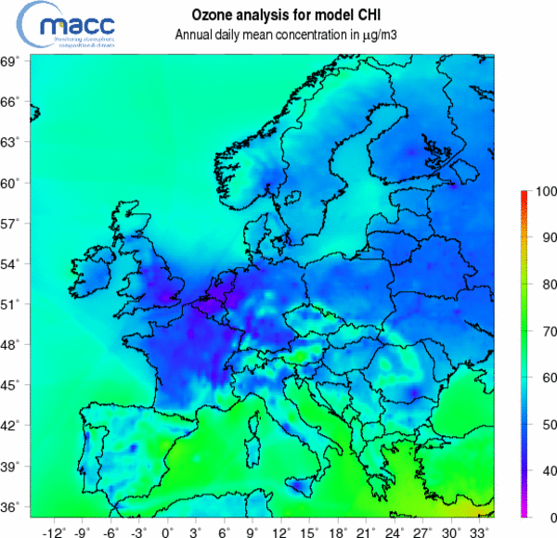
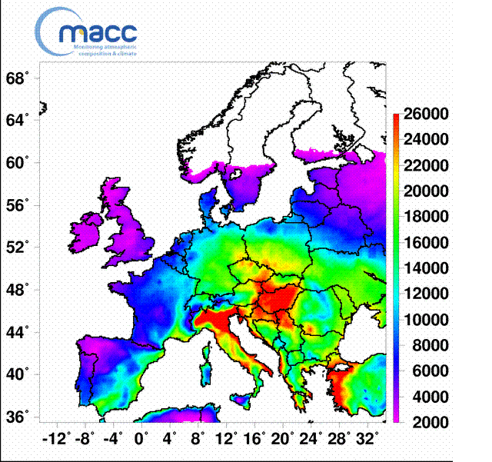
Reporting on regulatory air pollutant concentrations and exposure to PM2.5
MACC/R-EVA service ( http://www.gmes-atmosphere.eu/services/raq/raq_reanalysis/) providing a posteriori validated air quality assessments for Europe, based on re-analysed air pollutant concentration fields.
SOMO35 in 2007 (ensemble)

Slide 7
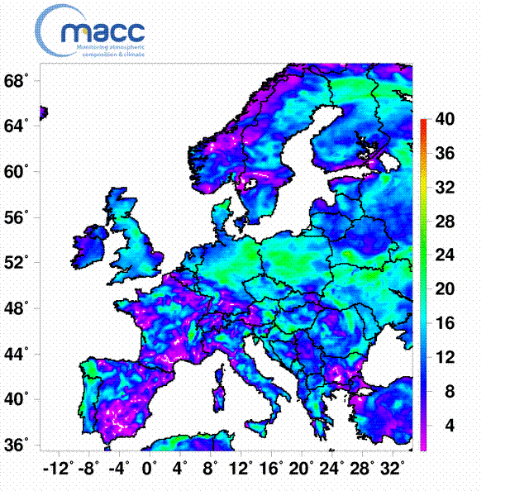
Access to the « ENSEMBLE » information
Median of seven individual chemistry transport models :
More accurate
Model variability can be seen as an information about the inherent modelling uncertainty
Standard deviation of the MACC models results to the ensemble

Slide 8
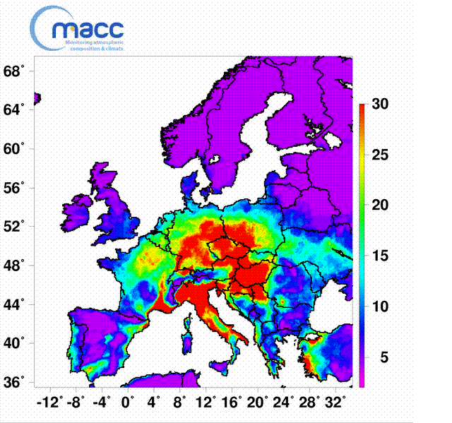
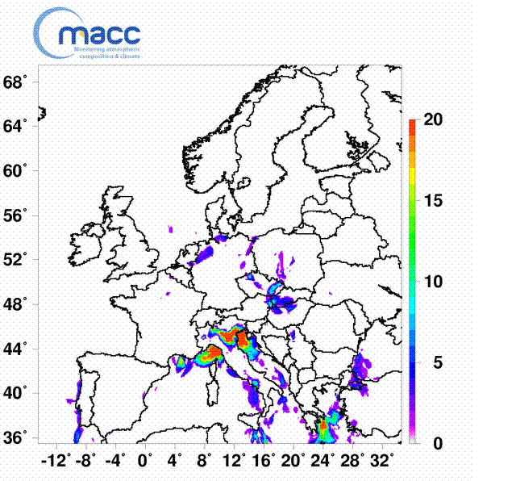
Reporting on the exceedances of regulatory threshold values
Ensemble re-analyses of the number of days when 8-hours average exceeds 120 µg/m³ and of the number of hours when hourly average exceeds 180 µg/m³·in 2007

Slide 9
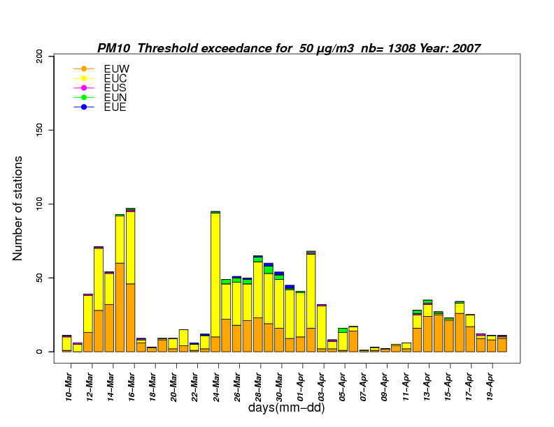
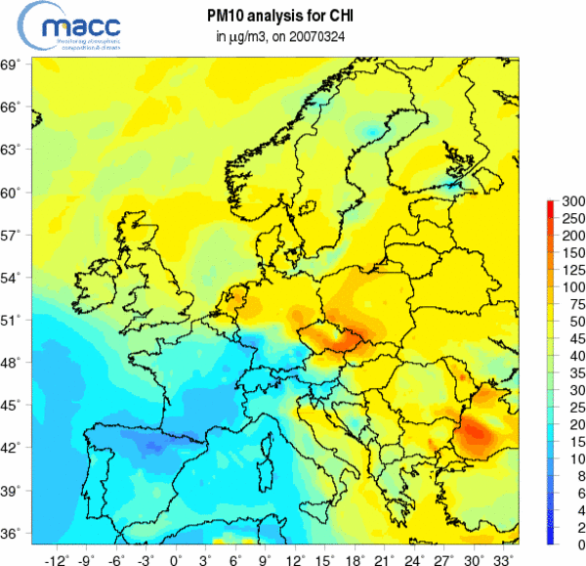
Interpretation of pollution events and transboundary contribution
Analysis of a specific PM10 pollution event in spring 2007. On the left number of stations exceeding the 50 µg/m³ threshold (daily average) between the 22nd March and the 12th April. On the right, MACC simulation of the PM10 concentration on the 24th March.
On a day per day basis, the GMES/MACC regional air quality ensemble forecasting system (http://www.gmes-atmosphere.eu/services/raq/raq_nrt/) can provide useful inputs for the analysis of the air pollution episode at the country level

Slide 10
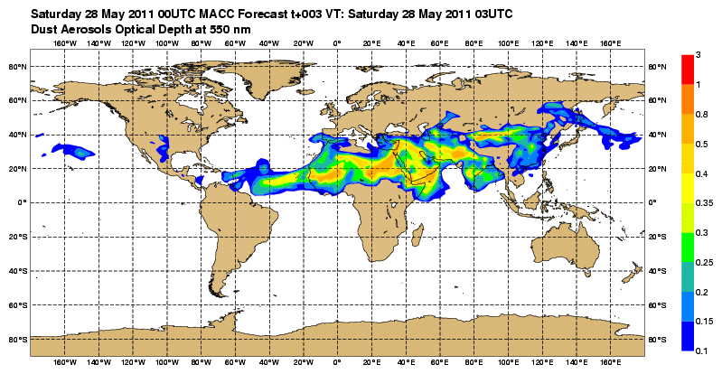
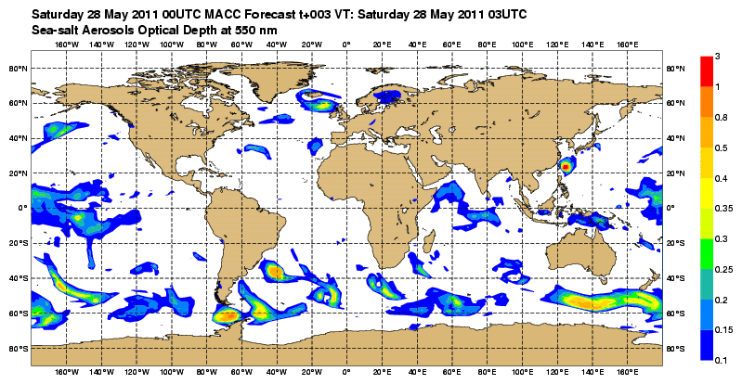
Contribution of natural sources
Forecasts and analyses of global aerosol optical depth assimilating MODIS satellite observations (http://www.gmes-atmosphere.eu/d/services/gac/nrt/nrt_opticaldepth). Sea salt and desert dusts categories are distinguished.

Slide 11
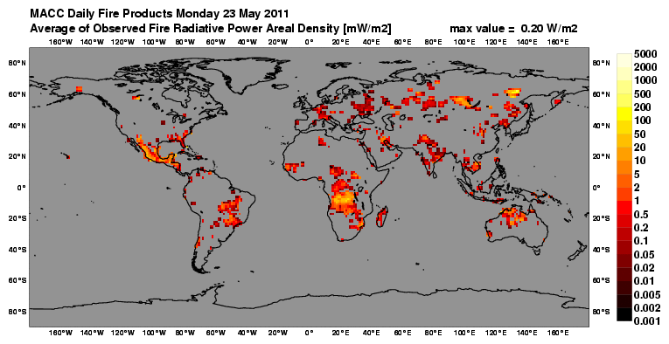
Forest fires monitoring
MACC proposes a service providing on a daily basis an updated picture of the active forest fires from SEVIRI (EUMETSAT) and MODIS (NASA) instruments (http://www.gmes-atmosphere.eu/about/project_structure/input_data/d_fire/).

Slide 12
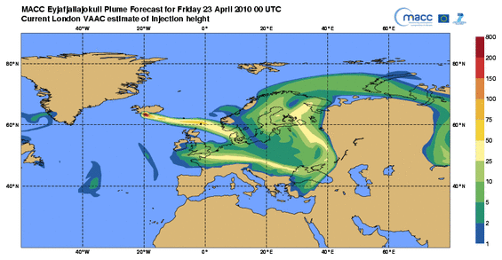
… and unusual air pollution sources.....

Slide 13
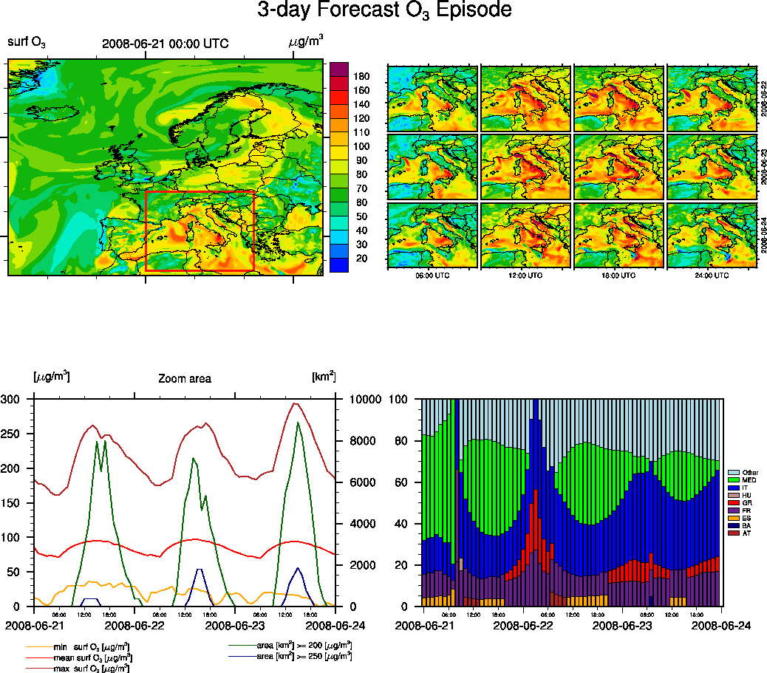
Reporting on action plans in pollution episode situation and on a long term perspective
Ozone episode in Italy in June 2008 : qualification of the episode: on the left main characteristics of the ozone concentration levels in Italy. On the right, amount of ozone due to local production versus contribution of neighboring countries

Slide 14
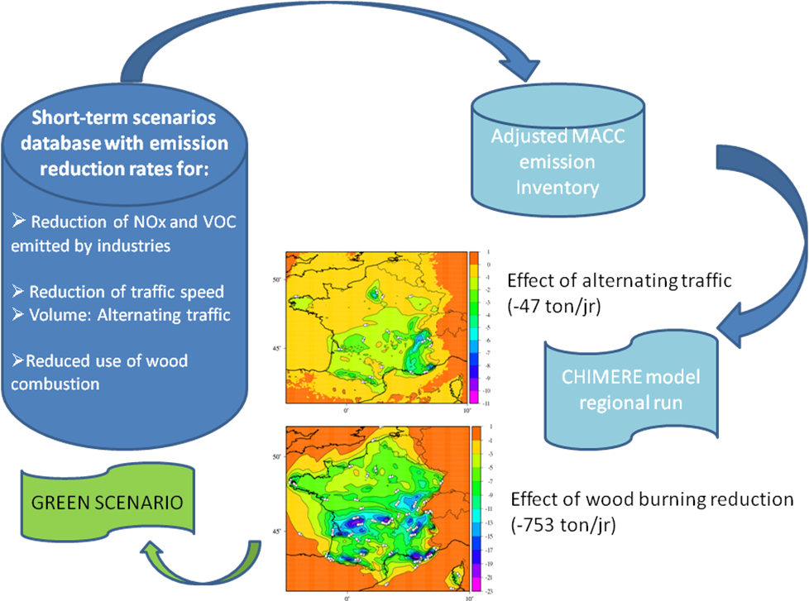
Impact of emergency or short term emission control scenarios
Development of a scenario toolbox based on the MACC forecasting capacities with a priori defined scenarios

Slide 15
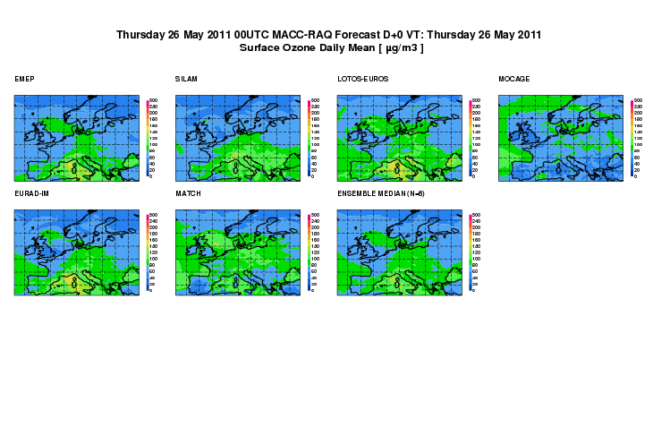
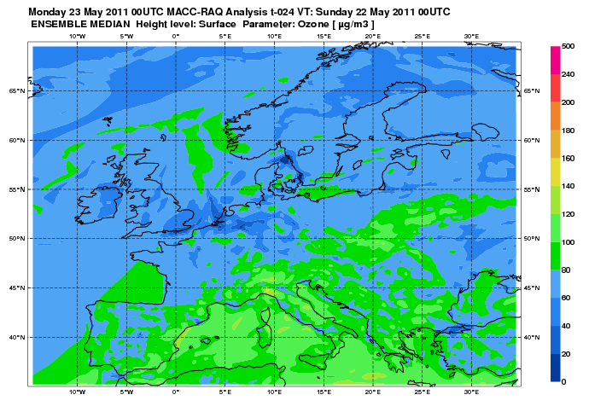
Public information
The MACC forecasting and analysis are available on a daily basis for ozone, nitrogen dioxide and PMs (http://macc-raq.gmes-atmosphere.eu/index.php?op=get) . Both individual model results contributing to the MACC system (seven models are involved) and ensemble results are available.

Slide 16
Conclusions
Pre-operational services are open for use and feedback from users is highly expected for an overall improvement of the system.
Core services are usually focused on global, European-wide and national issues. Therefore background pollution levels are targeted while the situation of the “man in the street” falls rather in downstream services areas.
However, a large range of questions the national authorities and the EIONET community have to deal with, for compliance with the air quality directives can find some answers in the data products likely to be proposed in the GMES AS.
Archive data sorted by type available by request : http://www.gmes-atmosphere.eu/data/

