Slide 1
SMHI (Norrköping) 14-16 June 2011
WG1 – Guidance
The role of modelling in the AQ Directive(s)
Anke Lükewille
Air and Climate Change Programme
European Environment Agency (EEA)

Slide 2
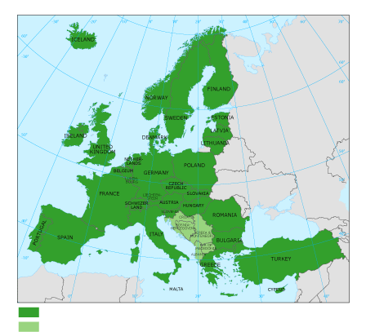
The European Environment Agency (EEA)
... is the EU body dedicated to providing sound, independent information on the environment.
... is a main information source for those involved in developing, adopting, implementing and evaluating environmental policy, and also the general public.
http://www.eea.europa.eu Copenhagen, Denmark

Slide 3
AQUILA, MACC …
AP Policy Review

Slide 4
SMHI – Mange Ta(c)k!

Slide 5
SMHI – Mange Ta(c)k!

Slide 6
European Pollutant Release and Transfer Register (E-PRTR) diffuse air emissions dataset
http://www.eea.europa.eu/data-and-maps/data/european-pollutant-release-and-transfer-register-e-prtr-regulation-art-8-diffuse-air-data
Contact at EEA: Bob.Boyce@eea.europa.eu

Slide 7
European Pollutant Release and Transfer Register (E-PRTR) diffuse air emissions dataset
Article 8 of the E-PRTR Regulation (No 166/2006) requires the Commission, assisted by the EEA, to produce information on releases from diffuse sources using an adequate geographical disaggregation and to provide information on the methodology.
Data are derived from a range of different sources and data collection processes. The emission data are based on United Nations Economic Commission for Europe (UNECE) Convention on Long-range Transboundary Air Pollution (CLRTAP) and United Nations Framework Convention on Climate Change (UNFCCC) official datasets.

Slide 8
European Pollutant Release and Transfer Register (E-PRTR) diffuse air emissions dataset
Diffuse sources for road transport, shipping, aviation, domestic heating, agriculture and small business.
Emissions of nitrogen oxides (NOX), sulphur oxides (as SO2), carbon dioxide (CO2), ammonia (NH3) and particulate matter (PM10) for the year 2008.
There are 32 maps in total each based on a 5 km by 5 km grid.
The maps complement existing data on emissions from individual industrial plants from the E-PRTR
http://www.eea.europa.eu/data-and-maps/data/european-pollutant-release-and-transfer-register-e-prtr-regulation-art-8-diffuse-air-data

Slide 9
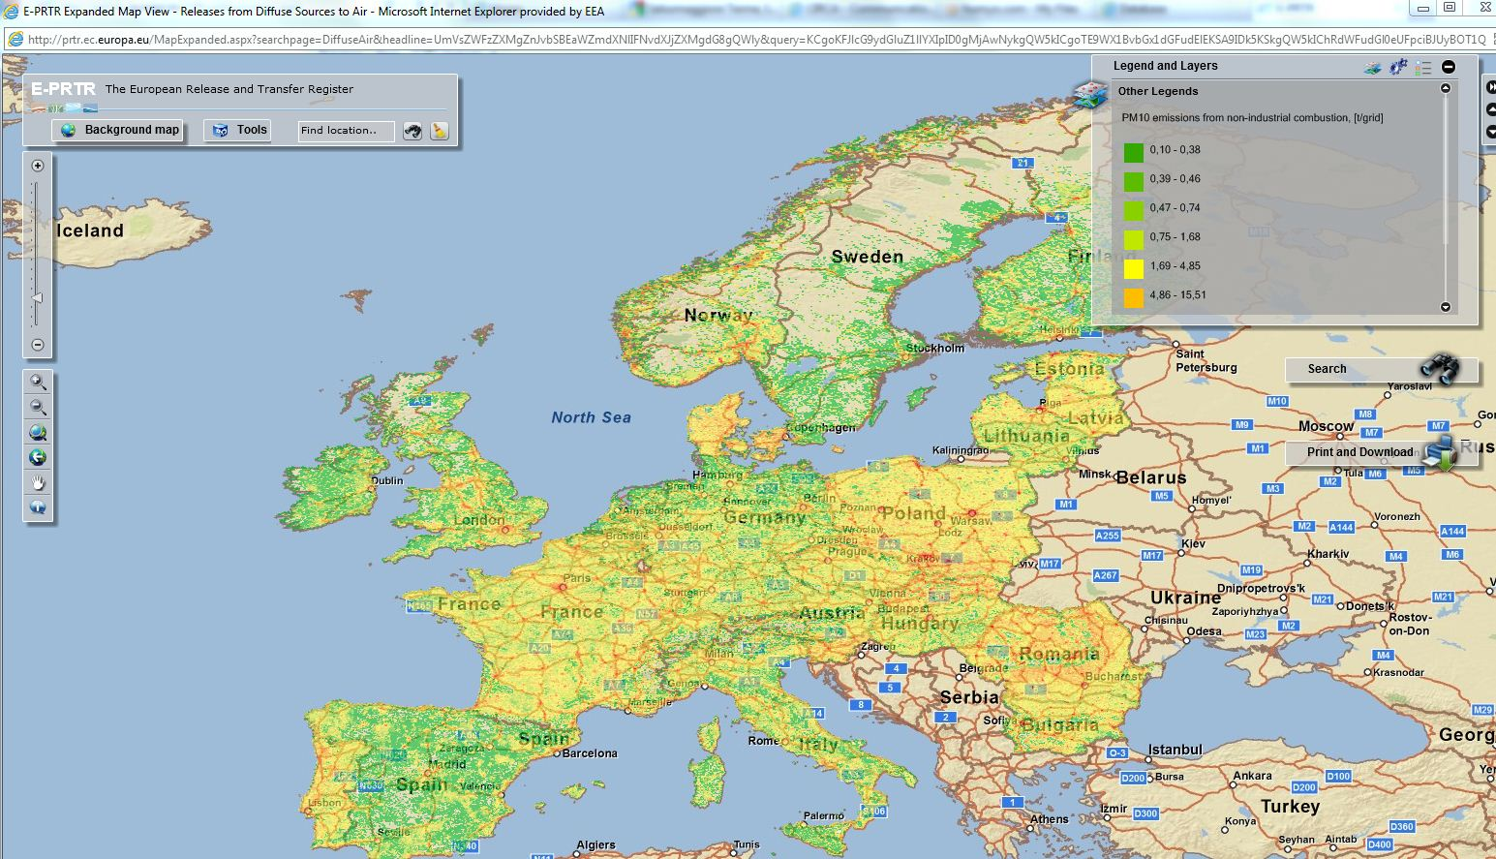
European Pollutant Release and Transfer Register (E-PRTR) diffuse air emissions dataset
Vector based data files are available on the EEA website.
Grid/raster data will be made available in the coming weeks.

