Slide 1
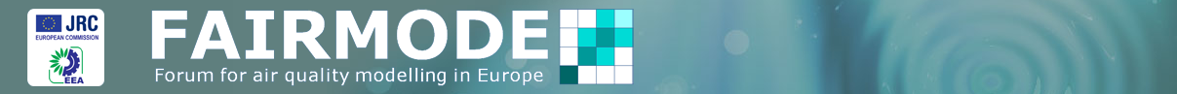

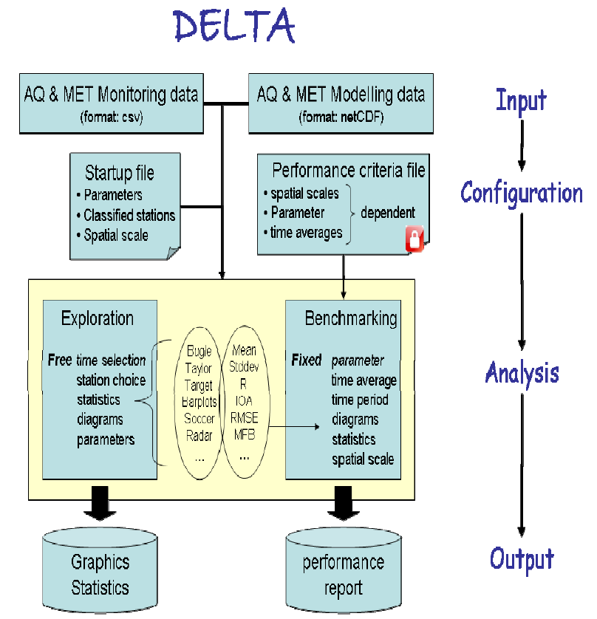
DELTA tool testing for a Portuguese City
Ana Miranda and Helena Martins
University of Aveiro, Portugal
WG2 Meeting, SG4 Models Benchmarking
SMHI, Norrkoping, 14th June 2011

Slide 2
Installation /download
simple installation process
the needed side tools and where they can be downloaded should be mentioned earlier in the User’s Guide
Preparation of input files

Slide 3
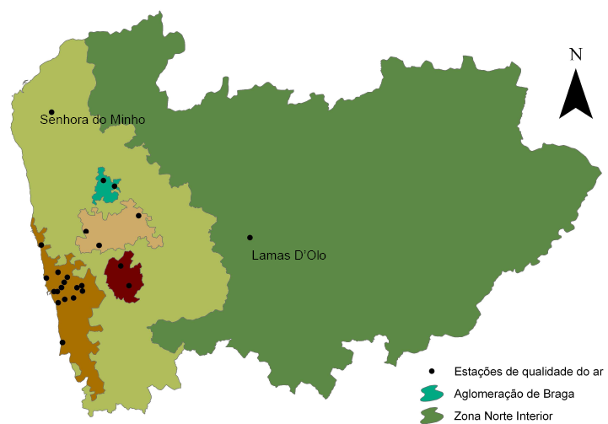

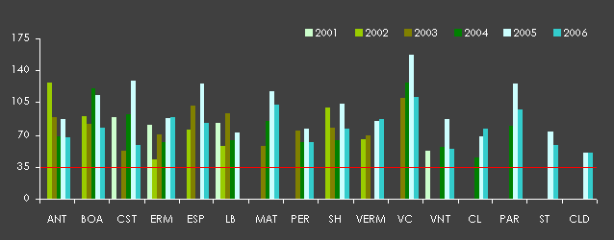
Case-study – Porto 2006 - monitoring data
Air quality monitoring stations with efficiency >90% in 2006:
O₃ - 8
PM10 - 6
NO2 - 6
PM10 daily LV exceedances

Slide 4
Case-study – Porto 2006 - modelling data
MM5-CAMx
simulation domains
D3 : 1km x 1km spatial resolution
binary CAMx output files
post-processing conversion to ascii
csv_to_modeltype.sav
check_io_preproc.sav

Slide 5
Installation /download
Preparation of input files
Configuration

Slide 6
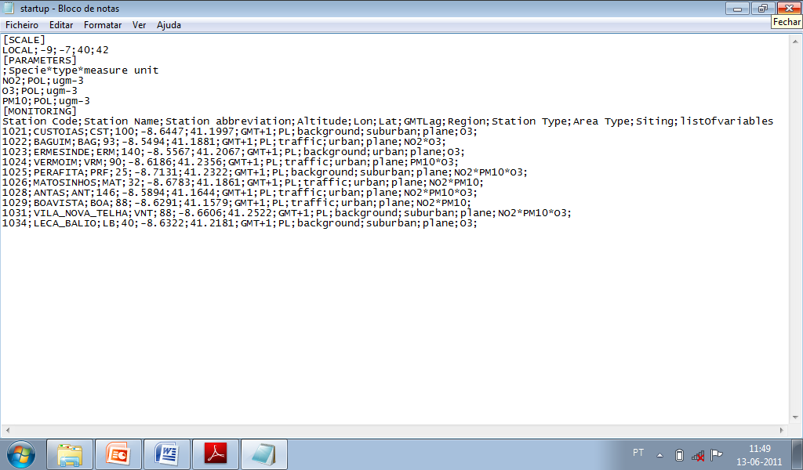

Slide 7
Installation /download
Preparation of input files
Configuration
Exploration

Slide 8
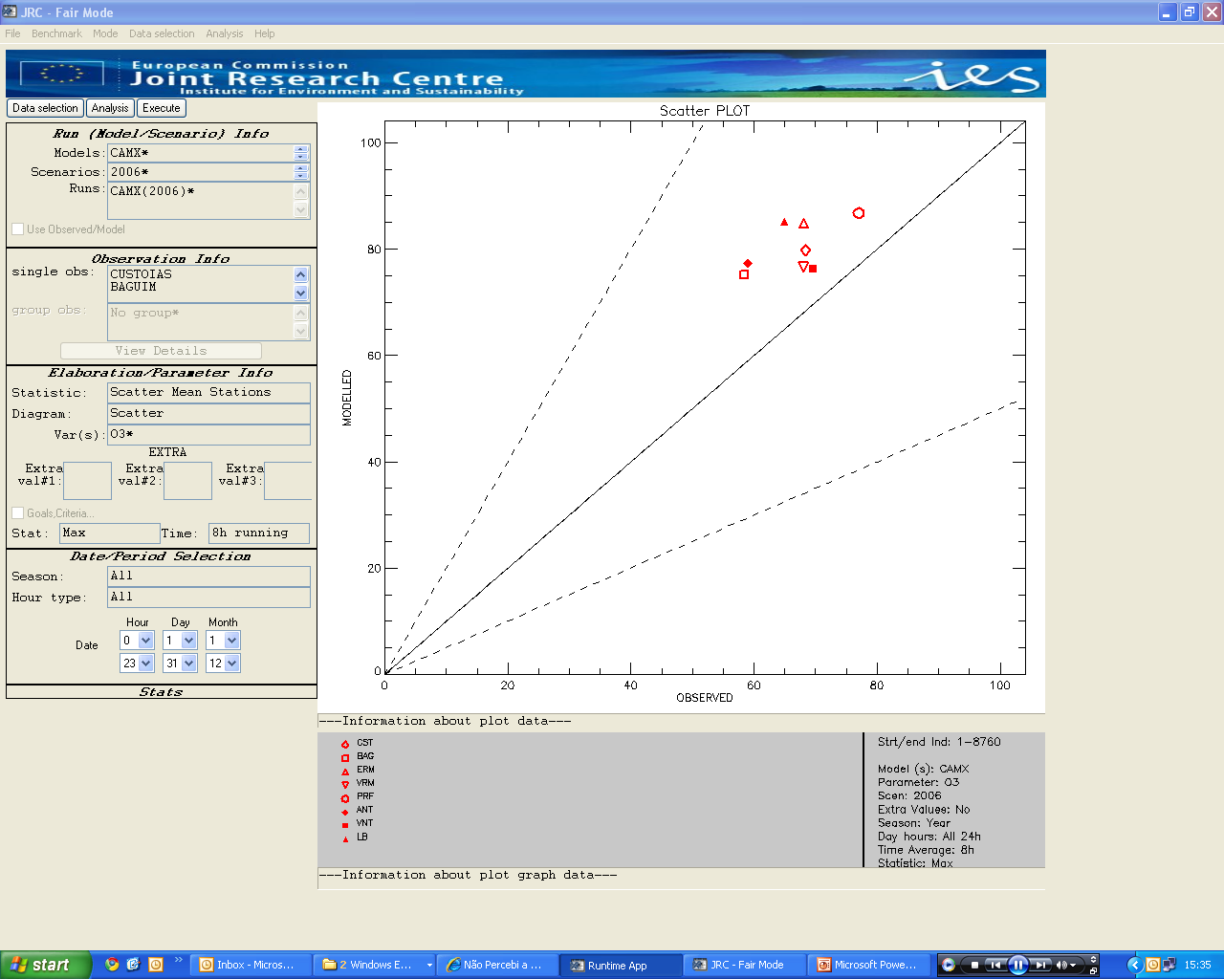
Exploration – O₃ 8-hour daily max – scatter mean stations

Slide 9
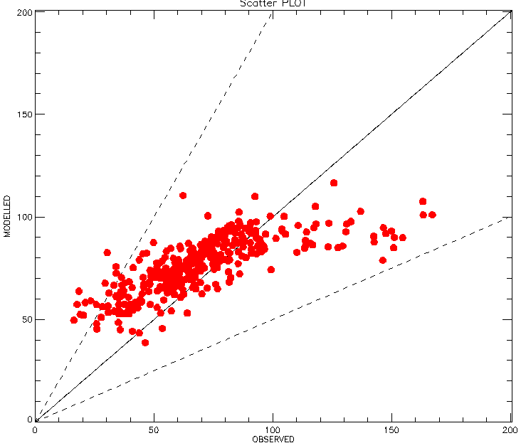
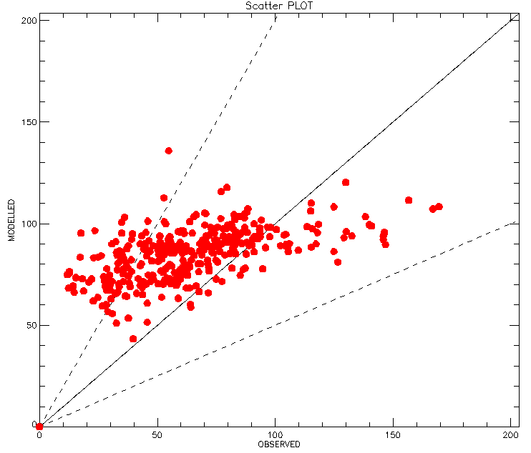
Exploration – O₃ 8-hour daily max – all values
VILA NOVA DA TELHA
LEÇA DO BALIO
general over-estimation of O₃ 8-hour daily maximum
under-estimation for peak concentrations

Slide 10
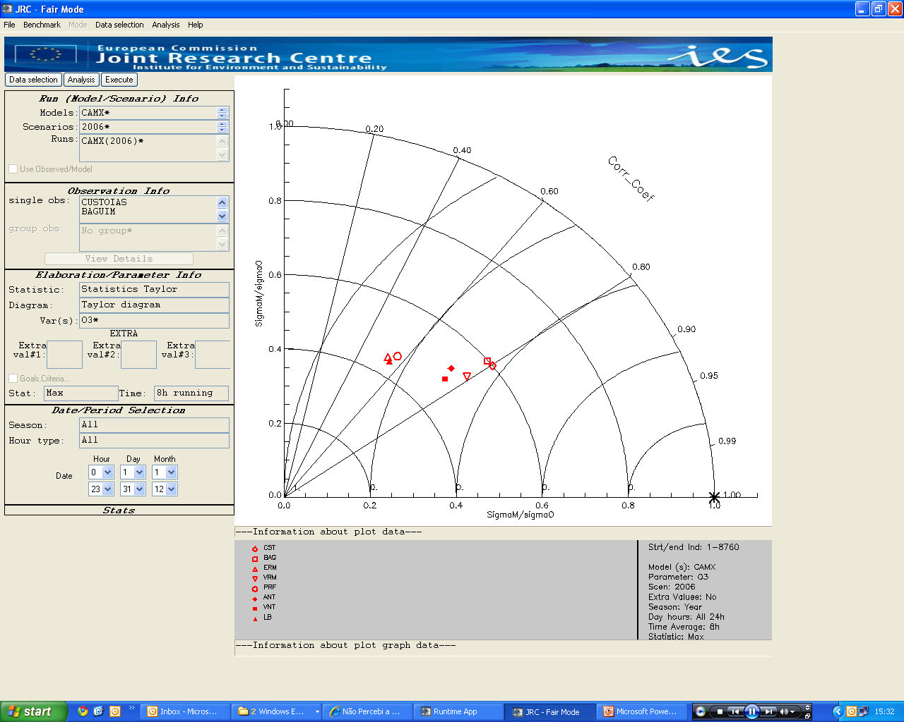
Exploration – O₃ 8-hour daily max – Taylor diagram
correlation coeficients between 0.5 and 0.8
CRMSE < 0.4
STD < 0.6

Slide 11
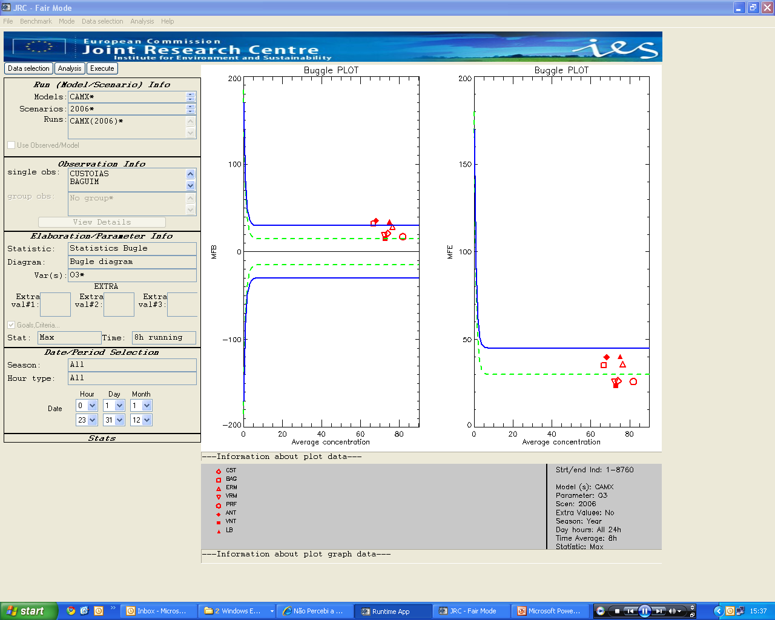
Exploration – O₃ 8-hour daily max – Bugle diagram
MFB : 3 monitoring stations outside the criteria line
MFE: all stations meet the goal or criteria

Slide 12
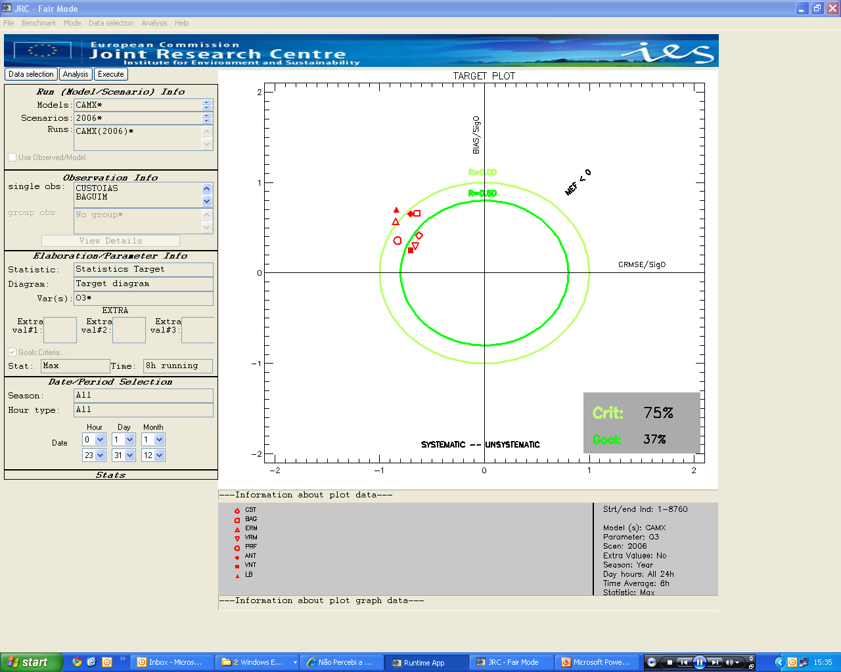
Exploration – O₃ 8-hour daily max – Target diagram
trouble in the interpretation (namely the r lines)

Slide 13
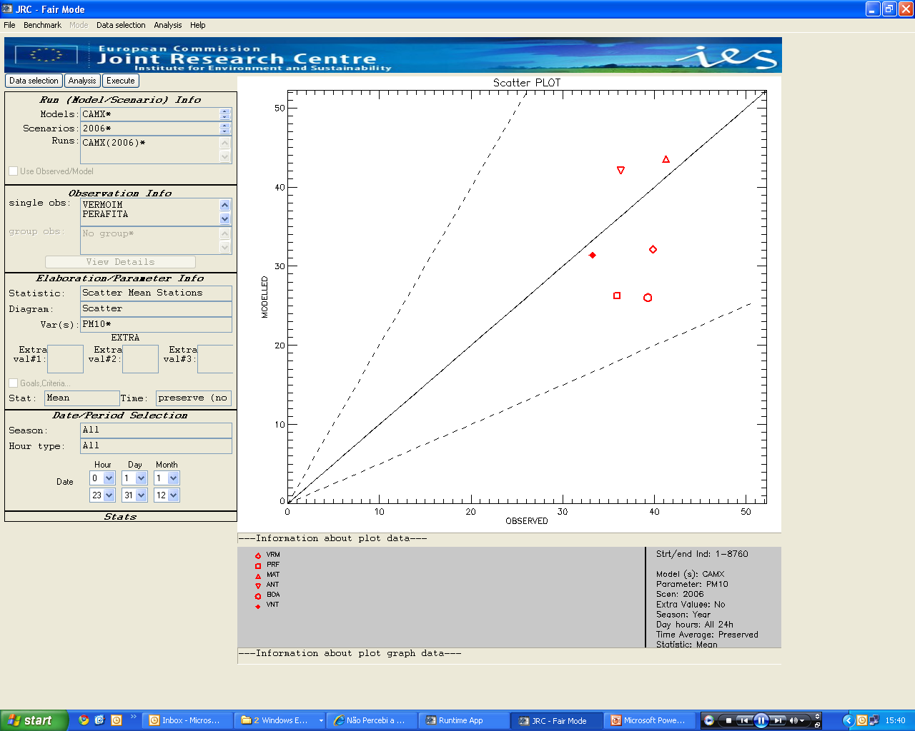
Exploration – PM10 daily mean – scatter mean stations

Slide 14
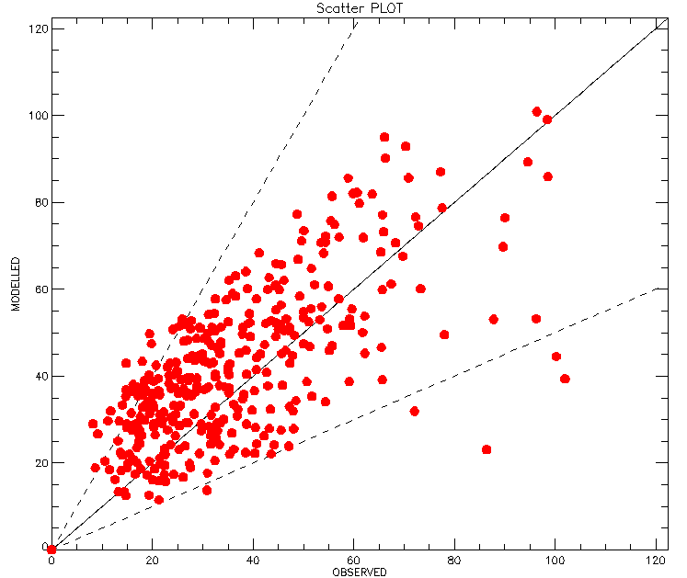
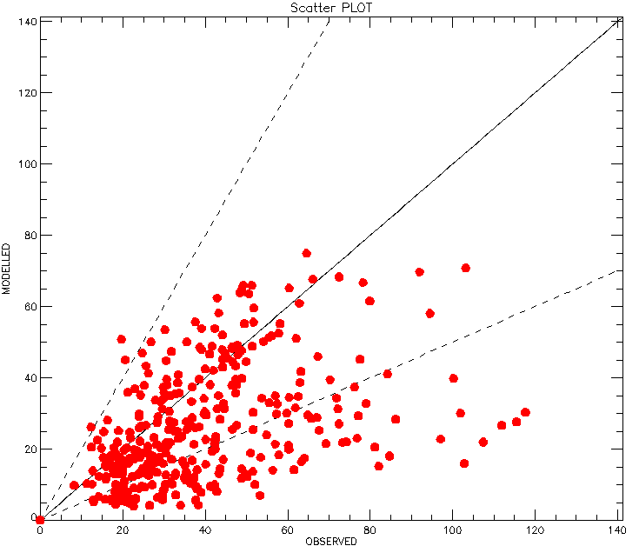
Exploration – PM10 daily mean – all values
ANTAS
BOAVISTA
ANTAS: hability to simulate some of the peak concentrations
BOAVISTA: unnable to simulate peak concentrations

Slide 15
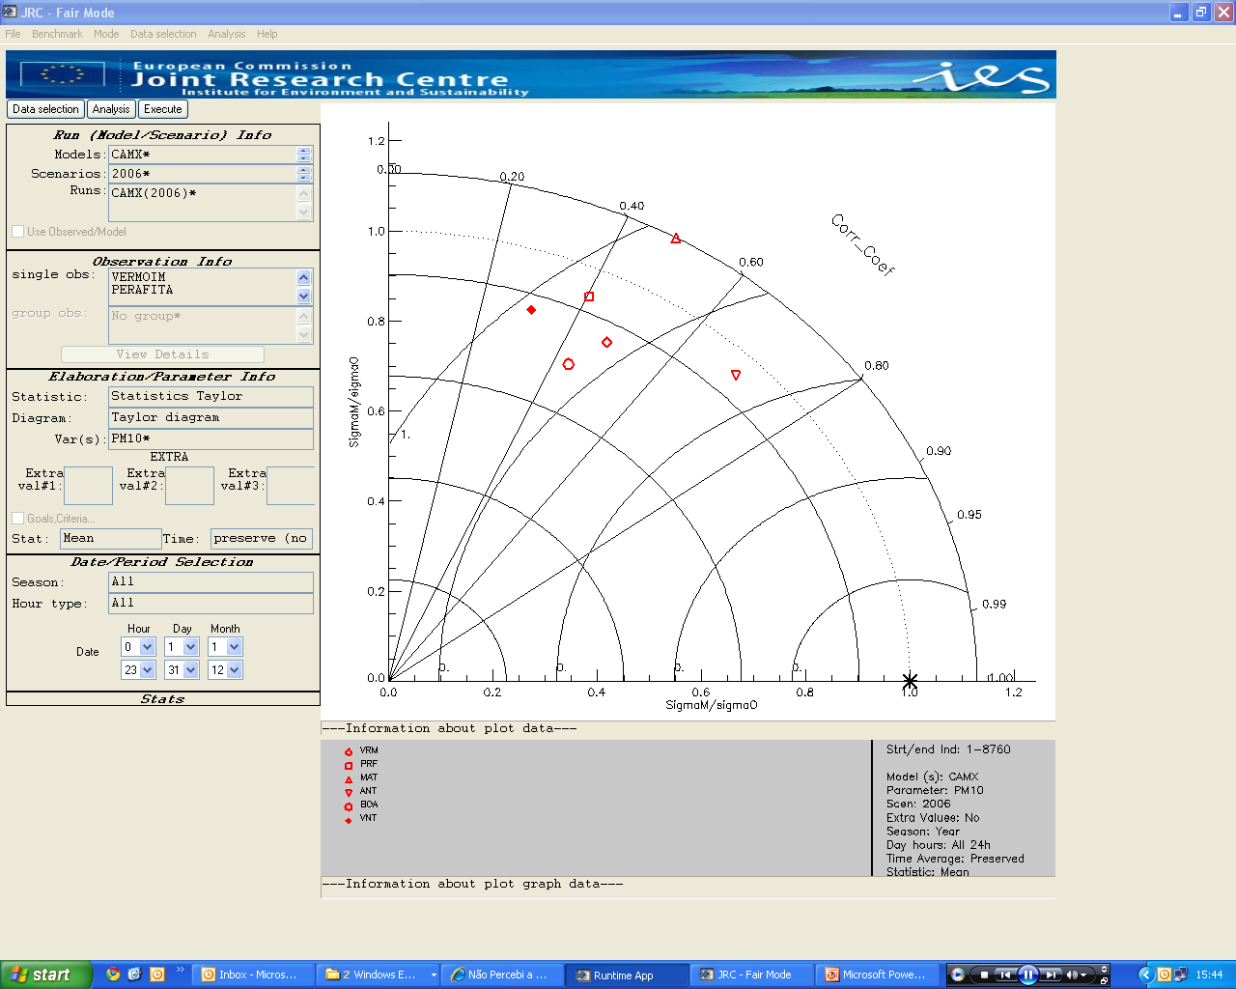
Exploration – PM10 daily mean – Taylor diagram
correlation coeficients between 0.3 and 0.7
STD > 0.8

Slide 16
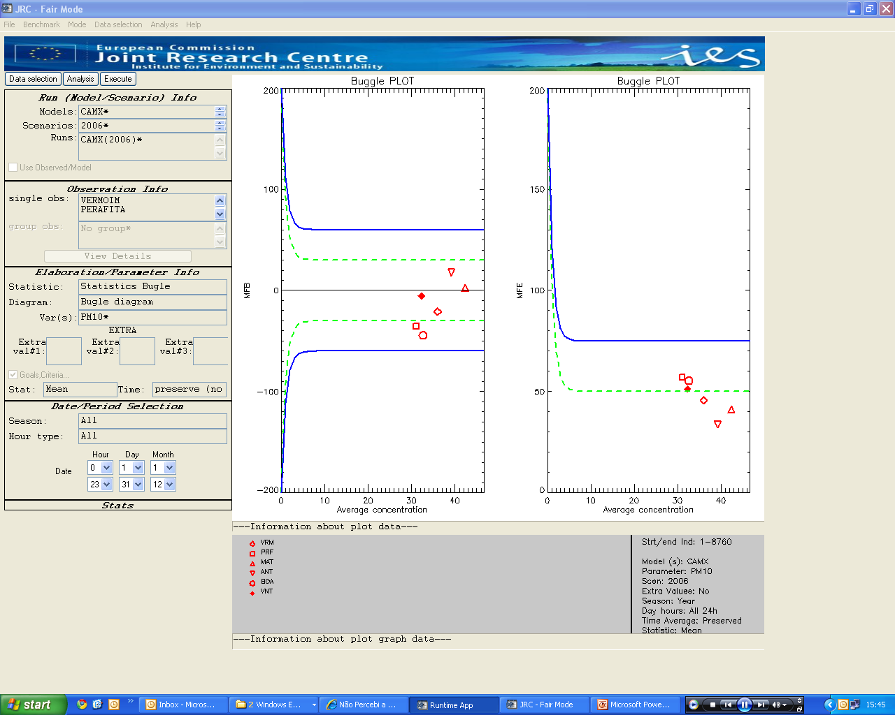
Exploration – PM10 daily mean – Bugle diagram
all stations meet the goal or criteria

Slide 17
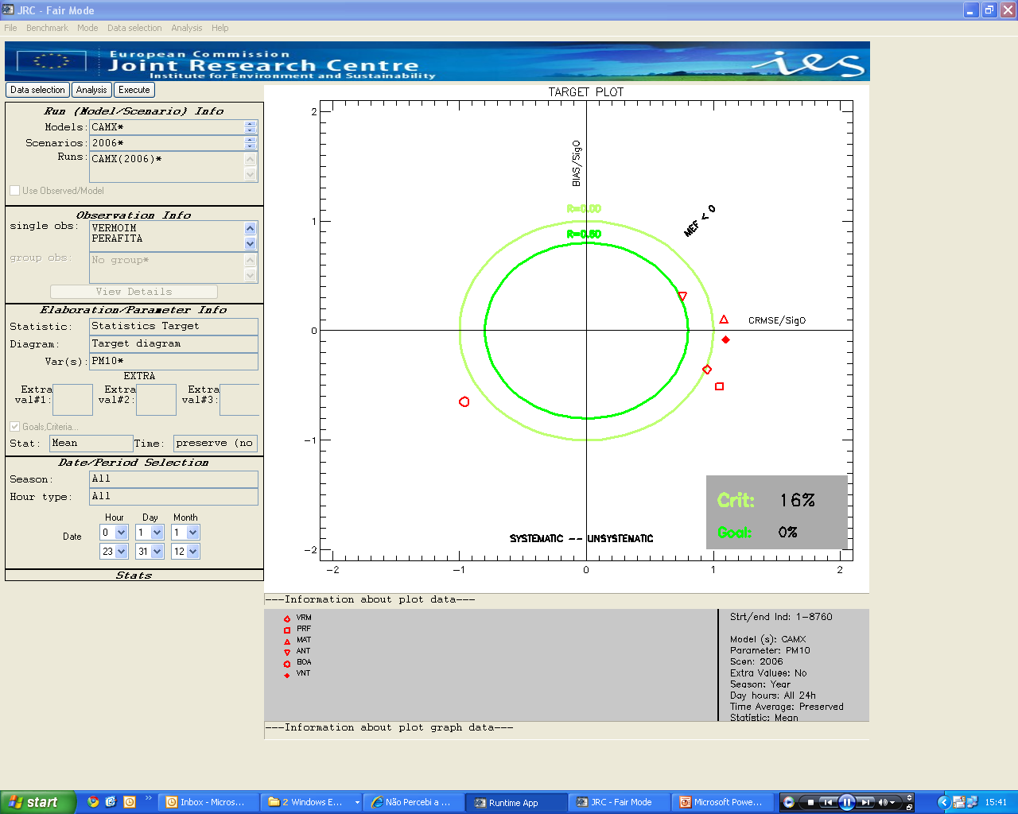
Exploration – PM10 daily mean – Target diagram
trouble in the interpretation (namely the r lines)
seems to indicate a worst performance than expected according to the previous diagrams

Slide 18
Installation /download
Preparation of input files
Configuration
Exploration
Benchmarking

Slide 19
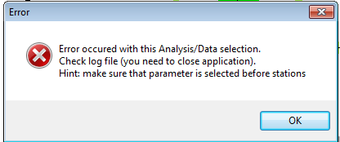
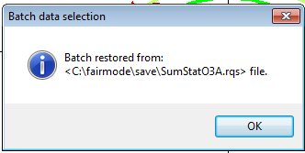
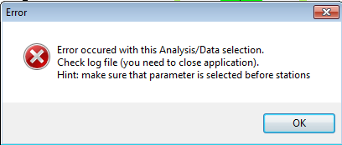
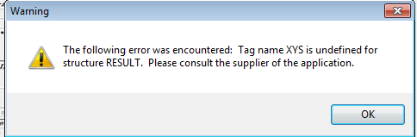
Benchmarking

Slide 20
Questionnaire
  The statistical indicators selected for the performance report are suitable and complete
  Difficulty in defining different performance criteria for different scales and pollutants
  Values for performance goals (and criteria) should be geographically dependent ex. areas of complex topography; countries at different development stages (different levels of information)
  Should the DELTA tool include directions regarding the minimum number of stations and the type of stations for model evaluation?
  Should a minimum spatial resolution be defined?

Slide 21
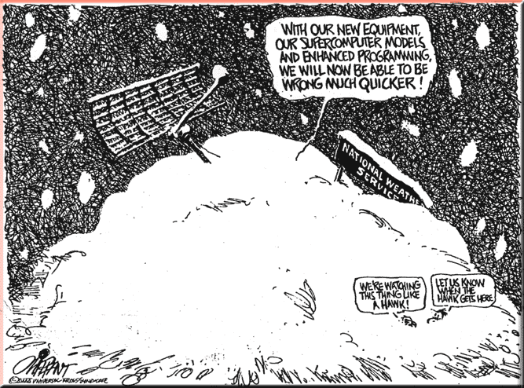
Next steps...
  Test DELTA for 5 European cities annual simulations with CAMx (200 m spatial resolution) and URBAIR (2nd generation gaussian model, 100 m spatial resolution)
  Joint FAIRMODE exercise

