Slide 1
UK feedback on MQO
Presented by: John Stedman, Daniel Brookes, Brian Stacey, Keith Vincent, Emily Connolly
10 April 2013

Slide 2
Outline
Current view on the proposed MQOs
Other aspects covered in accompanying presentation
MQO formulation
NO₂ measurement uncertainty
Fitting procedure
Application to NO₂
PM measurement uncertainty
Fitting procedure
Application to PM₁₀
Conclusions and recommendations
Views of the UK Competent Authorities

Slide 3
Current view of the proposed MQOs
NO₂:
Uncertainty budget for hourly measurements largely reasonable.
Less happy with the application to annual means in terms of the cancelling of random errors, specifically the lack of fit/linearity component.
Overall we think that the latest version of the coefficients for annual mean NO₂ are still a bit too stringent at low concentrations.

Slide 4
Current views of the proposed MQOs
PM₁₀:
There are a set of coefficients defined for each measurement type in early versions of the paper which do not appear in the latest paper, although data for all measurements appears in Figures.
In the Delta tool and in the latest paper the most stringent coefficients (gravimetric measurement based) have been carried through.
The resulting model DQOs (gravimetric measurement based) are too stringent at all concentrations for annual mean PM₁₀ on this basis.
TEOM (presumably FDMS) coefficients from an earlier version of the paper result in more generous uncertainty limits.

Slide 5
MQO formulation
T2012 proposed MQO:
T2013 Part I: Simplified formulation for RMS_{U}
Proportional component
Non-Proportional component

Slide 6
MQO formulation
T2013 Part II: MQO for annual average results
T2013 Part II: Extension of uncertainty formulation for time averaging
Introduction of N_{p} and N_{np} to account for autocorrelation
Dropping of σ²

Slide 7
MQO formulation
Shouldn’t this be?
T2013 Part II: Drops σ² using the substitution:
Only valid if N_{p}* is const. and independent of x_{m} or a constant function of x_{m} such that N_{p}* = f(x_{m}) = const.

Slide 8
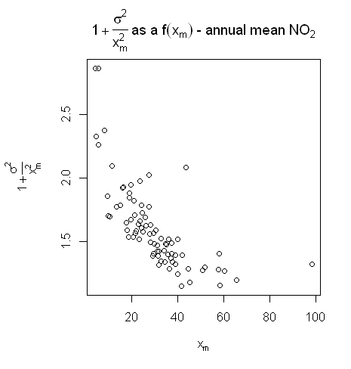
MQO formulation
T2013 Part II: However... using NO₂ monitoring data from 80 UK national network monitoring sites for the year 2010

Slide 9
NO₂ measurement uncertainty
Based on GUM methodology, type B uncertainty
Broadly happy but...
Cancelling of random errors, specifically the lack of fit/linearity component is unreasonable
994 urban stations in AirBase, 2009 data
Representative of all years?

Slide 10
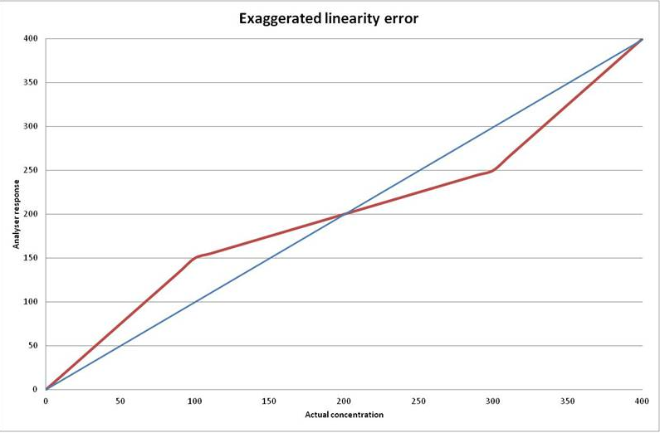
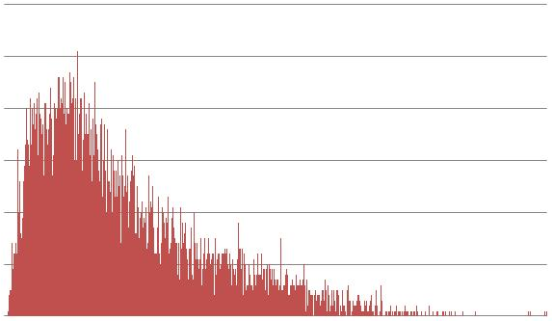
NO₂ measurement uncertainty
T2013 Part II: Table B.1
Lack of fit, linearity component is the largest component of NO₂ uncertainty budget
Is this uncertainty component normally distributed and 100% random?
Not the case:

Slide 11
Fitting procedure
Linear fit of u_{c}(x_{i})² vs x_{i}² for hourly, u_{c}(x_{m})² vs x_{m}² for annual (so missing σ² – should be u_{c}(x_{m})² vs x_{m}² + σ²)
Constant coefficient RV a reference value set at hourly LV
Constant coefficients u_{r}^{RV} and α calculated from linear fit of hourly NO₂ data
Constant coefficients N_{p}* and N_{np} calculated from linear fit of annual average NO₂ data, holding u_{r}^{RV}, α and RV constant
2 μgm⁻³ offset applied to annual fit to avoid underestimation of uncertainty at low concentrations

Slide 12
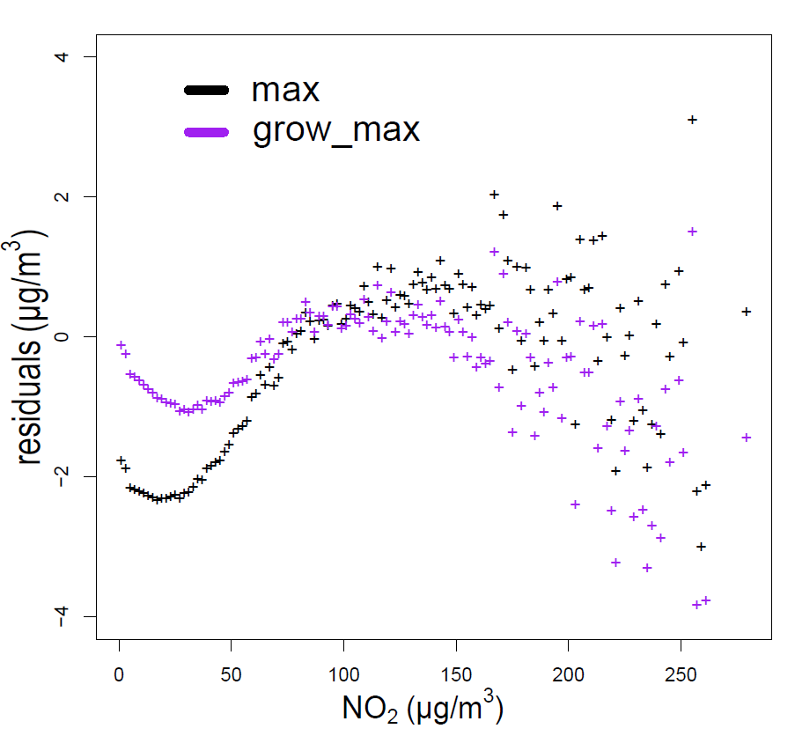
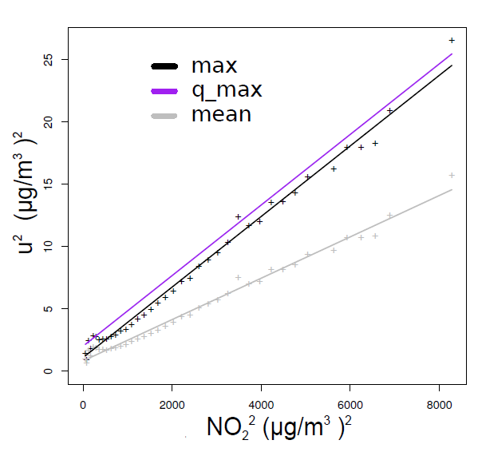
Fitting procedure:
Residuals for hourly NO₂ fit show non-linearity, overestimate uncertainty
But estimating maximum uncertainty so overestimate ok?
Annual NO₂ fit also shows non-linearity
Tendency to underestimate:
Hence 2 μgm⁻³ offset applied, and N_{p} and N_{np} re-calculated to estimate maximum uncertainty
Hourly values
Yearly values

Slide 13
Fitting procedure:
Explanation for non linearity at lower concentrations suggested as resulting from < 1 correlation between NO and NO_{x} at low NO₂ (Gerboles et al, 2003)
Sensitivity of the fit coefficients to the determination of the gradient and intercept
Sensitivity to the underlying measurement data so will be sensitive to year to year variations in observed concentrations
Approximation of measurement uncertainty, attempting to define maximum uncertainty

Slide 14
Application to NO₂: PCM model results for 2010
Parameter values in V3.0 (left) are not consistent with the paper circulated on 5 March 2013 (right)

Slide 15
Application to NO₂: PCM model 2010 and 2011
Model performance varies from year to year
Using parameters from 5 March 2013 paper

Slide 16
Application to NO₂: Sensitivity to inclusion of σ²
With (left) and without σ² term (right)
Using parameters from 5 March 2013 paper

Slide 17
PM₁₀ measurement uncertainty
GUM methodology, type B uncertainty:
T2013 Part II: Table C.1
Should be referencing the new prEN12341 standard
u flow calibration – 1.7% in the new EN12341
u mba balance calibration – 0.24ug/m³ in the new EN12341 (25/(3)^{0.5} = 0.24)
However, GUM method not applied:
T2013 Part II: Appendix C – Limitations to estimate PM measurement uncertainty

Slide 18
PM₁₀ measurement uncertainty
Instead an approach based on GDE (2010) method for PM₁₀ measurement uncertainty estimation
Calibration chain: Demonstration of equivalence with gravimetric standard => transfer standard => Demonstration of equivalence with transfer standard
Measurement uncertainty increases along calibration chain
GDE method means measurement uncertainty defined under limited conditions => representative across Europe?

Slide 19
PM₁₀ measurement uncertainty
Historically little evidence for demonstration of ongoing equivalence.
Efforts underway to improve quantification of PM measurement uncertainty:
WG15 working on quantification of uncertainty associated with filter media
Evidence to feed into a new measurement standard

Slide 20
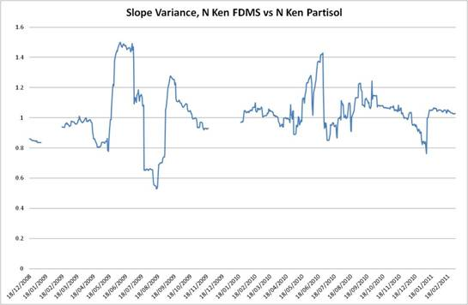
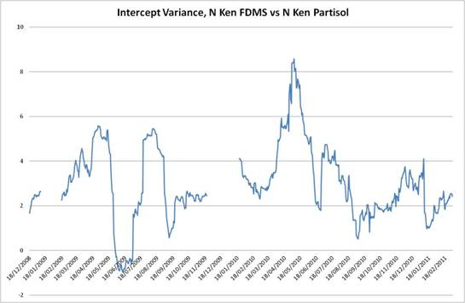
PM₁₀ measurement uncertainty
Comparisons show large variation in the relationship between measurement types

Slide 21
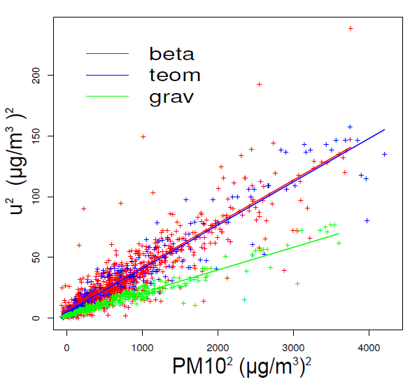
PM₁₀ measurement uncertainty
Previous versions of the paper: coefficients presented for gravimetric, teom and beta ray methods
Current paper only presents coefficients for gravimetric which tend to be much more stringent.
Uncertainty criteria applied should be appropriate to the measurement being compared:
Most of the UK network is TEOM.

Slide 22
Delta V3.0: PCM PM₁₀ in 2010
Using parameter values from 5 March paper (left)
Using parameters for TEOM (FDMS) (right)

Slide 23
Conclusions and recommendations
Model DQO Journal papers:
What is the process to go from journal papers to technical guidance for MS?
Revising the requirements for reporting that are presently within the AQD?
Is it proposed that this new method completely replaces the existing text in Annex I?
Our previous understanding was to include a reference to Commission Guidance on model DQO in a revised AQD legal text and that this would then be developed by FAIRMODE.
We now do not expect proposals for a new AQD for several years.
How should this be taken forwards?
How can we comply with the existing text in the interim once a new method is established but before the AQD is changed?

Slide 24
Conclusions and recommendations
Other complications:
Spatial representativity. ‘The measurements that have to be selected for comparison with modelling results shall be representative of the scale covered by the model.’
Developments in quantification of measurement uncertainty
Any revisions to the fit will lead to new coefficients to apply, new versions of Delta tool

Slide 25
Concluding remarks
Need to decide whether these formulations are fit for use
The Directive defines model and measurement in the vicinity of the limit value
Implication of a burden in formulating measurement uncertainty at values other than the limit value if we adopt this approach

