Slide 1
Applying the DELTA-FAIRMODE tool to support AQD: the validation of the TCAM Chemical Transport Model
C. Carnevale, G. Finzi, A. Pederzoli,
P. Thunis, E. Pisoni, M. Volta

Slide 2
Outline
Methodology
TCAM model
Results
Conclusions

Slide 3
MPC definition
MODEL PERFORMANCE CRITERIA (MPC):
“minimum level of quality to be achieved by a model for policy use” (Boylan and Russell, 2006)

Slide 4
Model evaluation: Main Statistical Indicators

Slide 5
Model Performance Criteria

Slide 6
Target Diagram
RMSE_{U}≤0.5 → RMSE < U → model results are on average within the range of the observation uncertainty for that station→ any attempt to improve the model performance further is unhelpful.
0.5<RMSE_{U}≤1 → RMSE on average > the range of U but the model might still be closer to the “true value” (i.e. the perfect measurement) than observations.
RMSE_{U}>1 observations are closer to the “true value” than the model results.

Slide 7
Measures: 50 monitoring sites (suburban, urban and rural background)
Model: TCAM
Year:2005
Domain resolution:6x6km² (POMI exercise)
Pollutants: O3 – PM10

Slide 8
TCAM: Transport and Depostion Module
Eulerian 3D model
Terrain-following coordinate system
Horizontal Transport Module: Chapeau Function + Forester Filter
Vertical Transport Module: Crank-Nicholson hybrid solver based on the vertical diffusivity coefficient
Deposition Module
Dry deposition: resistance-based approach
Wet deposition: scavenging approach for both gas and aerosol species

Slide 9
TCAM: Gas chemical module
Chemical Mechanism
CBIV 90
SAPRC 90/97
COCOH 97
Numerical Solver
QSSA (explicit)
IEH (hybrid)
Species: 95
Reactions: 187
Fast-Species (12): LSODE (implicit)
Slow-Species: Adams-Bashforth (explicit)

Slide 10
TCAM: Aerosol module
Chemical Species: 21
12 inorganics
9 organics
Size Classes: <10 (from 0.01 μm to 50 μm)
Fixed moving approach
Involved Phenomena:
Condensation/Evaporation
Nucleation
SO₂ aqueus chemistry
Shell
Core

Slide 11
Where using Delta?
GAMES: Gas Aerosol Modelling Evaluation System
Land use
Topography
Prognostic
output
Emission inventories
PROMETEO
POEM-PM
Temporal
Profiles
3D wind and temperature fields Turbolence and Boundary Layer parameters
Emission Fields
BOUNDY
Boundary and
Initial condition
TCAM
VOC speciation
Profiles
PM size and chemical speciation
Profiles
3D concentration
fields
Continental scale model output
Output
Notes:
Mi fa schifo questo titolo… Vogio introdurre le due slide successive su delta e meteo…
system is composed by (i) a meteorological preprocessor,
simulating the wind and temperature
fields and the turbulence parameters over the domain,
(ii) an emission processor, estimating emission
fields for the emitted species alternative emission
scenarios, (iii) a photochemical model that
describes the transport and the chemical transformations
taking place in the atmosphere.

Slide 12
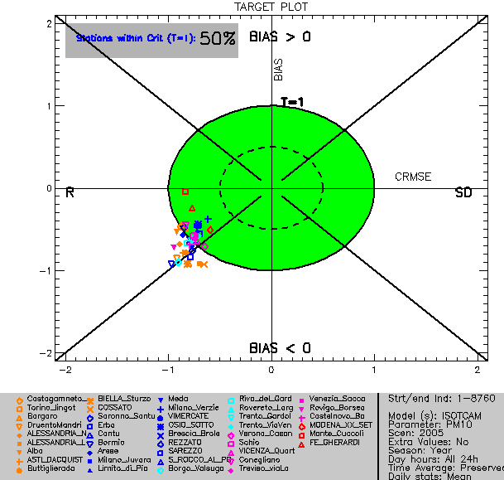
Target diagram: PM10 daily mean
Systematic error: Bias <0 (underestimation)
Random error: problem with correlation!
69% of sites respect the MPC_{RMSE}

Slide 13
Issue: What data to be used? (1/3)
Selecting a subset of station?
Limited number of stations
Different regimes
Selecting a subset of data for each stations?
Considering only the X% of the best data (X-th percentiles)

Slide 14
Issue: What data to be used? (2/3)
90% Stations
90% Data

Slide 15
Issue: What data to be used? (3/3)
Default Setup
85% Data
90% Data
80% Data

Slide 16
Issue: How good is “good”?
90% of station
inside the
“acceptance region”
Good
Very Good
Excellent
Notes:
Controllare inglese nel titolo!

Slide 17
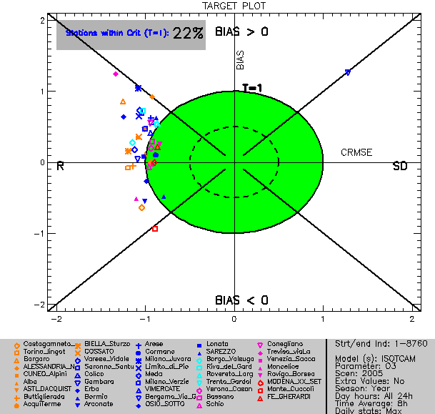
Target Plot: O3 8hmax
Worse than PM10?
Similar to other POMI model
O3
NO2, PM10
k=1.44
k=2

Slide 18
Issue: coverage factor k value?
k=1.44
k=1.75
k=2.00
Similar to PM10

Slide 19
MQO extension to meteorology: WS
WS
Uncertainty constant (0.5 m/s) below 5m/s (WMO)
Uncertainty proportional to WS (10%) above 5m/s (WMO)
Rounding (to integer) effects accounted for
EC4MACS 2009 (450 st)
R | 0.78
Bias | 36% | 1.3 m/s
NMSD | 63%
Parameter | Value
Alpha | 0.88
U_{RV} | 0.14
RV | 5

Slide 20
MQO extension to meteorology: TEMP
TEMP
Instrument uncertainty on test-bank → 0.1K
Instrument uncertainty in the field → 0.5-0.6K
Uncertainty including meteo-housing structure → 1K
Parameter | Value
Alpha | 1.0
U_{RV} | 0.04
RV | 25
EC4MACS 2009 (460 st)
R | 0.96
Bias | 2K
NMSD | 26%

Slide 21
Conclusions & Discussions
About Delta tool
Very valuable tool for the model (of different type…) validation/comparison
Continuosly improving/generalizing (Thanks!!!)
About MPC
Issue1: Considering all the data?
Issue2: What value of U?
About TCAM
Quite interesting and good performances
PM10: Very good
O3: comparable to other model
Are the performances good enough?
?

Slide 22
Thank you

