Slide 1
UK feedback on Delta V3.0
Presented by: John Stedman, Daniel Brookes, Keith Vincent, Emily Connolly
10 April 2013

Slide 2
Outline
Practical aspects
Other aspects covered in accompanying presentation
Use of models for UK compliance assessments
Feedback provided last year
Using Delta V3.0
Conclusions and recommendations
Views of the UK Competent Authorities

Slide 3
Models for UK compliance assessments
Pollution Climate Mapping (PCM) models as supplementary assessment methods for annual compliance assessment (Decision 2004/461/EC)
SO₂, NO_{x}, NO₂, PM₁₀, Pb, C₆H₆, O₃, PM_{2.5}, As, Cd, Ni and B[a]P
Annual mean
Pollutant specific metrics
High percentiles for SO₂ and AOT40 and days above threshold for O₃

Slide 4
Models for UK compliance assessments
Pragmatic dispersion model
Large point sources – modelled using the air dispersion model ADMS and emissions estimates from the UK National Atmospheric Emissions Inventory (NAEI)
Small point sources – modelled using the small points model and NAEI emissions
Distant sources – characterised by the rural background concentration. From measurements or results from other models
Area sources – modelled using a dispersion kernel and emissions estimates from the NAEI.
Roadside increment model for traffic locations

Slide 5
Models for UK compliance assessments
Assessment is based on a combination of measurement data and model results. The compliance status for each zone is based on the maximum of the measured and modelled concentrations

Slide 6
Models for UK compliance assessments
The models are designed to assess compliance at locations defined within the directives
Urban (and Rural) Background locations: 1 km x 1 km grid squares representative of the exposure of the general population
Traffic locations: ~9000 receptors 4 m from the kerb of major roads in urban areas (to be representative of more than 100m segment and more than 25m from junctions.
The same models are used for
Extent of exceedance
Source apportionment
Projections for the development of air quality plans
Consistent with the assessment for the reference year

Slide 7
Feedback from 2012
Easier input of annual mean data 
75% data capture threshold 

Slide 8
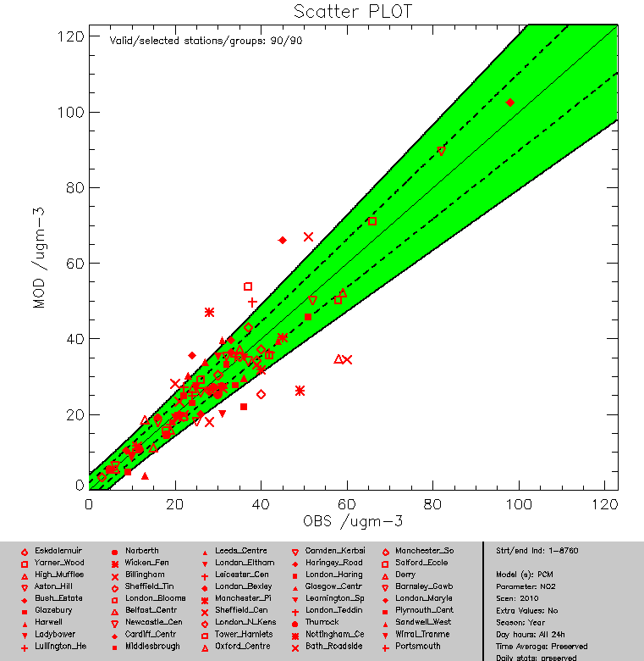
Delta V3.0: PCM model results for NO₂ in 2010
Problems with file headers now resolved
Manual had
an additional “;”

Slide 9
Delta V3.0: PCM model results for NO₂ in 2010
In previous version had to enter 8760 identical values
If you do this in V3.0 DQO for hourly are used in the plot

Slide 10
Delta V3.0: PCM model results for NO₂ in 2010
Parameter values in V3.0 (left) are not consistent with the paper circulated on 5 March 2013 (right)

Slide 11
Delta V3.0: NO₂ in 2010 and 2011
Model performance varies from year to year
Using parameters from 5 March 2013 paper

Slide 12
Delta V3.0: NO₂ 2011
With (left) and without σ² term (right)
Using parameters from 5 March 2013 paper

Slide 13
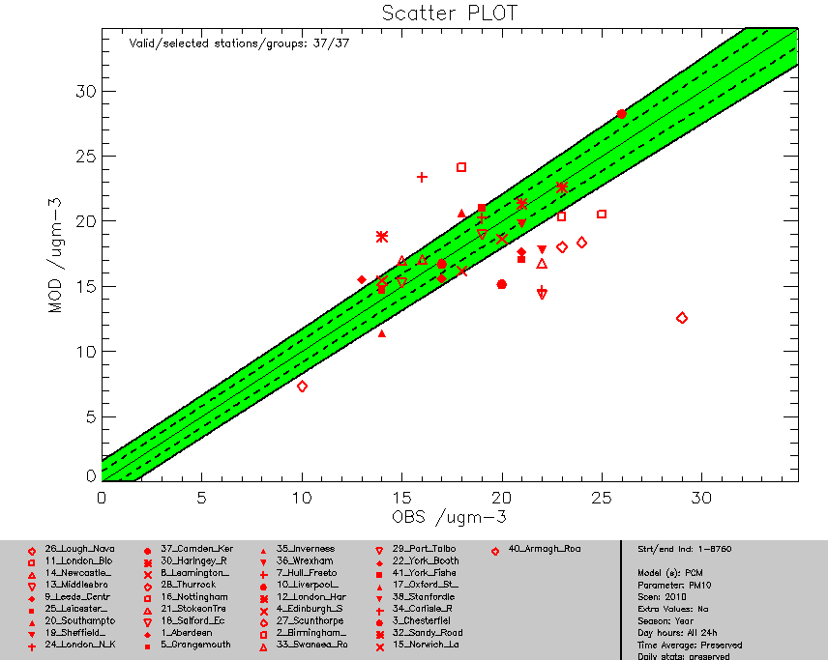
Delta V3.0: PCM PM₁₀ in 2010
Reproduced in spreadsheet calculations

Slide 14
Delta V3.0: PCM PM₁₀ in 2010
Using parameter values from 5 March paper (left)
Using parameters for TEOM (FDMS) (right)

Slide 15
Conclusions and recommendations
Input of annual data much easier
Parameters in Delta V3.0 do are not consistent with the circulated paper
Assessment of model performance is highly sensitive to the selection of parameters
Recommendations
Include parameter values in Delta plots for version control
Allow users to choose no-default values to explore sensitivities
Will need to address all the AQD and DD4 pollutants

