Slide 1
CT6: Near real time assessment with low-cost sensors
Benchmarking
Vera Rodrigues & Carla Gama
08/10/2021

Slide 2
Data for PM2.5 benchmark
Reference station measurements
Fixed sensor data from 18/01/2021
RIO simulations of PM2.5 concentrations over the Netherlands on a
1 km x 1 km grid, together with the estimated uncertainty

Slide 3
UAVR on-going work
Sensors calibration applying the methodology proposed by RIVM
Calculation of a factor of correction based on reference stations and group of sensors located within 7.5 km around the station
Calibration performed every hour (no consideration of the dataset as a whole)
Outliers detection: eliminate the highest and the smallest values (percentile 95?)
F= CRef / mean(Ci)
Ci – the concentration value for the ith closest sensor
Where no sensor near a station: interpolation of the correction factor based on Inverse Distance Weighting

Slide 4
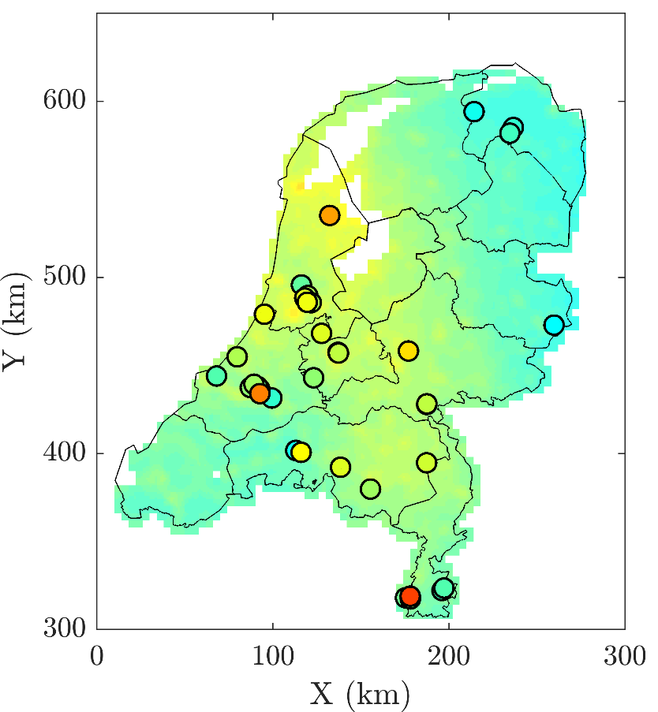
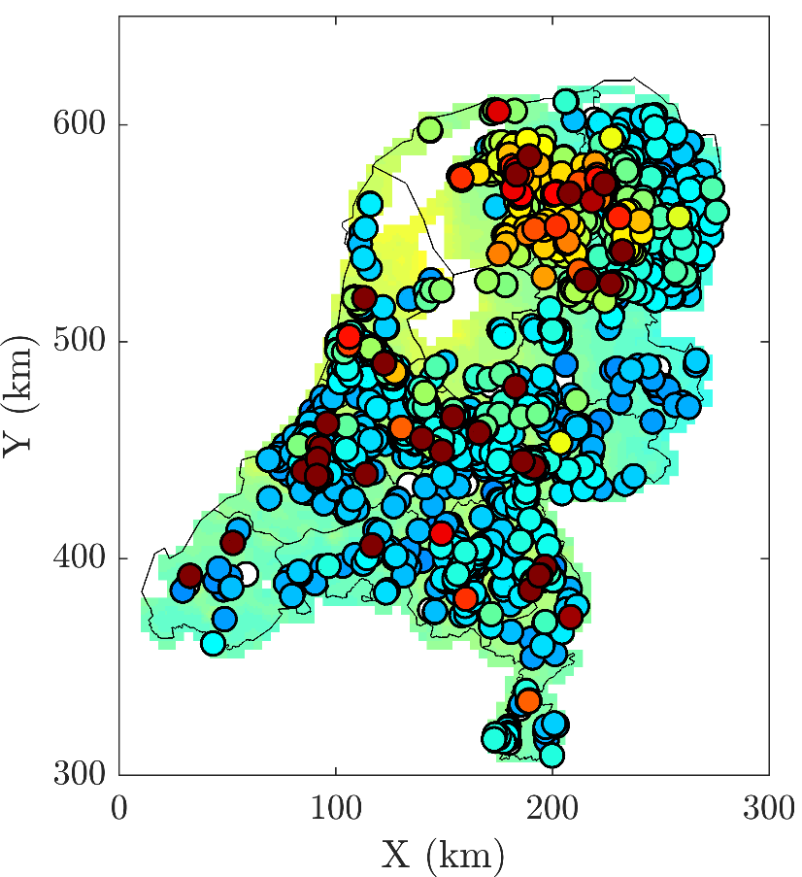
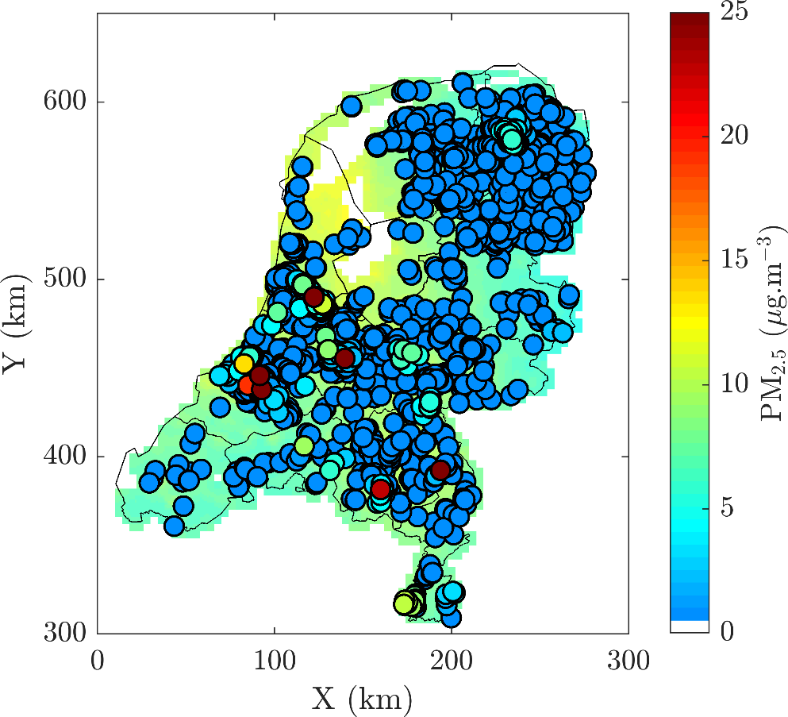
UAVR on-going work
29/04/2021 at 4 pm
RIO + reference data
RIO + sensor raw data
RIO + sensor calibrated data

Slide 5
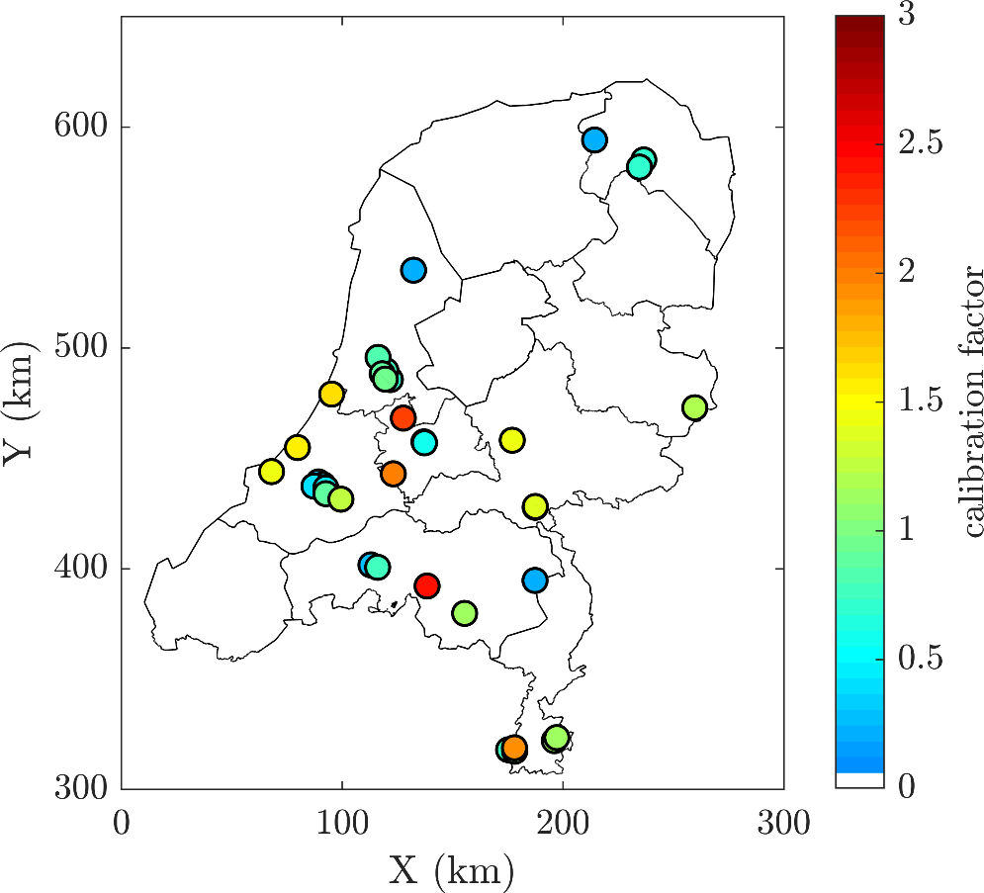
UAVR on-going work
29/04/2021 at 4 pm
Calibration factor calculated at each reference station applied to all sensors in the vicinity of the station
RIVM calibration
Calibration factor

Slide 6
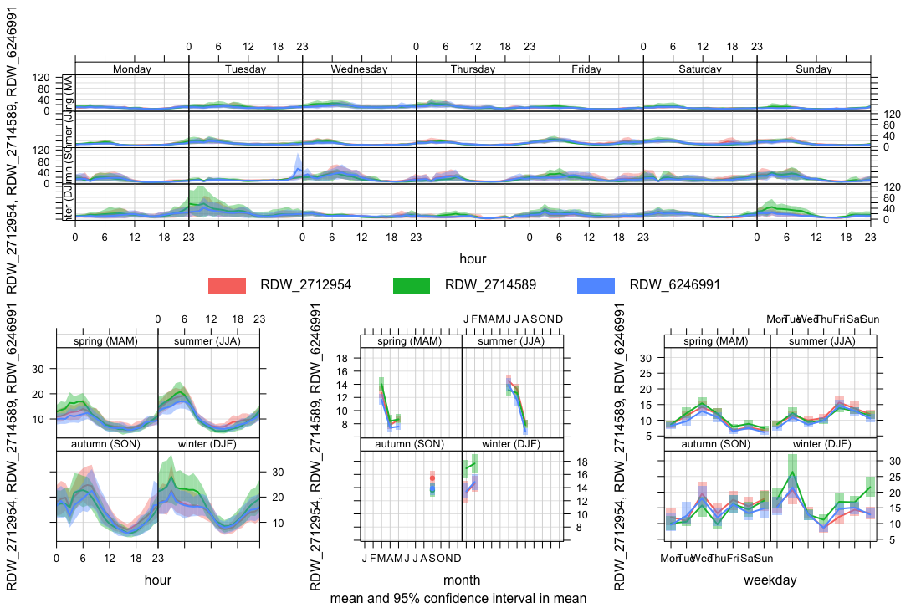
Outliers detection
Percentil 99.9
Raw data
Notes:
Data review:
A data review is a technical evaluation of the data collected by a monitoring device. It is a good idea to evaluate the quality of your data during the collection phase to identify and correct potential problems that may arise. In order to do this, analyze data to look for seasonal, day/night, or weekday/weekend patterns. An absence of expected patterns may indicate a problem with your sensor or with your measurement approach. (Text from https://www.epa.gov/air-sensor-toolbox/how-useair-sensors-air-sensor-guidebook)
Suggestion for the analysis of temporal patterns: R / openair
We did timeseries + temporal profiles

Slide 7
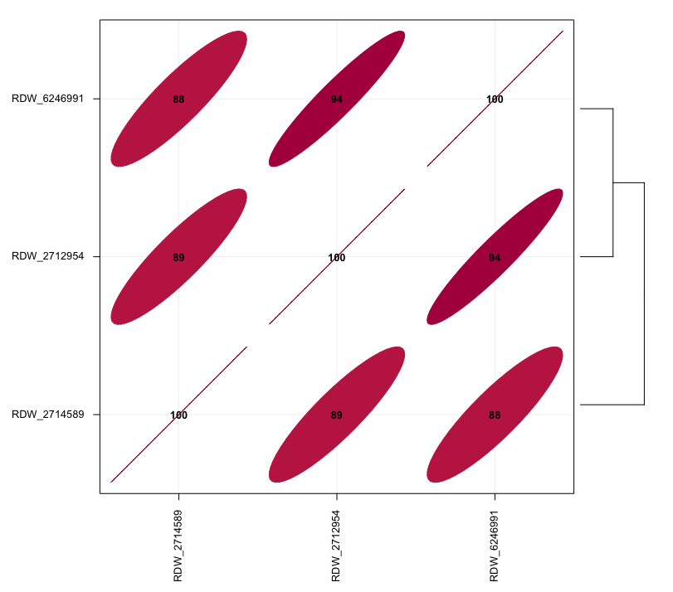
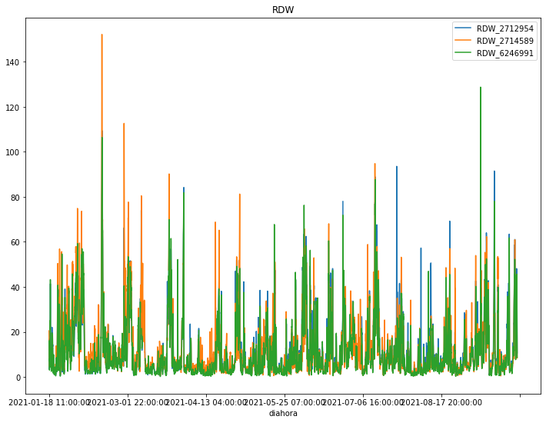
Outliers detection

Slide 8
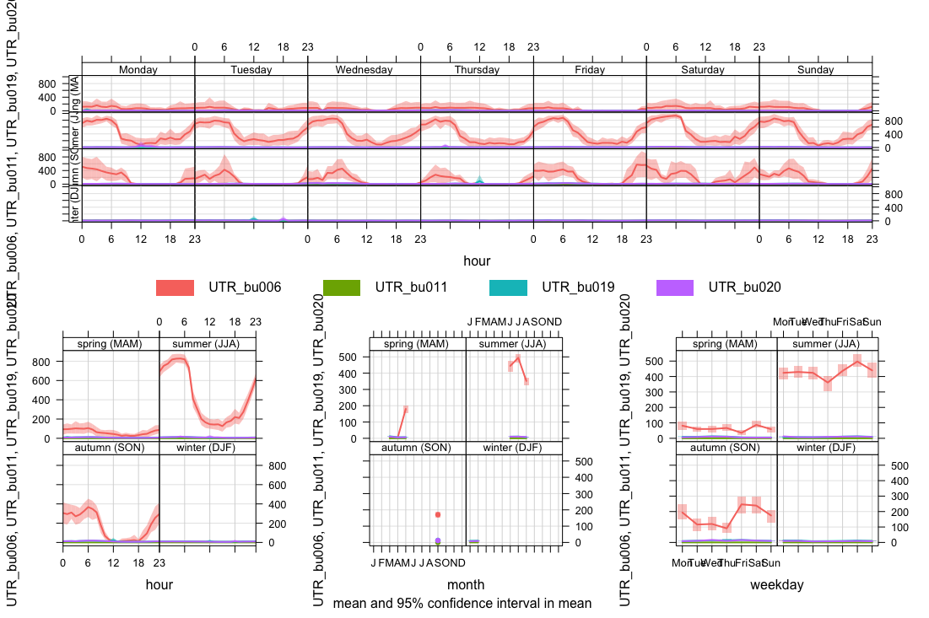
Outliers detection
Percentil 99.9
Raw data

Slide 9
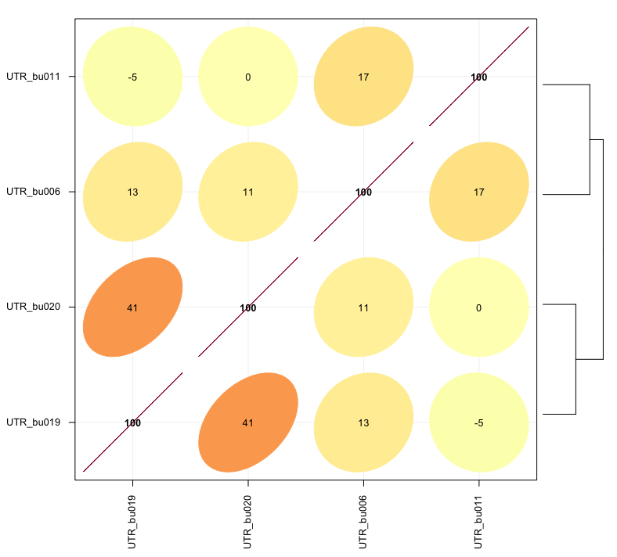
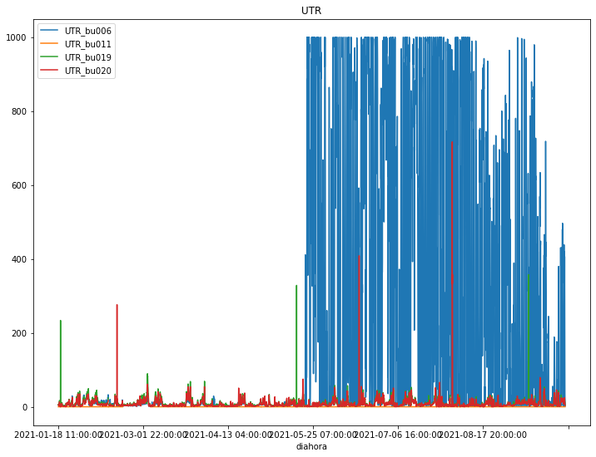
Outliers detection

Slide 10
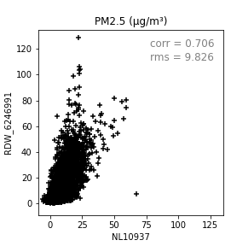
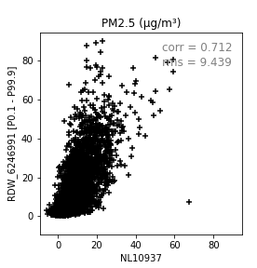
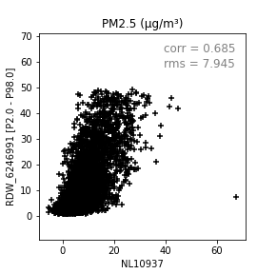
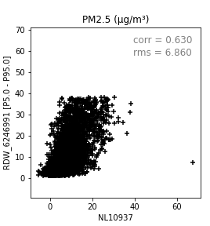
correction factor per sensor and not per hour ? It implies that a testing period has to be set up, and data has to be analysed in comparison with reference stations, prior to its use.
Notes:
Data validation is the process of evaluating collected data against established acceptance criteria to determine data quality and usability. As you are collecting data, it is important to visually screen for odd patterns, decreases in overall response, and other unusual features. If you wait until your study is complete, it will be too late to fix these issues, which tend to produce data that look too regular or change too abruptly to be caused by natural atmospheric phenomena. Some specific problems which may occur during data collection include: ◦ Interferences - factors that hinder, obstruct, or impede the ability of a sensor to make accurate measurements. Interferences may have a positive or negative effect on sensor response, and can include anything from pollutants or other chemical compounds that are not of interest to weather conditions and dirt/dust/insects. It is possible for a sensor to respond to several different interferences simultaneously. Manufacturers usually disclose pollutants and weather conditions that may impact sensor performance, but may not describe how severely the sensor will be affected. Before using a sensor to monitor air quality, consider possible sensor interferences, test for them, and minimize them if possible. ◦ Drift – refers to a gradual change in a sensor’s response characteristics over time. Instrument drift may lead you to wrongly conclude that concentrations have increased or decreased over time. Drift can be positive or negative, and it may occur due to a variety of reasons. One way to reduce drift is to calibrate the sensor frequently so that the instrument only drifts a small amount between each recalibration. The frequency of calibration needed will depend on how much drift occurs. (Text from https://www.epa.gov/air-sensor-toolbox/how-use-air-sensors-air-sensor-guidebook)

Slide 11
UAVR future work
Sensor data calibration
Assess the temporal profile of the calibration factor of each sensor
How to relate fixed sensors with reference station measurements considering the classification of the sensor (type of influence)
Can we have access to traffic counting data to support the classification of the surroundings?
Should we use land-use data to support the classification of the surroundings?
AI/ ANN as tools to support future methodologies (do we have enough data?)
Should we focus on the influence of the type of equipment of the sensor?
Should we focus on the influence of the meteorological conditions?
Data fusion

