Slide 1
FAIRMODE - CT6
October 08, 2021
Rósín Byrne, University College Cork

Slide 2
Introduction
New PhD student in the Centre for Research into Atmospheric Chemistry (CRAC).
CRAC is a research group in University College Cork with a wide range of studies including laboratory studies, field, and modelling studies.
PhD focus – low-cost air quality sensors and particularly networks and using the data they provide.
Case study – Cork City Low Cost Sensor Network

Slide 3
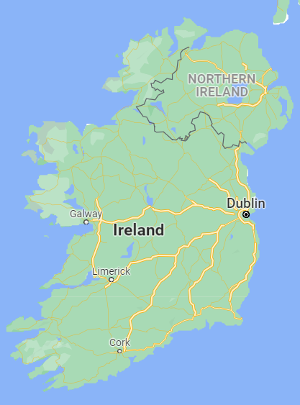
Cork City Network
Small city in the south of Ireland with a population of ⁓210,000.
A low-cost sensor network of PurpleAir units was established by local authorities to give a better understanding of the local air quality and to provide this information to the local population. (corkairquality.ie/ )
The first planned network of its type in Ireland.

Slide 4
Cork City Network

Slide 5
Establishing the network
How to calibrate the network?
Can one location be used to calibrate many locations?
Is there variability among sensor readings?
How can we tell when a sensor is failing or giving bad readings?

Slide 6
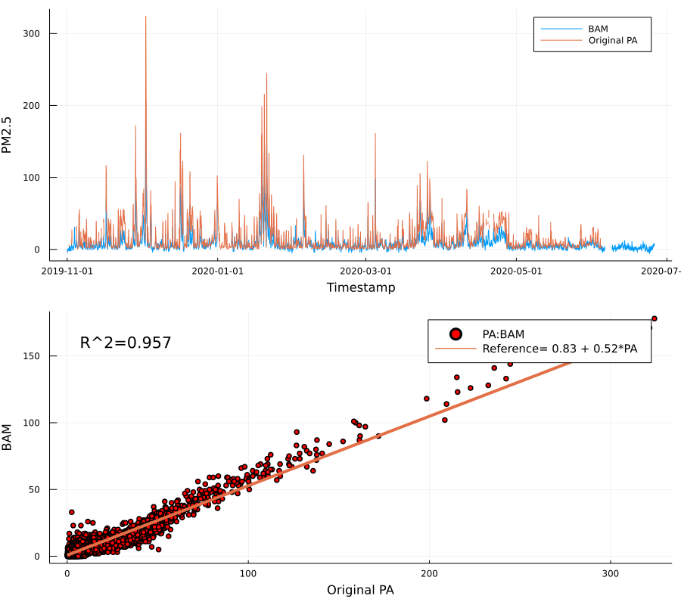
Sensor Performance
Raw Data
A sensor unit co-located with a PM_{2.5} reference instrument.
High correlation over a 7 month period.
However, the data was offset by as much as a factor of 1.7.
FAIRMODE | CT6 | October 08, 2021

Slide 7
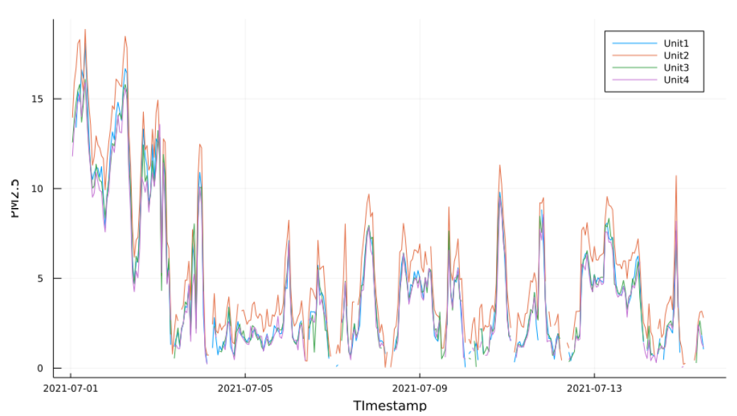
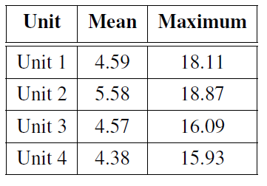
Inter-sensor comparison
Co-located sensors have shown to have high agreement with one another when co-located for a period.
Over a winter period, there was some more variability in their raw measurements.
However, with some more quality control procedures to remove outliers, their variability was significantly improved.
PM2.5
Timestamp
FAIRMODE | CT6 | October 08, 2021

Slide 8
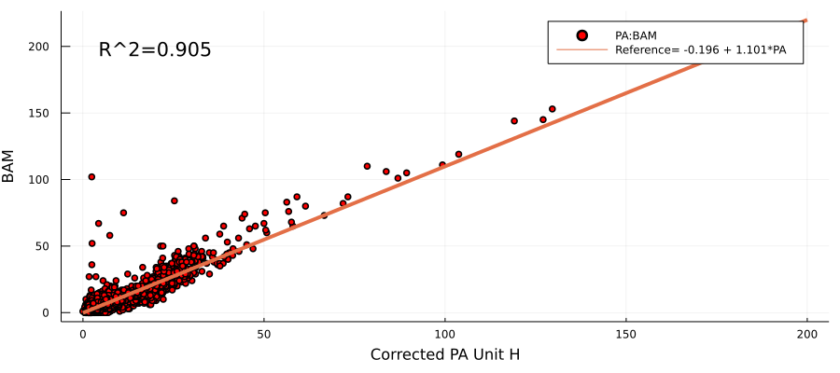
Network Calibration
Multiple Linear Regression Correction Model
Trained on 70% of the co-location data.
Tested on 30% of the co-located data, and also on data from another co-located device.
The model performed well on both data sets.
The model takes into account the effects relative humidity and temperature, and the relationship between the sensor device and the reference instrument.

Slide 9
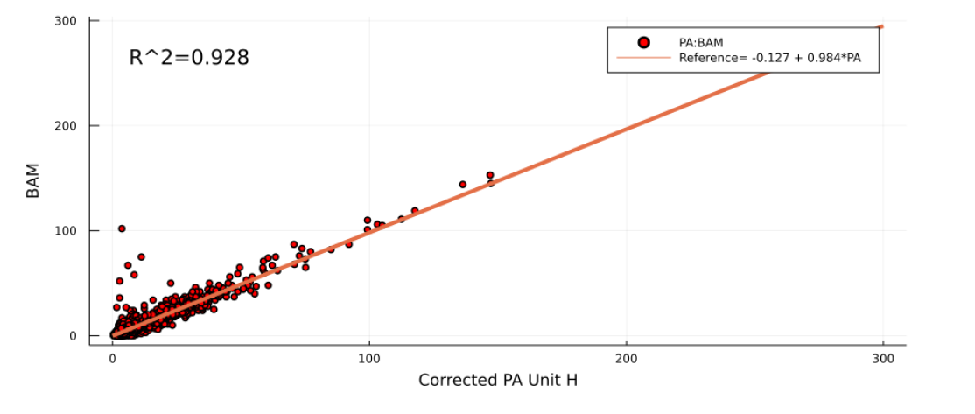
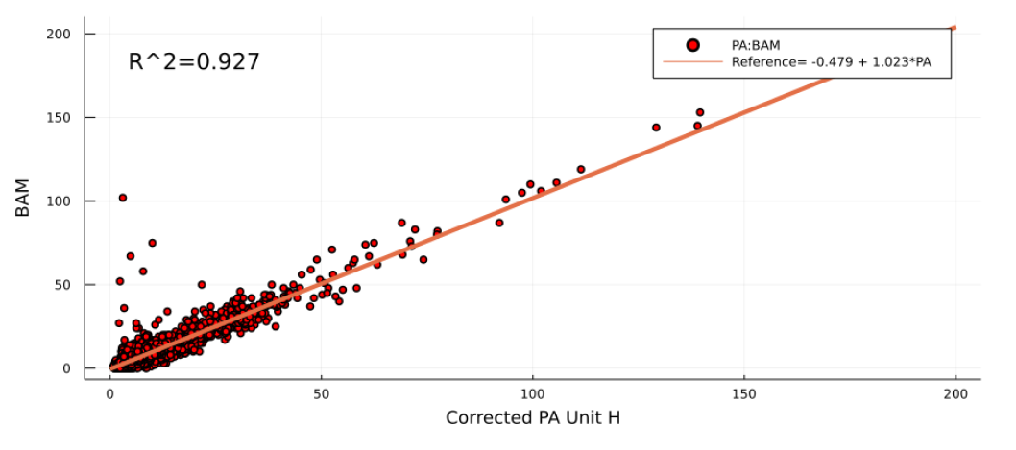
Model Variations
Meteorological and temporal model
Temporal model

Slide 10
Local Air Quality Goals
We hope the network will help the local authorities achieve their air quality objectives, as per their air quality strategy.
A Clean Air Zone will be established within the city centre with fully pedestrianised streets and further low-cost sensors will be used to analyse the air quality differences.

Slide 11
Thank You !

