Slide 1
A model inter-comparison exercise in Belgium – determination of best large scale concentration maps
Bino Maiheu^{(*)}
Nele Veldeman, Koen De Ridder, Dirk Lauwaet, Peter Viaene, Felix Deutsch, Nele Smeets, Stijn Janssen
6th FAIRMODE Plenary and Workshop – Antwerp, Belgium
^{(*)} email: bino.maiheu@vito.be

Slide 2
Outline
Mission statement
  Producing yearly large scale concentration maps for Belgium/Flanders
Brief overview of modelling techniques
  RIO geospatial interpolation model
  AURORA deterministic model
  AURORA + data assimilation
  (VL)-OPS
Qualitative comparison
Temporal validation
Spatial validation
Application of the JRC Delta-tool, comparison v1 and latest version

Slide 3
Mission statement : why ?
What are the best large scale concentration maps for Flanders/Belgium ?
  Env. impact assessments -> background concentrations
  Communication : the air quality map for Flanders/Belgium ?
Harmonisation & optimization of resources
  different environmental administrations
  Boundary conditions : different application domains
    Operational mapping
    Scenario (e.g. long term prognoses) analysis
    Exposure assessment

Slide 4
Mission statement : how ?
Elaborate validation excercise : qualitative, quantitative
PM₁₀ (58 stations), PM_{2.5} (34 stations), NO₂ (67 statoins)and O₃ (39 stattions)
  all except traffic
Different aspects
  Temporal (where possible)/ spatial
  Sensitivity studies e.g. spatial correlation
  Norm exceedances (e.g. PM₁₀ > 50 µg/m³)
  Impact of calibration/correction methods in deterministic modelling
    Data assimilatoin
    Bias correction
Spatial resolution 4x4 km², reference year 2009

Slide 5
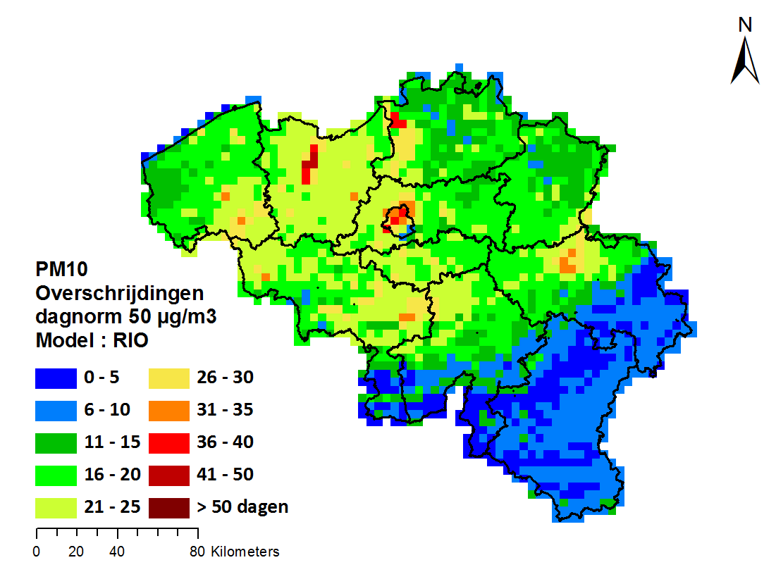
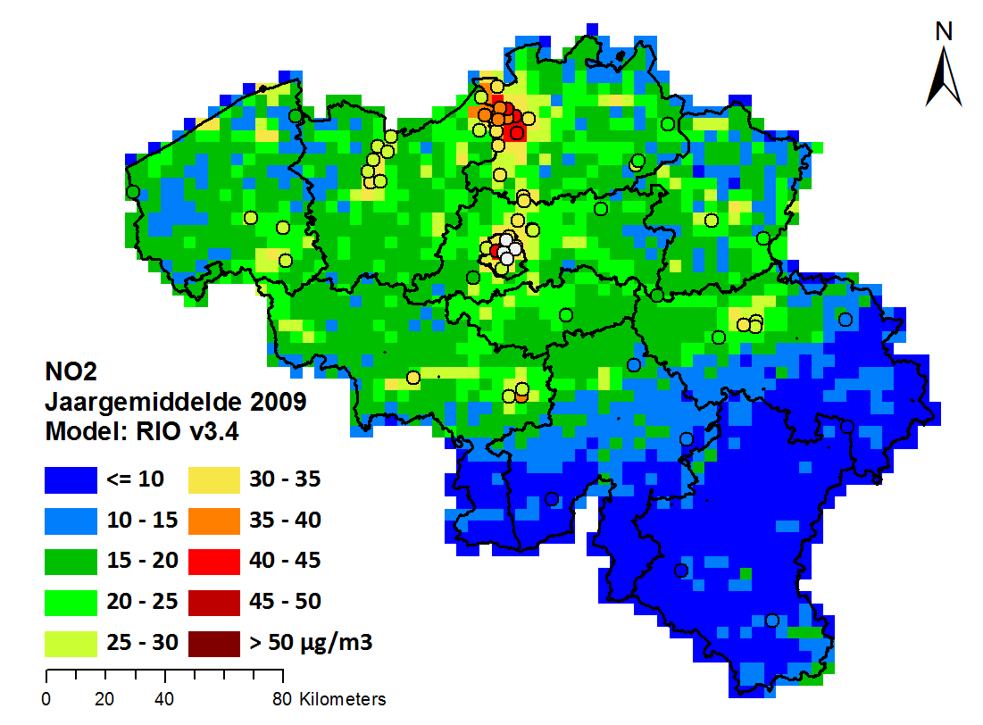
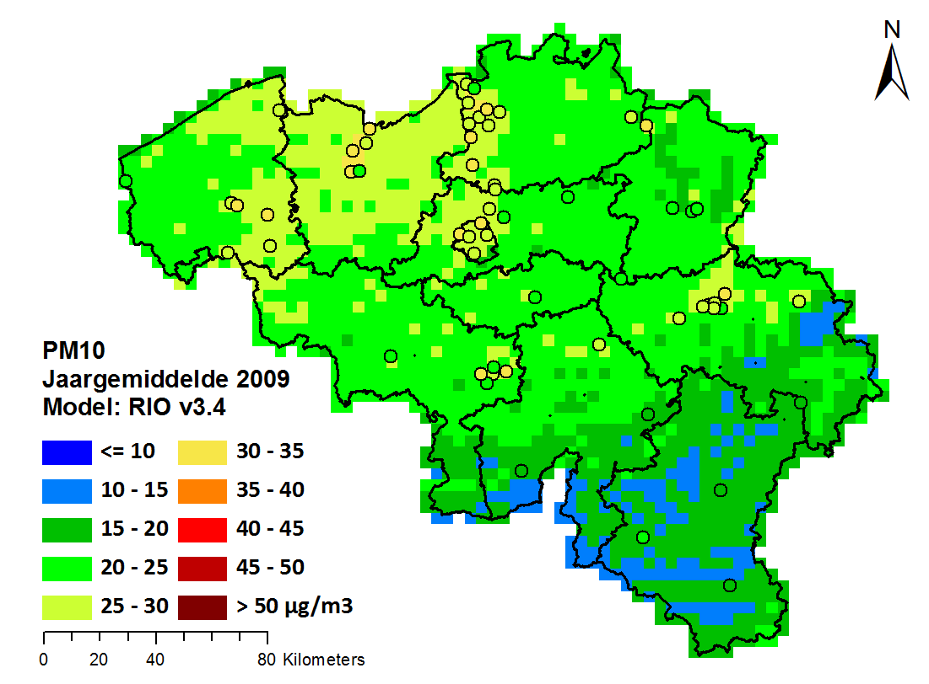
Modelling techniques : RIO
Geospatial Interpolation : RIO v3.4
  Land use regression + Ordinary Kriging of the residuals
  Janssen, S. et al. Spatial interpolation of air pollution measurements using CORINE land cover data, Atmospheric Environment, 42(20), 4884–4903
  …

Slide 6
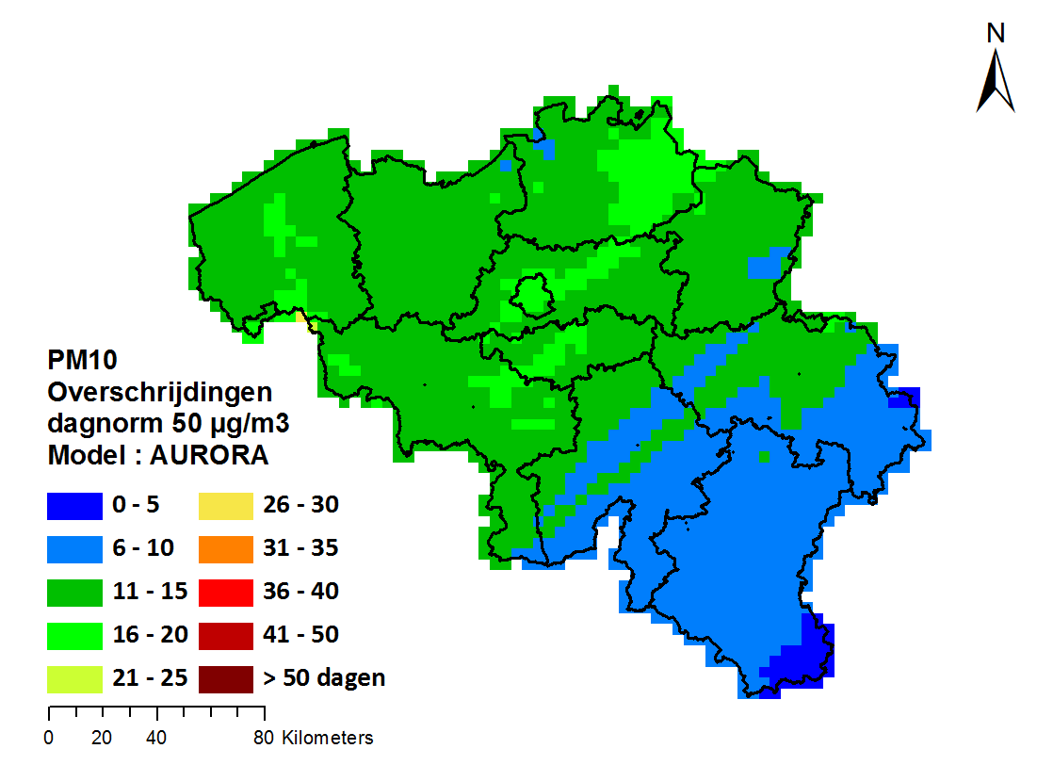
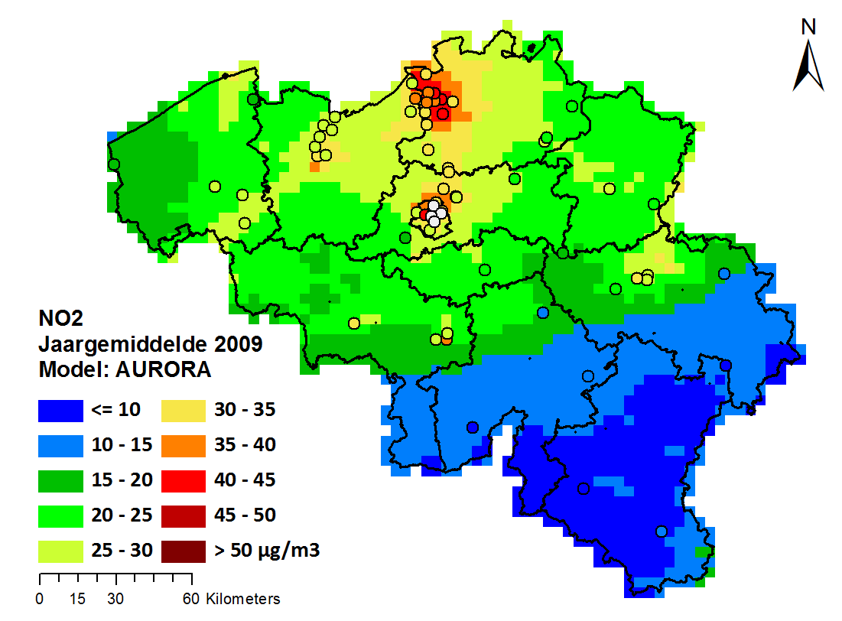
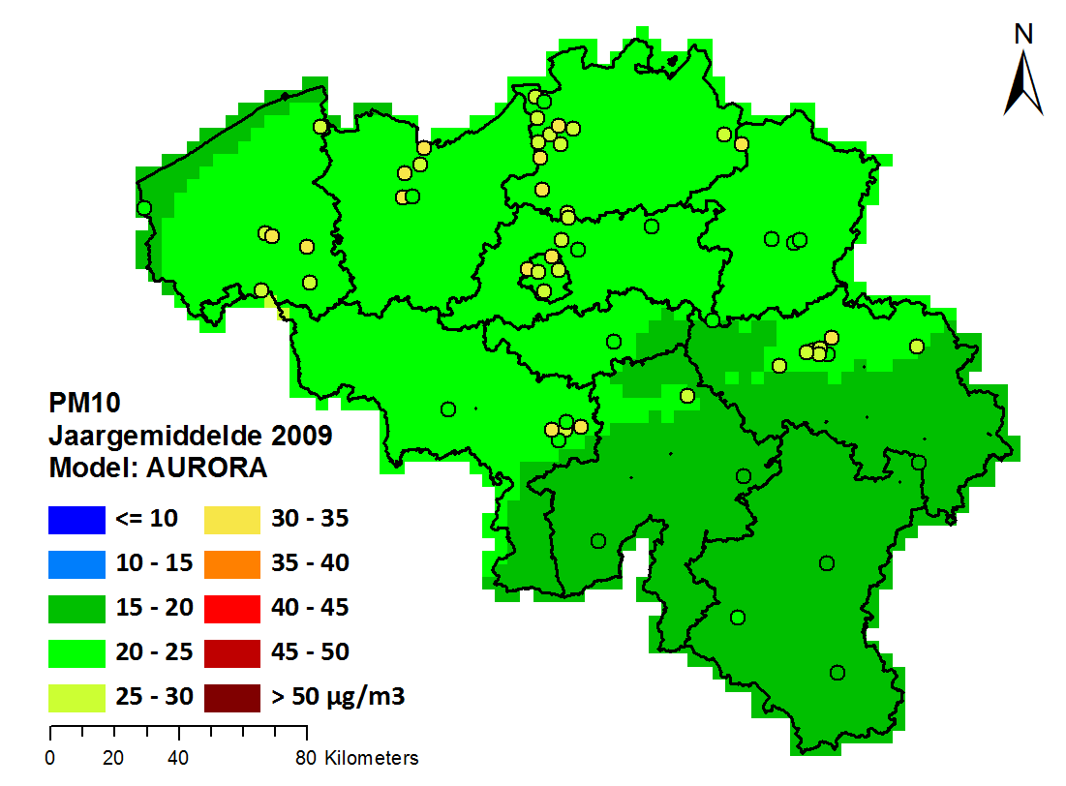
Modelling techniques : AURORA
Detailed vertical structure : higher resolution
For urban air quality (~1 km)
Deterministic modelling
emissions
3-D hourly gridded concentration
meteorology
AURORA
boundary cond.
diff.
adv.
chem.
dep.
Van de Vel, K., et al., 2009. Environmental Monitoring and Assessment 165, p665.

Slide 7
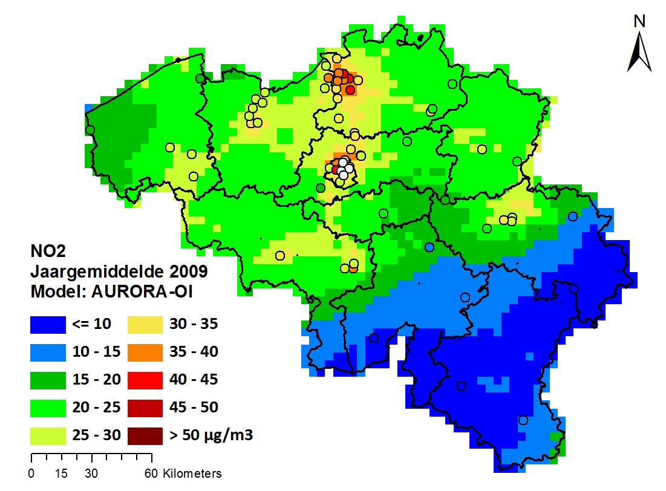
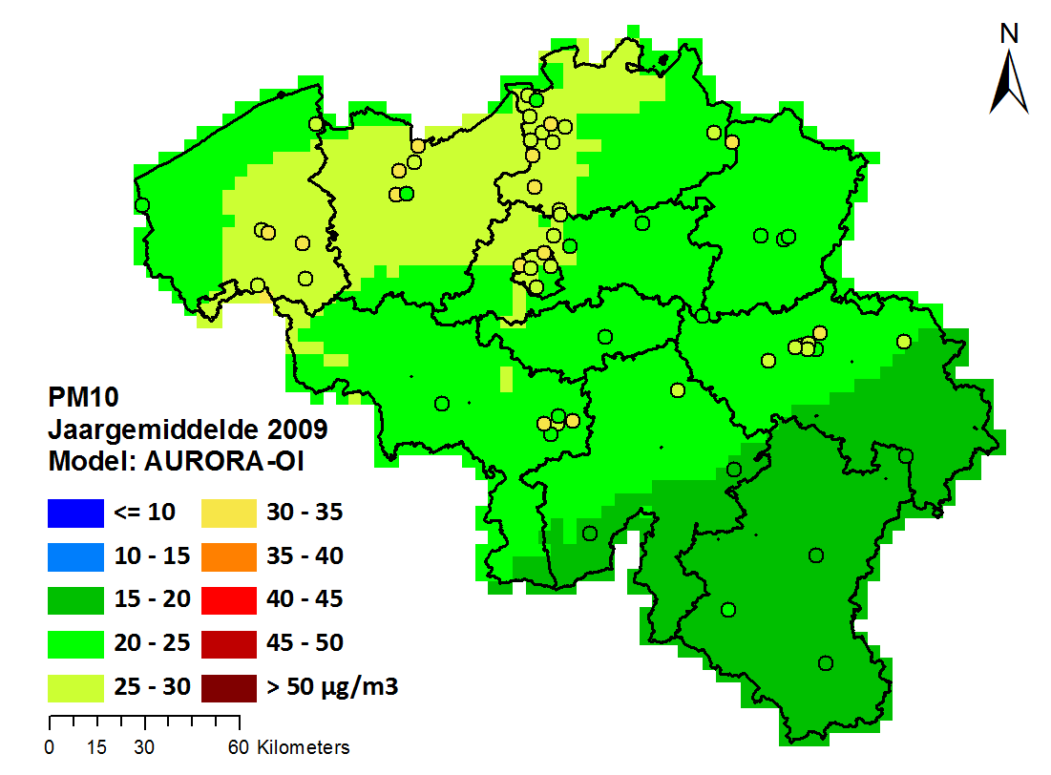
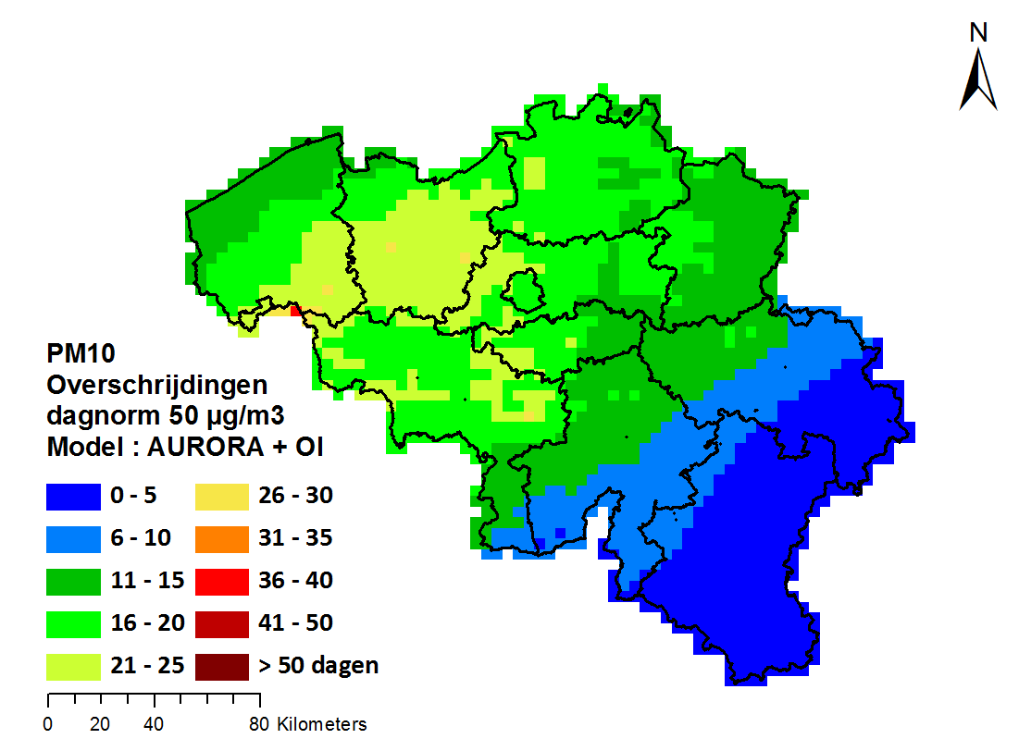
AURORA+ Hourly OI
interpoleert modelwaarden
naar positie meetstations
gecorrigeerde
concentratie
(‘analyse’)
verschil tussen geobserveerde
en gemodelleerde waarde
niet-gecorrigeerde
gemodelleerde
concentratie
gain matrix: spreidt de model-vs-obs
verschillen naar alle roostercellen v/h model
model error
covariance matrix
observational error
(co-)variance matrix

Slide 8
Qualitative comparison
 |  | rio | rio 09 | aur | aur bias | aur ortho | aur oi | aur kf | ops | ops bias | ops ortho
inzetbaarheid | assessment | + | + | + | + | + | + | + | + | + | +
 | scenario | ± | ± | + | ± | ± | ± | ± | + | ± | ±
 | domein | BE | BE | BE | BE | BE | BE | BE | VL | VL | VL
resolutie | temporeel | uurlijks | uurlijks | uurlijks | uurlijks | uurlijks | uurlijks | uurlijks | jaarlijks | jaarlijks | jaarlijks
 | ruimtelijk - gridcel | 3-4km | 3-4km | 1-10km | 1-10km | 1-10km | 1-10km | 1-10km | 1km | 1km | 1km
 | ruimtelijk - receptor | + | + | - | - | - | + | + | + | + | +
input data | metingen | + | + | - | + | + | + | + | - | + | +
 | emissies | - | - | + | + | + | + | + | + | + | +
 | meteo | - | - | + | + | + | + | + | + | + | +
 | randvwn | - | - | + | + | + | + | + | - | - | -
output data | polluenten | PM10; PM2.5; NO2; O3 | PM10; PM2.5; NO2; O3 | PM10; PM2.5; NO2; O3 | PM10; PM2.5; NO2; O3 | PM10; PM2.5; NO2; O3 | PM10; PM2.5; NO2; O3 | PM10; PM2.5; NO2; O3 | PM10; PM2.5; NO2 | PM10; PM2.5; NO2 | PM10; PM2.5; NO2
 | tijdreeksen | + | + | + | + | + | + | + | - | - | -
 | depositie | - | - | + | ± | ± | ± | ± | + | ± | ±
performantie | Rekentijd | +++ | +++ | + | + | + | + | + | + + | + + | + +

Slide 9
Validation indicators
Spatial & temporal validation
  RMSE, R², BIAS, target plots (cmp v1) : timeseries/distribution
  But also : QQ plots (temporal)
  PM₁₀ exceedances of 50 µg/m³ : FFA, FCF, RPE
Use JRC DELTA as well !

Slide 10
Results temporal validation NO₂

Slide 11
Results temporal validation PM₁₀

Slide 12
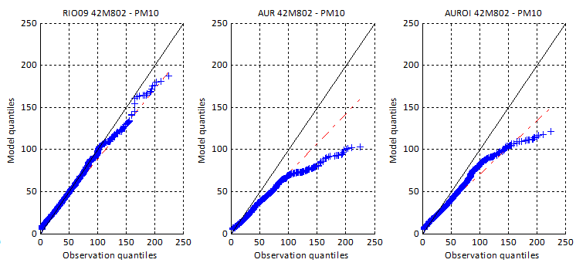
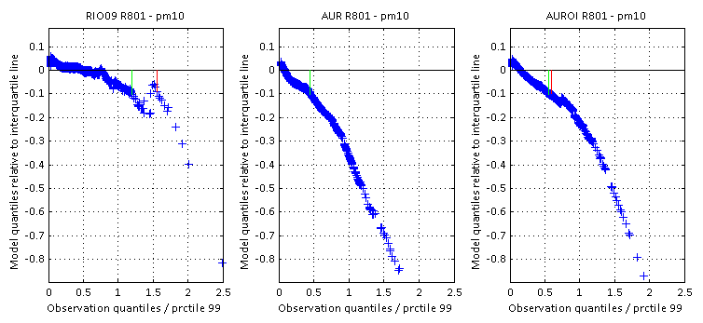
PM₁₀ exceedance indicators
FCF
FFA
?
RPE

Slide 13
What model has best temporal characteristics ?
Conclusion : RIO best, data assimilation method needed to calibrate aurora, simple land use regression scheme > OI + deterministic model !
Ideally : MCA -method assigning importance weights to each statistical indicator for different applications :
  Assessement : target indicators, bias, RMSE
  Exceedance mapping : FFA, FCF, RPE
Here : simple score assignment
  10 points : winner
  5 points : median over models
  Rescale & add
MODEL | ZONE | rio | rio09 | aur | auroi | aurkf | aurbias
PM10_MEDIAN_STATION_BIAS | 0 | 9.28 | 8.94 | 0.00 | 0.00 | 1.06 | 10.00
PM10_MEDIAN_STATION_RMSE | 0 | 9.79 | 10.00 | 0.00 | 5.98 | 4.02 | 3.38
PM10_MEDIAN_STATION_TCOR | 0 | 9.84 | 10.00 | 0.00 | 6.11 | 3.89 | 0.87
PM10_MEDIAN_STATION_TARGET | 0 | 10.00 | 9.92 | 0.00 | 5.32 | 3.43 | 4.68
PM10_MEDIAN_STATION_QQID | 0 | 9.02 | 10.00 | 0.11 | 1.58 | 2.40 | 7.60
SCORE : |  | 47.93 | 48.86 | 0.11 | 18.99 | 14.79 | 26.54
MODEL | ZONE | rio | rio09 | aur | auroi | aurkf | aurbias
PM10_MEDIAN_STATION_FFA | 0 | 7.10 | 6.46 | 0.00 | 10.00 | 3.54 | 1.78
PM10_MEDIAN_STATION_FCF | 0 | 10.00 | 10.00 | 0.00 | 0.00 | 2.93 | 7.07
PM10_MEDIAN_STATION_QQID | 0 | 9.02 | 10.00 | 0.11 | 1.58 | 2.40 | 7.60
PM10_MEDIAN_STATION_RPE | 0 | 10.00 | 9.22 | 0.00 | 0.00 | 0.78 | 9.73
SCORE : |  | 36.12 | 35.67 | 0.11 | 11.58 | 9.66 | 26.18
MODEL | ZONE | rio | rio09 | aur | auroi | aurkf | aurortho | aurbias
NO2_MEDIAN_STATION_BIAS | 0 | 8.36 | 9.29 | 0.02 | 10.00 | 2.75 | 5.00 | 3.74
NO2_MEDIAN_STATION_RMSE | 0 | 10.00 | 10.00 | 0.00 | 7.25 | 4.08 | 3.47 | 5.00
NO2_MEDIAN_STATION_TCOR | 0 | 10.00 | 9.90 | 0.00 | 6.33 | 5.00 | 1.54 | 3.27
NO2_MEDIAN_STATION_TARGET | 0 | 10.00 | 9.54 | 0.00 | 6.87 | 4.50 | 2.71 | 5.00
NO2_MEDIAN_STATION_QQID | 0 | 7.78 | 5.00 | 4.23 | 10.00 | 0.00 | 4.37 | 5.82
SCORE : |  | 46.13 | 43.73 | 4.25 | 40.44 | 16.33 | 17.09 | 22.83

Slide 14
Results spatial validation NO₂

Slide 15
Results spatial validation PM₁₀

Slide 16
Robustness spatial correlation
Test for robustness of spatial correlation ?
  Progressively leave out stations with worst BIAS

Slide 17
Summary spatial validation
MODEL | ZONE | rio | rio09 | aur | auroi | aurorth | aurbias
PM10_SPATIAL_CORR | 0 | 9.79 | 10.00 | 3.81 | 6.19 | 3.54 | 1.31
PM10_SPATIAL_DSLOPE | 0 | 6.50 | 7.26 | 1.92 | 3.50 | 10.00 | 1.77
PM10_SPATIAL_MEDERR | 0 | 5.40 | 4.60 | 0.00 | 9.14 | 3.92 | 10.00
PM10_SPATIAL_RMSE | 0 | 10.00 | 8.00 | 0.00 | 7.14 | 0.00 | 2.86
SCORE : |  | 31.70 | 29.85 | 5.73 | 25.97 | 17.46 | 15.95
MODEL | ZONE | rio | rio09 | aur | auroi | aurorth | aurbias
NO2_SPATIAL_CORR | 0 | 10.00 | 9.72 | 4.21 | 5.79 | 3.39 | 3.83
NO2_SPATIAL_DSLOPE | 0 | 4.18 | 10.00 | 6.10 | 0.00 | 0.00 | 5.82
NO2_SPATIAL_MEDERR | 0 | 7.35 | 10.00 | 0.00 | 9.89 | 0.00 | 2.65
NO2_SPATIAL_RMSE | 0 | 10.00 | 9.34 | 2.65 | 6.42 | 3.58 | 2.88
SCORE : |  | 31.5 | 39.1 | 13 | 22.1 | 6.97 | 15.2
Comparision RIO/AUR-OI : fair ?
  JRC DELTA v3.2 !

Slide 18
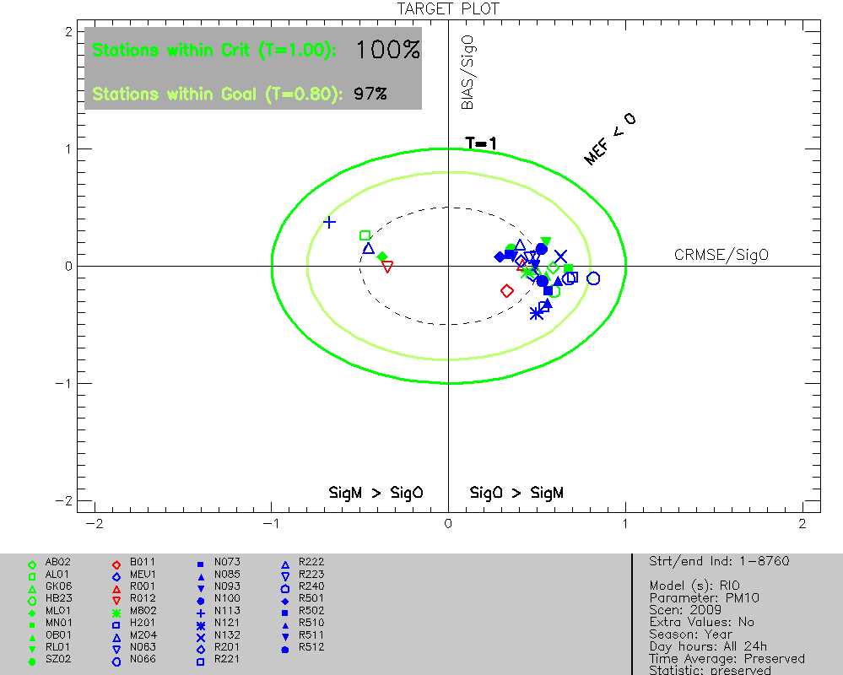
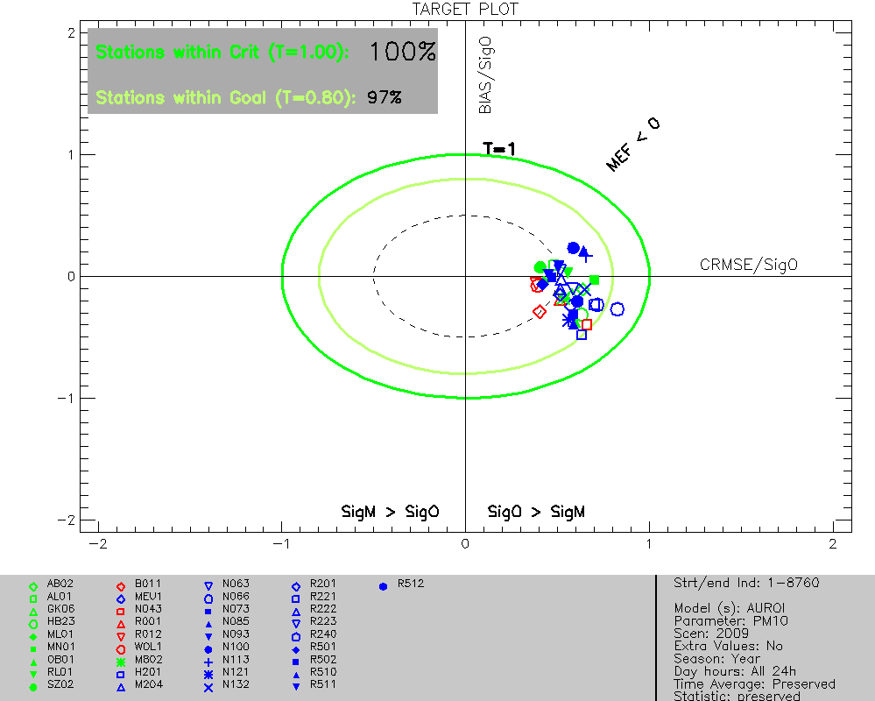
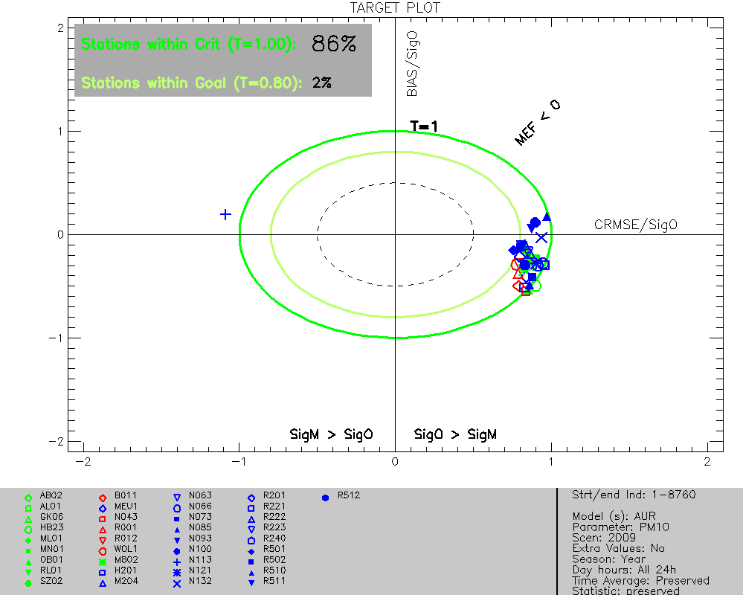
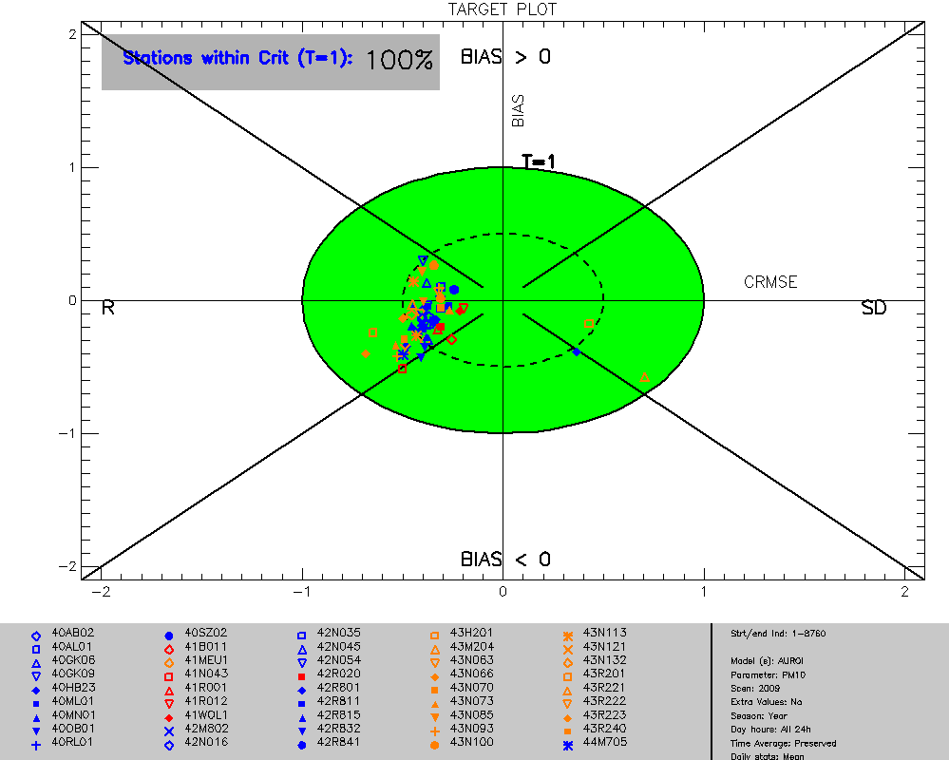


JRC DELTA Results target plots : PM₁₀
JRC Delta v1
JRC Delta v3.2
AURORA
AURORA + OI
RIO

Slide 19
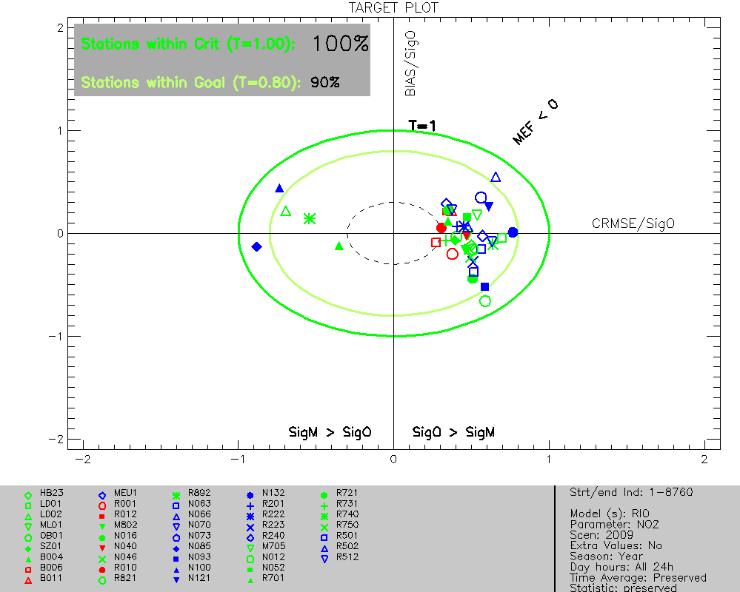
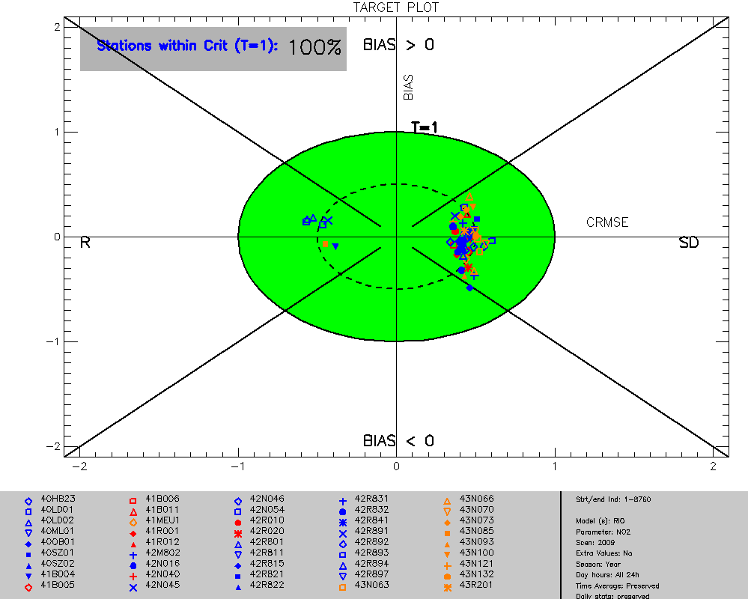
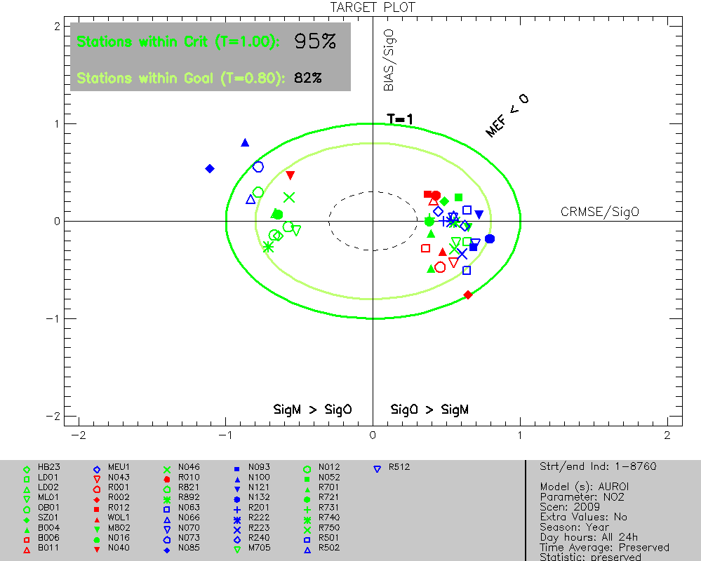
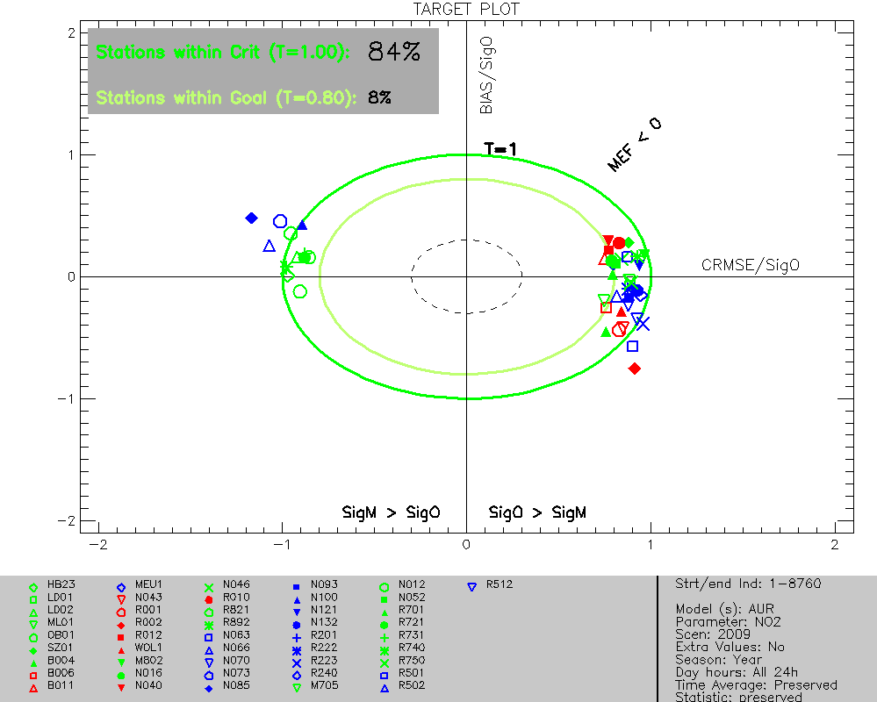
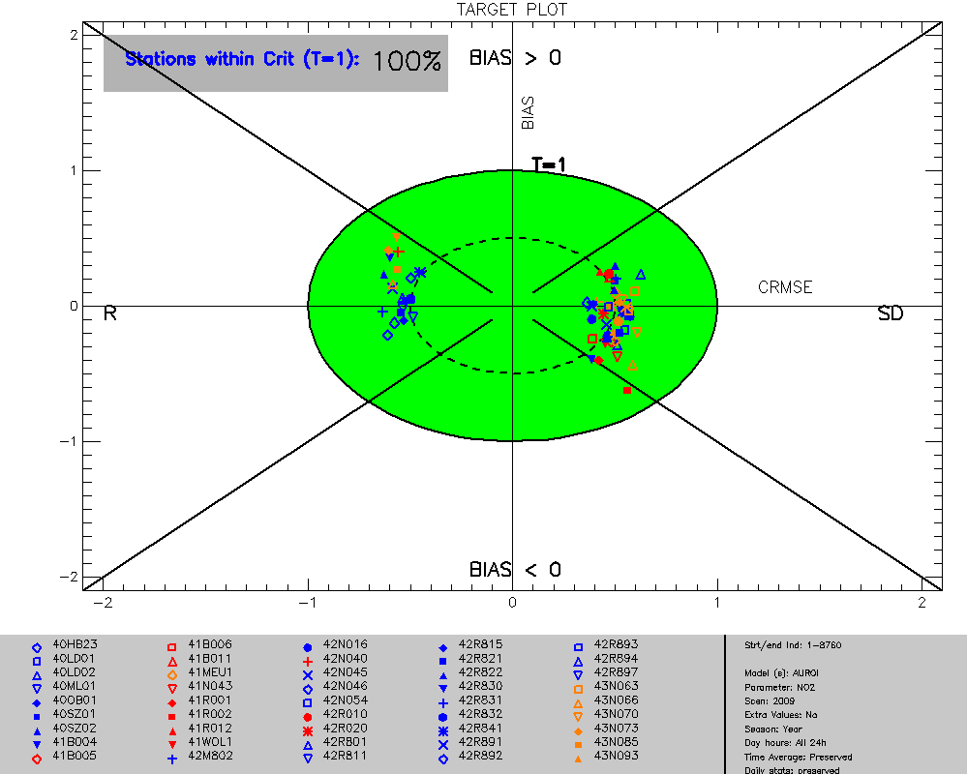

JRC DELTA Results target plots : NO₂
JRC Delta v1
JRC Delta v3.2
AURORA
AURORA + OI
RIO

Slide 20
General conclusions
Simple geospatial interpolation model using land cover information outperforms deterministic modelling approaches for Belgium
  Even with data assimilation techniques !
Correction technique raw output determinisitc model : OI
In harmonised approach still need for deterministic modelling
  Scenario assessement
  Prognoses
  Apply differences between scenario/base run with deterministic model to RIO maps
RIO results in JRC delta tool largely fall within the RMSE_{U} < 0.5 region
  But : more stringent requirements for data-assimilated techniques !
RMSE_{U} for PM₁₀ mostly dominated by R, whereas NO₂ mostly by SD
  Consistent for both modelling approaches
Inclusion of uncertainty in delta tool appears not to change the conclusion : RIO outperforms AURO+OI
Discussion point : treatment of data assimilation/geospatial interpolation models in delta tool

Slide 21
Backup slides

Slide 22
Temporele validatie
Validatie statistieken op tijdsreeksen van stations
  Gepaarde uurlijkse observatie/model waarden
  Usual suspects : RMSE, BIAS, R² ,
  Geavanceerdere : (CRMSE), Target indicator/plot, QQ plot, QQID
  Overschrijdingsindicatoren (PM₁₀ - da): RPE, FFA, FCF
Analyse apart per zone : Vlaanderen, Wallonië, Brussel & België
Geen OPS resultaten : enkel jaargemiddelde

Slide 23
Hoe kwantificeren ? : QQID
Om te kwantificeren tot welke concentraties de QQ plot de x=y lijn blijft volgen : QQID.
Wat experimentele index (©Bino), waarschijnlijk betere manieren om dit te doen…
  Neem residu van de QQ plot t.o.v. de x=y lijn
  Normaliseer de model & observatie quantielen op het 99ste percentiel
  Bepaal waar de model quantielen onder de 10% van het 99ste percentiel duiken (zowel vanaf lage waarden -> groene lijn, als hoge waarden -> rode lijn)
  Minimum van beide is de QQID

Slide 24
Kwantitatieve vergelijking : scores
Scores gebaseerd op de mediaan van een statistische indicator over alle stations in een bepaalde zone (België, Vlaanderen, … )
Berekeningswijze scores :
  10 punten voor best scorende model
  5 punten aan de mediaan van een validatie statistiek over alle modellen, e.g. de mediaan RMSE over alle modellen
  Op basis hiervan worden de indicatoren geschaald tussen 0 en 10
  Resulterende scores lager dan 0 worden op 0 gezet.
Uiteindelijke winnaar is het model met de meeste punten over een aantal statistische indicatoren.
We nemen als basisset : BIAS, RMSE, TARGET, Temporele R² en de QQID.
Voor PM10 vergelijken we ook FFA, FCF, QQID en RPE.
AUR_ortho weggelaten voor PM_{x} wegens op het zicht reeds weinig zinvol

