Slide 1
Air Implementation Pilot Task 3. Assessing modelling activities
FAIRMODE
Forum for air quality modelling in Europe
Núria Castell and Bruce Denby
NILU

Slide 2
Aim
To examine the model practices in the cities taking part in the Air Implementation Pilot to:
assess the strengths and weaknesses of such applications
to identify needs for guidance in the use of air quality models

Slide 3
Modelling Questionnaire
Overview and Contacts
Use of models
Are models used, for what applications? If not, why not?
What model is used, is it documented?
Who runs the model?
Awareness of other modelling activities by or in cooperation with other institutions (Cooperation activities, point 4)

Slide 4
Modelling Questionnaire
Modelling activities
General description of the model: spatial resolution, time resolution, pollutants modelled.
Modelling description
How are the emissions included (traffic, commercial/domestic, industry)?
How are the meteorological fields obtained and validated?
How are background concentrations accounted?
Has monitoring data used in combination with models?
What kind of AQ model has been used? How has it been used and validated?
User experience
Cooperation activities (other modelling activities by or in cooperation with other institutions)

Slide 5
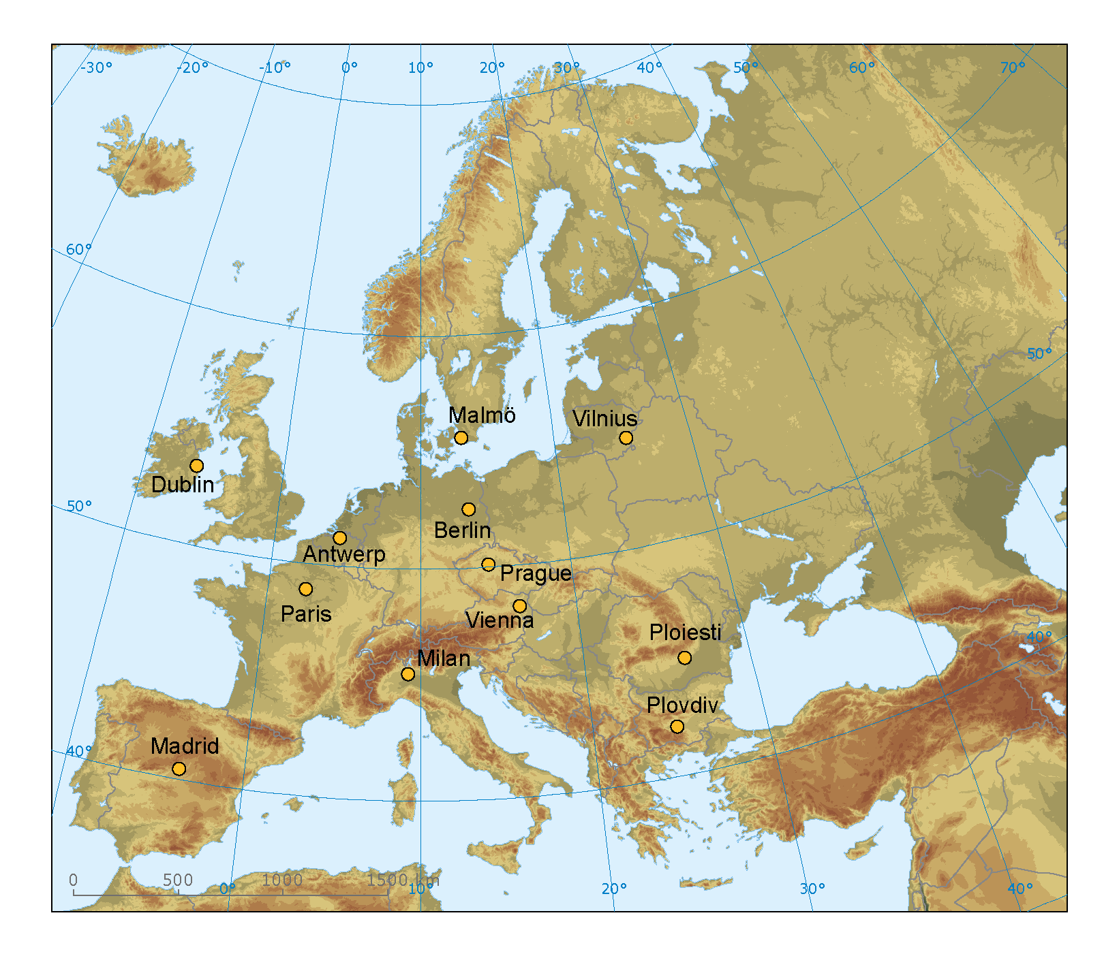
The cities: 8 (2012) + 4 (2013)
Antwerp (Belgium),
Berlin (Germany),
Dublin (Ireland),
Madrid (Spain),
Malmö (Sweden),
Milan (Italy),
Paris (France),
Ploiesti (Romania),
Plovdiv (Bulgaria),
Prague (Czech Republic),
Vienna (Austria) and
Vilnius (Lithuania).

Slide 6
For what purposes are models used?

Slide 7
User experience evaluation
Most of the cities collaborate with other institutes for the modelling.
Run the model themselves: Malmo, Milan and Paris
All the cities have found models helpful for the purpose it was applied
Almost all the cities have taken into account the model results for AQ decisions

Slide 8
Cities
Purpose | Models
Air quality assessment | Malmo, Milan, Vienna, Prague, Berlin, Paris, Plovdiv, Antwerp, Vilnius
Reporting air quality compliance | Malmo, Milan, Vienna, Madrid, Prague, Paris, Vilnius
Assessment of source contribution | Malmo, Milan, Vienna, Madrid, Prague, Berlin, Paris, Plovdiv, Vilnius
Long term planning | Malmo, Milan, Vienna, Madrid, Prague, Berlin, Paris, Plovdiv, Antwerp
Short-term action plans | Malmo, Milan, Vienna, Madrid, Prague, Plovdiv, Vilnius
Air quality forecasting | Milan, Vienna, Madrid, Paris, Vilnius
Population exposure | Malmo, Milan, Vienna, Prague, Berlin, Paris, Plovdiv, Antwerp, Vilnius
Supplement measurements | Milan, Vienna, Berlin, Plovdiv, Antwerp, Vilnius

Slide 9
What models?
Purpose | Models
Air quality assessment | AERMOD, FARM, GRAM/GRAL, ATEM, REM_CALGRID_RCG, IMMISluft, ADMS-urban, CALPUFF, AUSTAL 2000, POLTRAN
Reporting air quality compliance | OSPM, FARM, GRAMM/GRAL, WRF-SMOKE-CMAQ, ATEM, STREET, ADMS-urban
Assessment of source contribution | AERMOD, SPRAY, CALPUFF, GRAM/GRAL, WRF-SMOKE-CMAQ, IMMISluft, CHIMERE, AUSTAL, POLTRAN, ADMS-urban
Long term planning | AERMOD, FARM, GRAMM/GRAL, WRF-SMOKE-CMAQ, IMMISluft, STREET, AUSTAL,
Short action plans | AERMOD, FARM, MM5-CAMx, WRF-SMOKE-CMAQ, ATEM, SYMOS, AUSTAL, ADMS-urban
Air quality forecasting | MM5-CAMx, SERENA, CHIMERE, AUSTAL, , ADMS-urban
Population exposure | AERMOD, FARM, GRAMM/GRAL, ATEM, IMMISluft, STREET, AUSTAL, POLTRAN, ADMS-urban
Supplement measurements | FARM, GRAMM/GRAL, IMMISluft, AUSTAL, POLTRAN, ADMS-urban
Source apportionment | AERMOD, CBM, GRAM/GRAL, REM_CALGRID, CHIMERE

Slide 10
Emissions
All the cities have developed a specific local emission inventory to run the model
The spatial and temporal resolution vary according to the AQ model resolution
OSPM –> 50 m
REM_CALGRID -> 2 km

Slide 11
Emissions
The sources included vary from city to city and from model to model.
Street canyon models -> only relevant sources (usually road traffic emissions)
Local or regional models -> all known sources (usually all sectors)

Slide 12
Traffic emissions
Traffic congestion is a problem in all the cities but it is not always reflected.
IMMISluft (Berlin) -> reflected
FARM (Milan) -> not reflected
Traffic emissions are included as line sources in some cities.
AERMOD and OSPM (Malmö) -> line sources
FARM (Milan) and CAMx (Vienna) -> grid sources

Slide 13
Commercial and domestic emissions
The PM speciation is not completely implemented.
Madrid -> US EPA speciation
Vienna -> PM speciation not considered
Malmö -> all PM is considered as PM10
Consideration of height and point sources is not always done.
Malmö -> only large sources
Madrid -> only coal-fired boilers as point sources
Prague -> commercial as point sources, domestic as grid

Slide 14
Industrial emissions
PM speciation is not well resolved in all the cities.
Milan -> speciation profiles for PM10 and PM2.5
Berlin -> EC and OC as percentages of PM in REM_CALGRID, but EC is calculated and used as input for IMMISluft
Madrid -> US EPA speciation
In all cities source height is described and industries are considered as point sources.

Slide 15
Meteorology
The meteorological fields are obtained from:
Measurement towers (Malmö, Prague, Berlin, Plovdiv, Antwerp)
one observation site is employed (IMMISluft, Berlin)
optimum interpolation (REM_CALGRID, Berlin)
High resolution meteorological models as:
GRAMM or ALADIN/ALARO (Vienna)
WRF (Madrid, Paris)
ECMWF fields interpolated with local monitoring network (Milan)

Slide 16
Background concentrations
The background concentration is considered in all the cities but using different sources:
estimation from modeling of regional sources together with several measurement stations (Malmö)
estimation from monitoring data from background stations and emission inventories of neighboring provinces (Vienna, Paris, Plovdiv, Vilnius, Antwerp);
provided as boundary conditions under nesting models (Madrid) or other regional models (Berlin, Vilnius);
European simulations (Berlin)

Slide 17
Monitoring data
Four of the cities have used monitoring data in combination with a dispersion model.
Adjusting regional background concentrations of NO₂ and PM (Malmö)
Data fussion (Milan)
Assimilation of monitoring data (Paris)
Characterization of spatial representativeness (Antwerp)
[Statistical modelling (Madrid)]

Slide 18
How are models validated?
All the cities have validated the model against local measurements.
The common air quality indicators are: bias, rmse, correlation, etc.
The cities of Milan, Vienna, Madrid, Berlin, Paris, Plovdiv, Antwerp and Vilnius have also estimated the uncertainty of the air quality model as required by the EU legislation.

Slide 19
Do models fit for purpose?
All the cities have found the models employed are fit for the purpose they were applied to.
The results have been helpful in relation to AQ assessment activities.
The results have been successfully taken into account in AQ management.

Slide 20
Difficulties
Estimation of the uncertainties of each source sector in source contribution and source apportionment studies.
The computation time is very high.
The model results can overstimate or understimate pollutants levels.
The compilation of the emission inventory
The estimation of the background concentration.

Slide 21
Weak points
Emission estimation: correct amount of vehicles in each road, sea traffic, spatial and temporal variation, emission factors, etc.
Interpretation of the model results.
The required resources (human, temporal and financial) are high.
Consideration of sub-grid processed, hotspots.
Background dependency in street canyon models.

Slide 22
Guidance
Validation of the models: meteorology and air quality.
Emission estimation: Balance between the required emissions for modelling and the work effort.
General framework for modelling approach and criteria harmonization.

Slide 23
Next step: City modelling guide
The air implementation pilot study has indicated a need for more shared information on experience
Currently the FAIRMODE ‘Forum’ page is not easily accessible or used.
A city user web page provides an alternative and more easily accessible entrance to the guidance documents
A web based Q&A structure is easily updatable with a low threshold of interaction
It can be easily linked to the MDS. Similar structure

Slide 24
Forum and updates of Q&A
Forum will provide a source of exchange of experience
Questions posed will be used to update Q&A
The main challenge is to have an active and relevant forum that invites participation
To achieve this a low threshold of interaction is required as well as the inclusion of reliable, updated information

Slide 25
Thank you for your attention
Nuria Castell
ncb@nilu.no

