Slide 1




Compilation of urban emission inventories as analysed within the Air Implementation Pilot
Fairmode meeting 11.04.2013
ETC/ACM task manager: Ulrike Döring, Öko- Institut
ETC/ACM deputy manager: Christian Nagl, Umweltbundesamt Vienna

Slide 2
Background
Problem:
Air quality in cities still remains a problem in Europe.
=> NOx & particle emissions
=> greenhouse gas emissions
Main sources here:
transport,
construction machinery,
residential sector.
For improving the situation a review of the existing EU strategy on air pollution and climate change mitigation policy started in 2012 - integrated in an Air Implementation Pilot project.

Slide 3
Background
Air Implementation Pilot
=> Joint EEA – DG ENV project
=> Focused on cities in the EU.
Set-up for modelling activities under FAIRMODE task in ETC/ACM’s Implementation Plans of 2012 and 2013!
AIP OBJECTIVES
Share experiences among pilot cities;
Develop proposals for improved implementation;
Share experiences with other cities;
Not intended to solve AQ problems, but improve information base for future action.

Slide 4
Objectives for the two city pilot projects
1a) Analysis of existing initiatives and projects & local initiatives in the CC/AP mitigation field & 1b) questionnaires of city inventories
2. Overview & understanding of the results of the studies
3. Where are the gaps and what can we learn?

Slide 5
Structured in four main groups
General issues
project group
contact
Emission inventories at local level
pollutants
Information on policies & measures
availability of information
good practices
finances
duration of project
methodology (EF, AD)
data handling & availability
updates
Other
project conclusions
findings
sharing of network

Slide 6
Why emission inventories (EI)?
Identification of the local sources of pollution;
Knowledge on the contribution each source;
Identification & implementation of measures to improve local air quality;
Monitoring the calculated change in emissions with time.

Slide 7
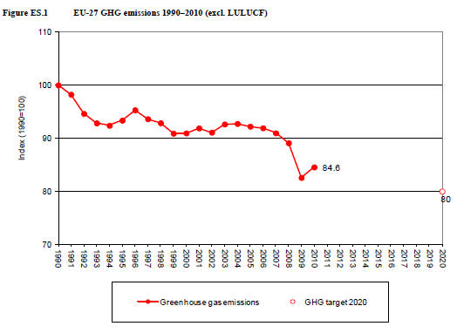
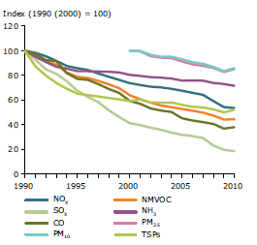
Emission trends & reports
Source: EEA, EU National Inventory Report, 2012
Source: EEA, European Union emission inventory report 1990–2010 under the UNECE Convention on Long-range Transboundary Air Pollution (LRTAP) , 2012

Slide 8
  Main questions:
Use of EI
Guidance, QA/QC
Availability of data
Use of co-benefits (pollutants)
Comparability of different approaches

Slide 9
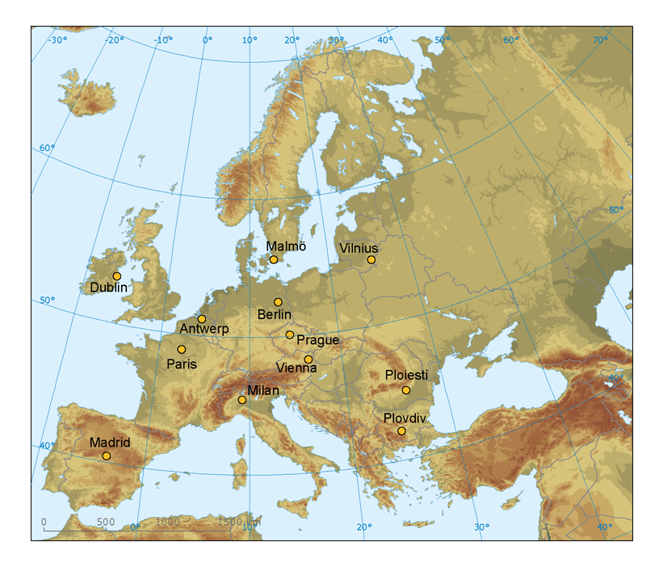
Choise of city projects (in total 11 projects):
Covenant of Mayors (CoM)
Common Information to European Air, CiteAir
EU CO2 80/50 Project
Selection of cities:
Antwerp, Berlin, Madrid, Malmö, Paris, Plovdiv, Vienna, Vilnius, Milan, Ploieşti, Prague.
Dublin started preparing an EI.
Notes:
CiteAir II
http://www.citeair.eu/
CiteAir II :
EU funded project with the aim of providing up-to-date information on air quality, greenhouse gases and emissions in European cities to local and regional authorities.
output: guidebook addressing the integration of greenhouse gases into air pollutant emission inventories at the local scale (covering CO₂, PM₁₀, NO_{x}, NO₂).
Covenant of Mayors (CoM)
http://www.eumayors.eu
The CoM is a grouping of more than 4800 cities that have voluntarily committed to increase energy efficiency and use of renewable energy sources.
Implemention of baseline emission inventories at urban level and includes emission factors for the main emission sources (fuels, electricity etc.), advice for activity data collection, and help to use existing tools.
EU CO₂ 80/50 – METREX
http://euco2.eu/
This project examined in which ways and in what regions an 80% reduction target for CO₂ emissions could be achieved by 2050.
CO₂ emissions and other greenhouse gases and energy data for 18 cities and three regions were compiled in the form of an urban emission inventory and mitigation scenarios were applied with a commercial inventory tool.

Slide 10
Main results - use of EI

Slide 11
Main results - pollutants
NEC: National Emission Ceiling Directive 2001/81/EC, AQD: Air Quality Directive 2008/50/EC
DD4: 4th Daughter Directive 2004/107/EC, GP: revised Gothenburg Protocol under the CLRTAP
UNFCCC: United Nations Framework Convention on Climate Change

Slide 12
Main results – co-benefits CC/AQ

Slide 13
Main results - internal guidance

Slide 14
Main results – data availability

Slide 15
Main results – Reference for EF

Slide 16
Main results - comparability

Slide 17
Conclusions
Good quality input data is essential (e.g. on traffic statistics, household combustion practices, construction emissions );
There are significant differences in comparability, completeness and consistency between the inventories;
Currently the EI can be used for qualitative assessments on a European level. Use for modelling or source apportionment requires substantial effort for harmonization.

Slide 18
Conclusions
Necessity for improved guidance for estimating fugitive and diffuse emissions (e.g. resuspension from traffic, construction work etc.), emissions of residential heating, future traffic emissions and for QA/QC in general;
Several cities and city projects consider and integrate synergies between management of air quality and greenhouse gases when planning action plans or measures.
Brochure: compilation of guidance material

Slide 19
Thank you!
Contacts
Christian Nagl
+43-1-31304-5866, christian.nagl@umweltbundesamt.at
Ulrike Döring
+49-30-405085-303, u.doering@oeko.de

Slide 20
11 city projects were analysed!
Covenant of Mayors (CoM)
Megapoli
CityZen, mega CITY - Zoom for the Environment
Soot free cities campaign
European Green City Index
Common Information to European Air, CiteAir
METREX - The Network of European Metropolitan Regions and Areas
InterMETREXplus Project
EUCO2 80/50 Project
Climate Cities Benchmark (CCB)
Fairmode

