Slide 1
Main Challenges for the Compilation of Urban Emission Inventories in Spain, What We Expect of FAIRMODE
José M. Baldasano^{1,2}, Marc Guevara¹
¹Barcelona Supercomputing Center-Centro Nacional de Supercomputación (BSC-CNS)
²Environmental Modeling Laboratory, Technical University of Catalonia (UPC)
Barcelona, Spain.
FAIRMODE Meeting
April 10-12, 2013 Antwerp, Belgium

Slide 2
Hermesv2.0 urban emission data for SPAIN: THE case of barcelona

Slide 3
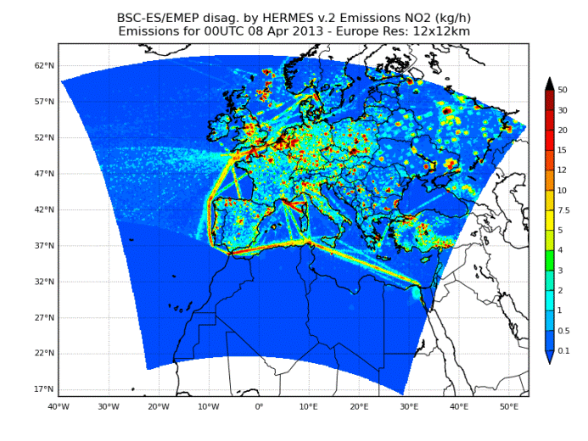
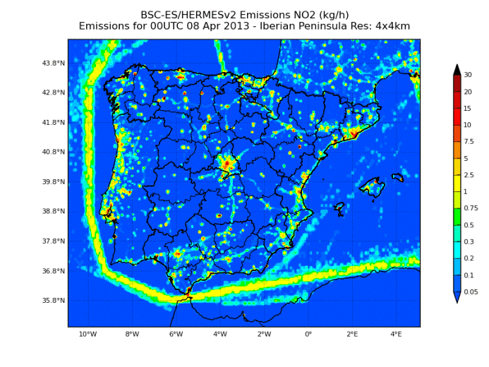
HERMESv2.0 emission model (AE submitted)
The High-Elective Resolution Modeling Emissions System 2.0 (HERMESv2.0) estimates anthropogenic and biogenic emissions with high spatial (up to 1 km²) and a temporal (1 h) resolution, taking 2009 as the reference period. It represents the core emission of the Spanish air quality forecast system CALIOPE
HERMES-DIS
Spatial/temporal disaggregation and speciation of the original annual gridded CEIP-EMEP emissions
HERMESv2.0
Hourly speciated emissions
HERMES-BOUP
Emission inventory specifically developed for Spain, using mainly bottom-up approaches & local info

Slide 4
Conceptual framework
HERMES-DIS
HERMES-BOUP
EMEP emission database
Source SNAP sector specific spatial and temporal proxies
SNAP01/03/04/09
Local point source inventory with specific data by stack
SNAP07
Road Network with daily average traffic, speed circulation, vehicle park composition and temporal profiles per stretch
SNAP08
Monthly traffic by airport
Annual ship operations by port
Agricultural vehicle fleet at NUTS 3 level
SNAP02
Statistics on fuel consume
Population map
SNAP05/06/10
INESP emission database
Elemental SNAP activity specific spatial and temporal proxies
Desaggregation Methodology
MEGAN v 2.04
Biogenic emissions
Bottom-Up approach
Top-Down approach
Down-scaling
GIS pre-processing data & Calculation process
Hourly-gridded NOx, NMVOCs, CO, SO2, NH3, TSP, PM10, PM2.5 emissions
Chemical speciation (CBIV, CB05, MELCHIOR2)
Emissions file management
Emission information/visualization
NetCDF, .csv, .kmz,…
Emission data for air quality modeling
CALIOPE (http://www.bsc.es/caliope)

Slide 5
EMEP-DIS
SNAP | TYPE OF SOURCE | SPATIAL SURROGATES | SOURCES | TEMPORAL SURROGATES
01 | Point | E-PRTR facilities related to SNAP01 ^{(*)} Industrial land use (Code 121) | E-PRTR v 3.2 CLC 2000/2006 v15 ^{(**)} | MONTHLY and WEEKLY profiles by country and SNAP sector (reported by IER as part of the GENEMIS project) HOURLY profiles by SNAP sector (reported by TNO-MEP for TROTREP/POET)
02 | Area | Urban/industrial land uses (Codes 111, 112, 121, 123 & 124) | CLC 2000/2006 v15 ^{(**)}
03 | Point | E-PRTR facilities related to SNAP03 ^{(*)} Industrial land use (Code 121) | E-PRTR v 3.2 CLC 2006 v15 ^{(**)}
04 | Point | E-PRTR facilities related to SNAP04 ^{(*)} Industrial land use (Code 121) | E-PRTR v 3.2 CLC 2000/2006 v15 ^{(**)}
05 | Point | E-PRTR facilities related to SNAP05 ^{(*)} Ports & Airports Service Stations Industrial land use (Code 121) | E-PRTR v 3.2 GISCO data Tele Atlas ® Multinet ® 2011 CLC 2000/2006 v15 ^{(**)}
06 | Area | Urban/industrial/construction land uses (Codes 111, 112, 121 & 133) | CLC 2000/2006 v15 ^{(**)}
07 | Line | Stretch roads discriminated by type of road (6 types from motorways to local roads). Weight factors assigned to each type of road | Tele Atlas ® Multinet ® 2011
08 | Area | Port/Airport land uses (Codes 123 & 124) Industrial/agricultural land uses (Codes 121, 122, 241,242 & 243) | CLC 2000/2006 v15 ^{(**)}
 | Area | Reallocation of EMEP SHIP emissions considering the maritime routes given by the combination of AMVER and ICOADS data sets | Wang, et al. (2008)
09 | Point | E-PRTR facilities related to SNAP09 ^{(*)} Industrial/Dump land uses (Codes 121 & 132) | E-PRTR v 3.2 CLC 2006 v15 ^{(**)}
10 | Area | Agricultural land uses (Codes from 211 to 243 ) | CLC 2000/2006 v15 ^{(**)}
(*) A relationship between NACE and SNAP activity codes has been carried out (**) CLC 2000 v 15 has been used in Greece due to the lack of data in the CLC 2006 v15

Slide 6
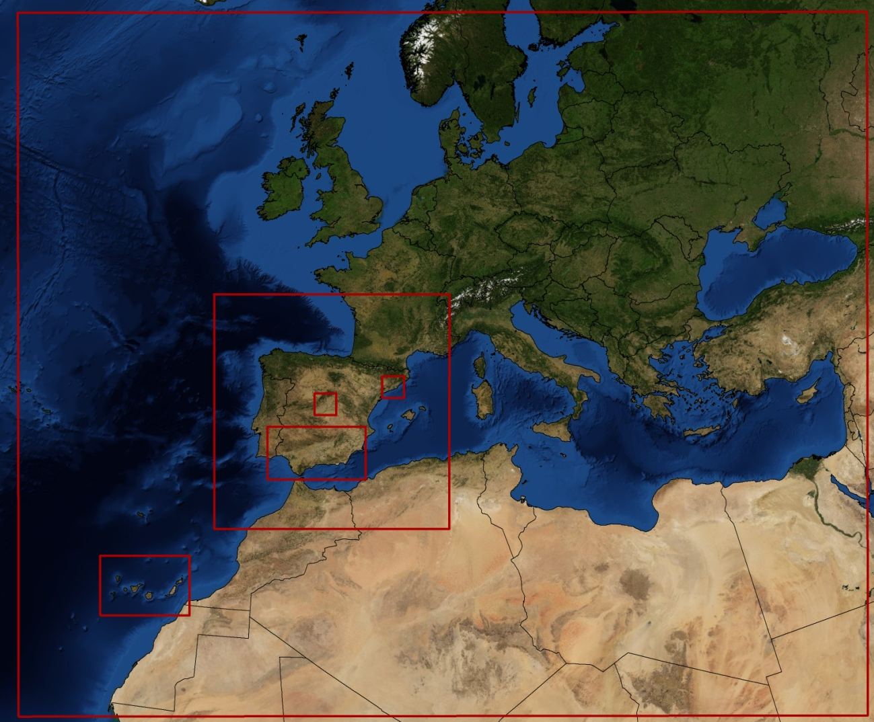
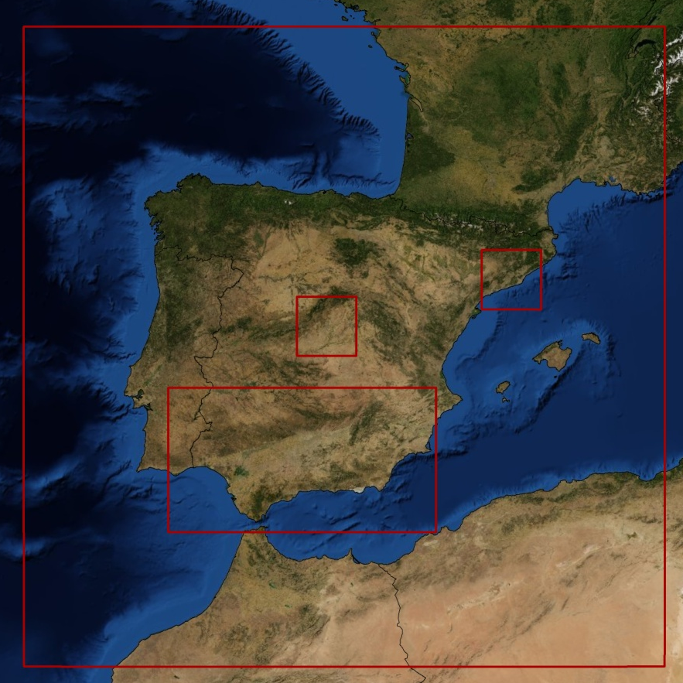
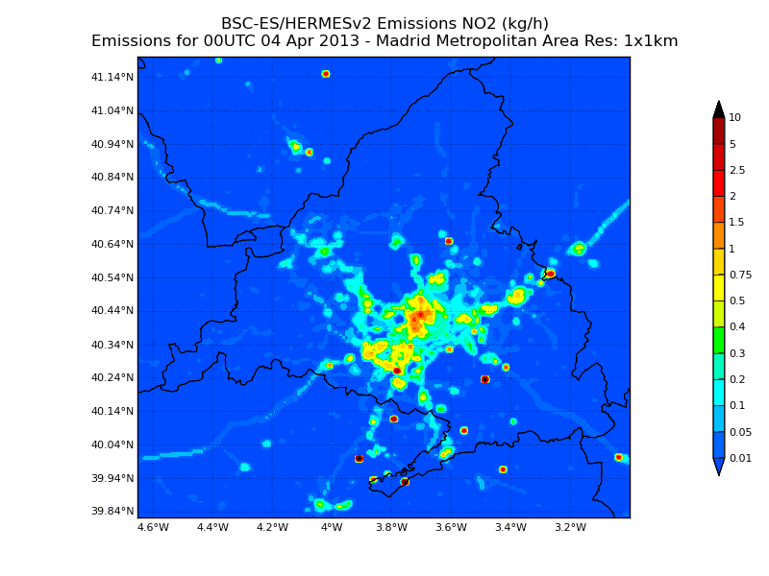
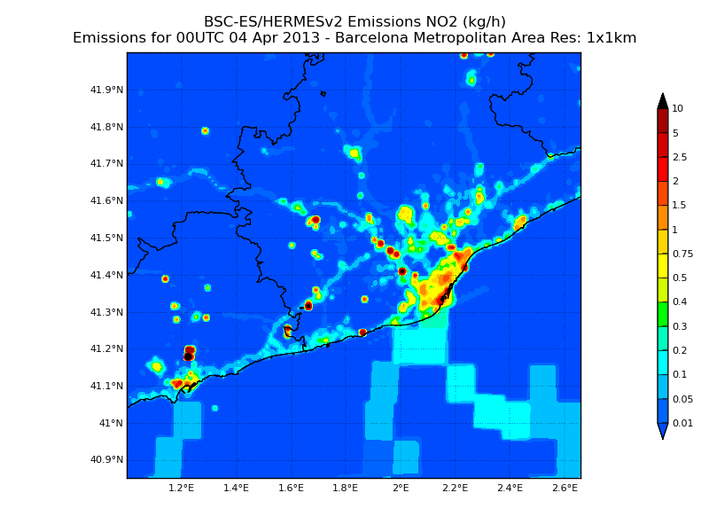
Principal working domains
D1
D2
D5
D6
D2
D5
D6
D4
D4
D3
Domain | Resolution | Emissions
D1 - Europe | 12km | HERMES-DIS (All)
D2 - IP + Balearic Islands | 4km | HERMES-BOUP (Spain) / HERMES-DIS (Rest of countries + Ship)
D3 – Canary Islands | 2km | HERMES-BOUP (All)
D4 - Andalucia | 1km | HERMES-BOUP (Spain) / HERMES-DIS (Rest of countries + Ship)
D5 – Barcelona Greater Area | 1km | HERMES-BOUP (All except ship emissions)
D6 – Madrid Greater Area | 1km | HERMES-BOUP (All)
Madrid urban city
Barcelona urban city

Slide 7
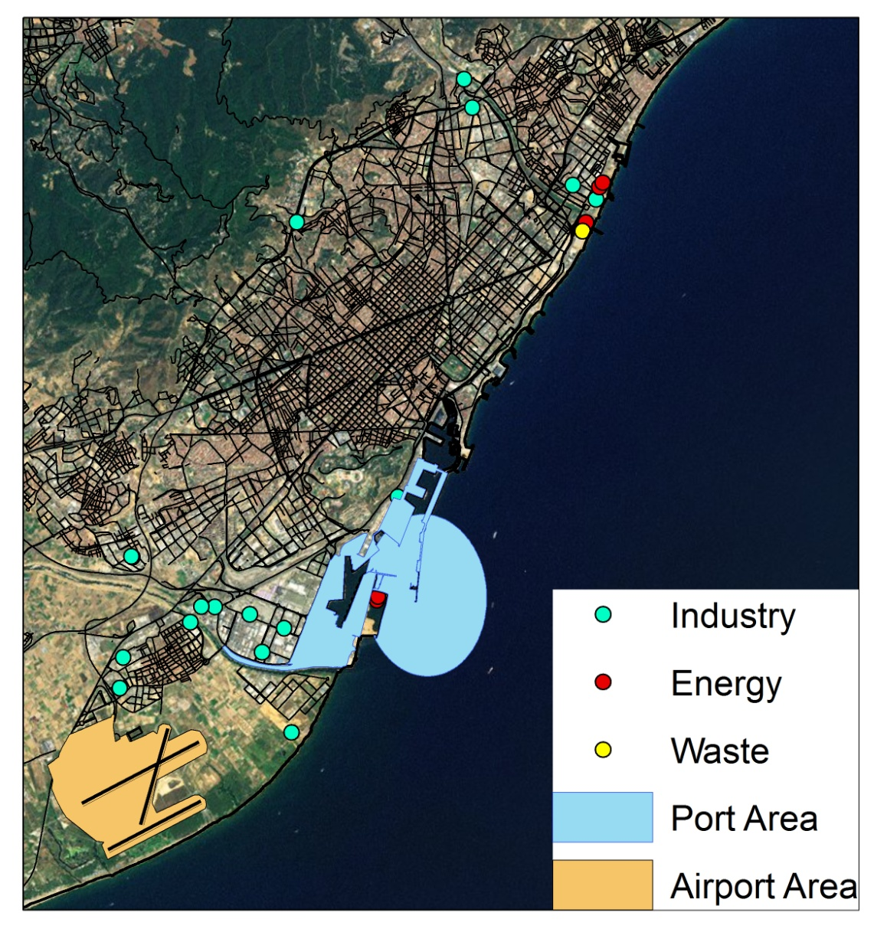
Barcelona: Main Characteristics
Population (> 1,500,000 inhabitants)
Energy industries
Manufacturing Industries
Waste Incinerator
Port → (> 8,000 operations/year)
Airport → (> 135,000 LTO/year)
Mean traffic flow > 20,000 veh./day)
Need of specific high resolution local data

Slide 8
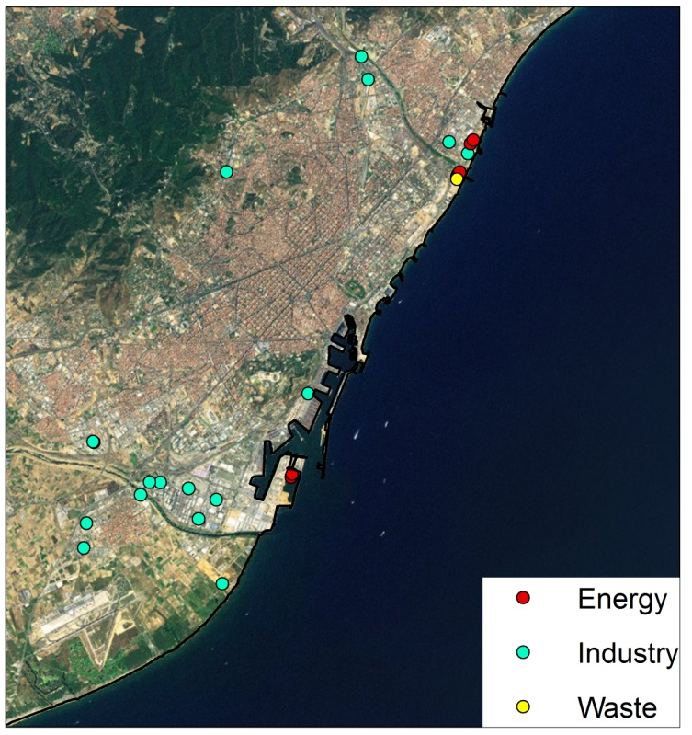
Energy-Industry-Waste (SNAP01/03/04/09)
Local point source inventory
Facility name
SNAP elemental activity code
Geographical location
Stack height
Activity Factor (annual production or fuel consumption)
Emission Factors for each pollutant
Temporal profiles
Speciation profiles
A total of 1,795 point sources considered
Industry
Emissions are obtained from measured data reported by XEAC (personal communication) or EMEP/CORINAR/EEA guidebooks
In some cases, production data is only available for the whole industrial. An assignation among each facility is performed using distributional factors
Waste
Emissions are obtained from measured data reported by XEAC (personal communication)
Energy
Emissions are obtained for each power station from measured data reported by CIEMAT (personal communication)
Energy
Energy mix varies from year to year, which directly affects the emissions
Lack of specific emission/production data from some large point sources
Energy forecasting (demand) would allow to develop a more realistic air quality forecast system

Slide 9
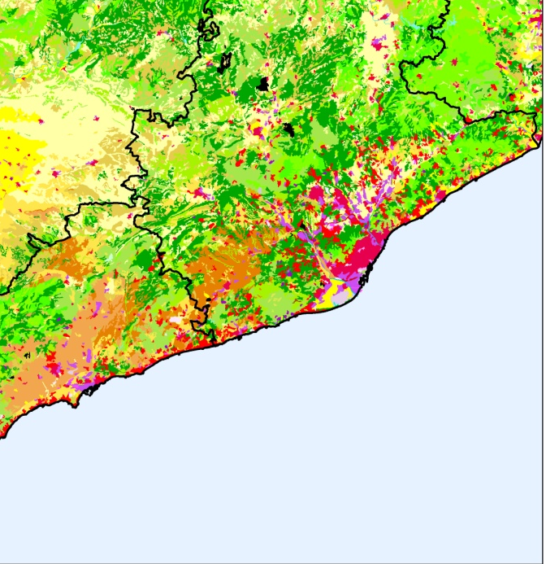
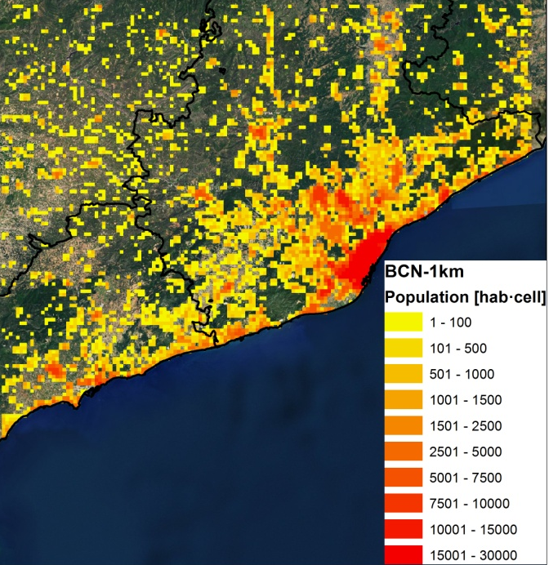
Residential-Commercial (SNAP02)
ACTIVITY DATA
EMISSION FACTORS
SPATIAL & TEMPORAL DISAGGREG.
Annual statistics on fuel consumptions (natural gas, gasoil C, GLP, fuel oil, coal and biomass) at NUTS level 3
EEA / EMEP / CORINAIR guidebooks
Population map from Tele Atlas ® Multinet ® 2011 cartography information
Industrial/urban land uses from CORINE Land Cover 2006 v 15 (100m res)
Difficulty to find local information and spatial allocation for biomass combustion.
Temporal allocation based on national consumption statistics, but not on specific weather conditions
Monthly/weekly/hourly profiles by type of fuel obtained from national statistics
Emissions from biomass combustion are allocated in cells with a limit value of population (depending on the domain’s resolution)
CLC 2006 v15 (100m)
Population map

Slide 10
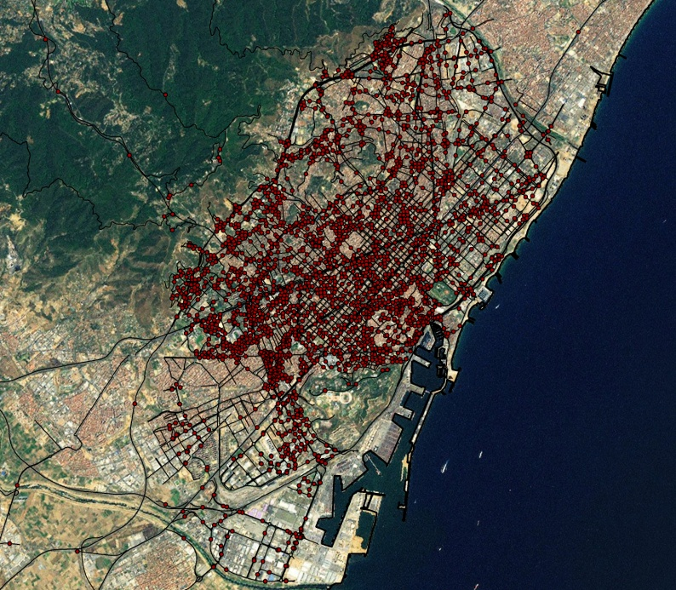
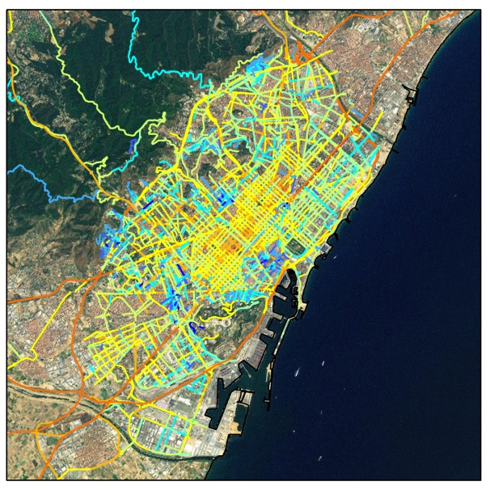
Transport – On-road traffic (SNAP07)
A complete digital road map with traffic flow information
Spent almost a year recopilating and geoprocessing the information for the whole country
2,575 Traffic Stations +
870 street km TeleAtlas Multinet
Used > 1,000 temporal profiles (including monthly, weekly, hourly)

Slide 11
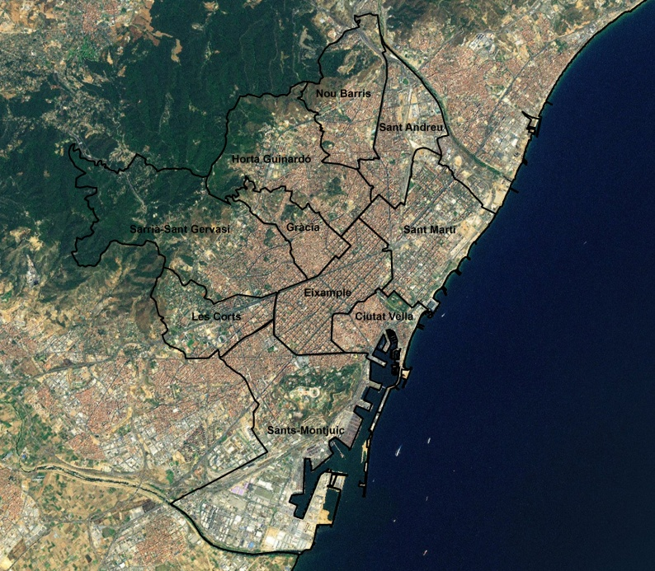
Transport – On-road traffic (SNAP07)
Composition fleet based on real circulation data per district
12 fleet composition profiles obtained from Remote Sensign Device (RSD) data
According to city council of Barcelona (2010), NOx emissions estimated in Barcelona using the RSD data are 16.2% higher than the ones obtained using CORINAIR EF.
EMEP/EEA does not include a methodology for estimating paved road dust resuspension emissions
AB, 2010
Methodologies for the emission estimation
EMEP/EEA - COPERT IV → Exhaust (hot&cold), evaporative and tyre/break/road wear emissions
Pay et al, 2010 → Paved road dust resuspension emissions

Slide 12
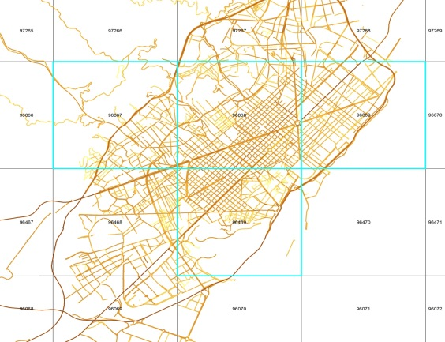
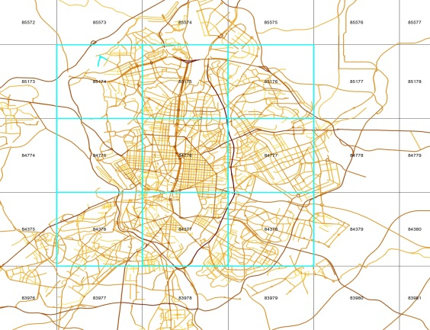
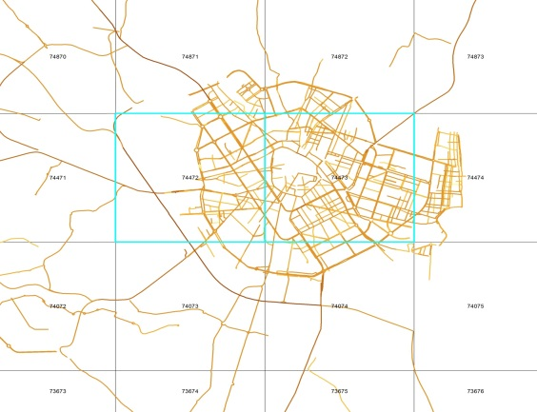
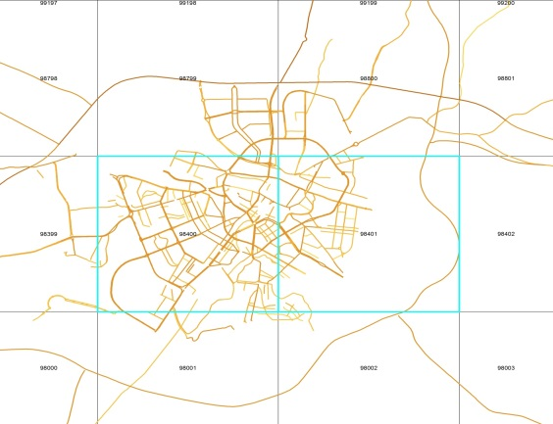
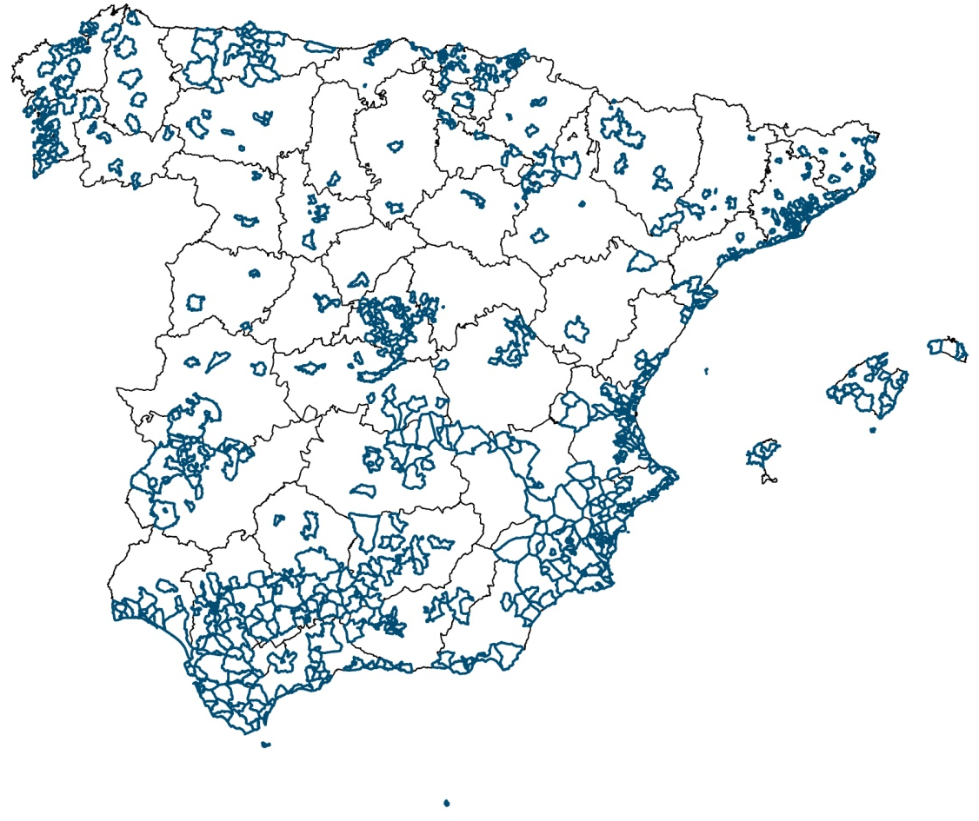
Transport – On-road traffic (SNAP07)
Other cities without traffic information
EFs [t/year/inhabitants] obtained from cities with available information
Specific methodology for estimating urban emissions in cities without traffic information
EF other cities [kg/hab/year]
 | NOx | NMVOC | SOx | CO | NH3 | TSP | PM10 | PM2,5
HERMES v 2.0 | 3,01 | 0,66 | 0,04 | 3,96 | 0,04 | 0,48 | 0,44 | 0,34
Applied to 745 municipalities
The emissions estimated represent a 28% and 23% of the total NOx and TSP on-road traffic emissions

Slide 13
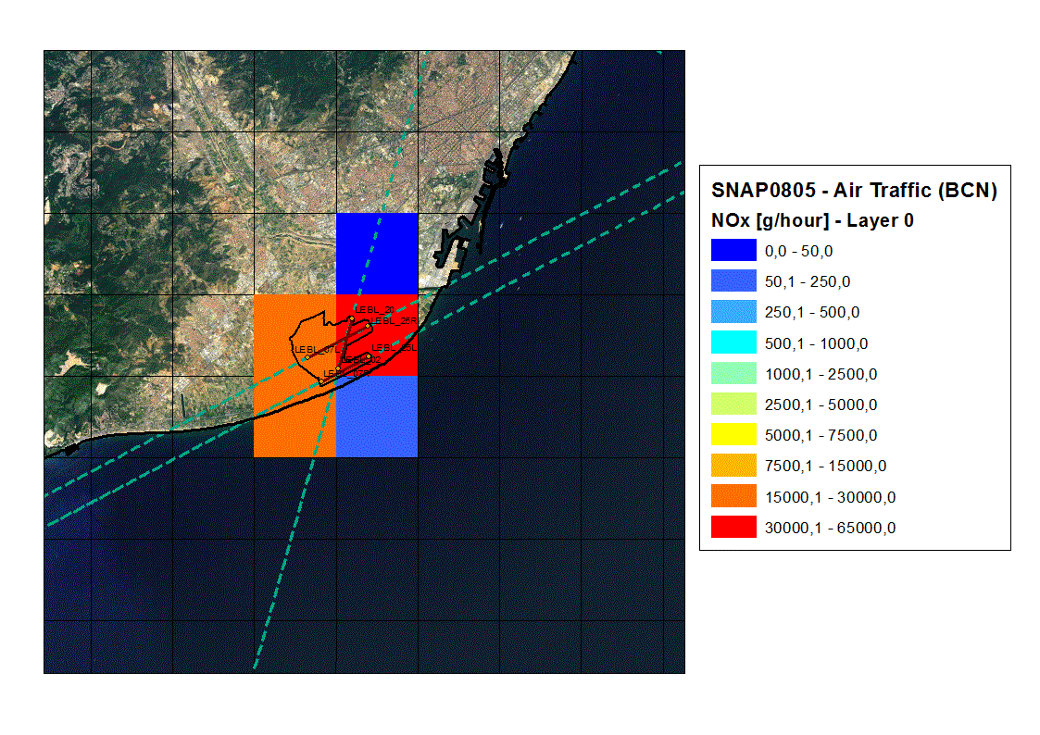
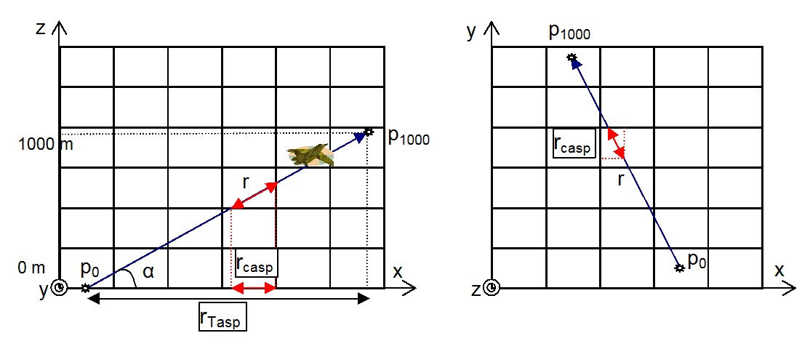
Transport – Other mobile sources (SNAP08)
Airport → LTO cycles emissions obtained using EMEP/EEA guidebook
Land-based port related emissions (e.g. vehicle traffic, loading/unloading operations) are significant, but they are not included in the EMEP/EEA guidebooks.
Hourly NOx emissions
Annual SOx emissions (1km*1km)
Port → Emissions per type of operation (maneuvering/hotelling) obtained using the Entec UK methodology

Slide 14
Rating of the database used
Data Attribute Rating System (DARS) (USEPA, 2003)
Activity - SNAP sectors | Score | Information sources
SNAP0101 - Public power stations | 76,0 | Emission factors: Measurements from the Spanish National Office of Emission Control for Large Combustion Facilities (OCEM-CIEMAT), TNO (1995), EEA (2007), EEA (2009) Activity data: UNESA (2009), REE (2009a), IEAs^{(*)} and ERs^{(**)} Temporal profiles: REE (2009b)
SNAP0103 - Petroleum refining plants | 47,3 | Emission factors: EEA (2009), EEA (2007) Activity data: Oilgas (2009), IEA and ER by facility, , MINECO (2003)
SNAP010406 - Coke oven furnaces | 61,3 | Emission factors: EEA (2009), EEA (2007) Activity data: MINETUR (2009a), IEAs^{(*)} and ERs^{(**)}, E-PRTR (2009)
SNAP02 - Non industrial combustion plants | 49,0 | Emission factors: EEA (2009) Activity data: MINETUR (2009b), CORES (2010), IDAE (2010B) Temporal profiles: USEPA (2002); CORES (2010); ENAGAS (2010)
SNAP030103, SNAP030104 & SNAP030105 - Cogeneration plants | 61,5 | Emission factors: EEA (2009), EEA (2007) Activity data: MINETUR (2009c), REE (2009), IEA and ER by facility, E-PRTR (2009) Temporal profiles: REE (2009)
SNAP030203, SNAP030302 & SNAP040202 to SNAP040207 - Iron and steel industry | 50,3 | Emission factors: EEA (2009), EEA (2007), TNO (1995) Activity data: E-PRTR (2009), UNESID (2009), IEAs^{(*)} and ERs^{(**)} Temporal profiles: Assumed constant activity profile
SNAP030305, SNAP030306, SNAP030322 & SNAP040301 - Non-ferrous metal industry | 54,3 | Emission factors: EEA (2009), EEA(2007) Activity data: IEAs^{(*)} and ERs^{(**)} Temporal profiles: Assumed constant activity profile
SNAP030311 & SNAP040612 - Cement industry | 61,8 | Emission factors: IEA and ER by facility, Measurements from the Catalonia's Atmospheric Emission Network (XEAC), MMA (2004), EEA (2009), Activity data: IEAs^{(*)} and ERs^{(**)}, OFICEMEN (2009), E-PRTR (2009)
SNAP030312 & SNAP040614 - Lime industry | 50,3 | Emission factors: EEA (2009), EEA (2007), TNO (1995) Activity data: IEAs^{(*)} and ERs^{(**)}, MAGRAMA (2007a), ANCADE (2009), E-PRTR (2009)
SNAP030314 up to SNAP030318 - Glass industry | 50,3 | Emission factors: EEA (2009), EEA (2007) Activity data: ANFEVI (2009), IEAs^{(*)} and ERs^{(**)}, MAGRAMA (2007a), E-PRTR (2009), ARDAN (2009) Temporal profiles: Assumed constant activity profile
SNAP030319 - Bricks and tiles industry | 50,3 | Emission factors: EEA (2009), EEA (2007) Activity data: HYSPALIT (2009), IEAs^{(*)} and ERs^{(**)}, MAGRAMA (2007a), E-PRTR (2009)
SNAP030320 - Fine ceramic materials industry | 50,3 | Emission factors: EEA (2009), EEA (2007) Activity data: ASCER (2009), IEAs^{(*)} and ERs^{(**)}, MAGRAMA (2007a), E-PRTR (2009), ARDAN (2009)
SNAP040101, SNAP040102 & SNAP040103 - Processes in petroleum industries | 57,0 | Emission factors: EEA (2009), EEA (2007) Activity data: Oilgas (2009), IEAs^{(*)} and ERs^{(**)}, E-PRTR (2009) Temporal Profiles: MINETUR (2009d)
SNAP040401 - Sulfuric acid industry | 54,0 | Emission factors: EEA (2007) Activity data: IEAs^{(*)} and ERs^{(**)}, E-PRTR (2009)
SNAP040602 & SNAP040603 - Paper pulp industry | 50,3 | Emission factors: EEA (2009), EEA (2007) Activity data: ASPAPEL (2009), IEAs^{(*)} and ERs^{(**)}, MAGRAMA (2007a), E-PRTR (2009), ARDAN (2009)
SNAP07 - On-road transport | 76,5 | Emission factors: EEA (2009), Pay et al. (2010) Activity data & Temporal profiles: MF (2009), Observation stations managed by Spanish Governmental Authorities (Central Government, Autonomous Communities, Provinces and City Councils), Tele Atlas ® Multinet ® (2011), DGT (2010), AB (2010), AM (2009)
SNAP0804 - Maritime activities | 65,8 | Emission factors: Cooper & Gustafsoon (2004) Activity data: Spanish port authority’s annual reports (AAPP), SPS (2009), Entec UK Limited (2007, 2010), Corbett et al. (2003) Temporal profiles: SPS (2009), Localizatodo.com
SNAP0805 - Air traffic (LTO cycles < 1000m) | 71,3 | Emission factors: EEA (2009), USEPA (2005), ICAO (2010), FOCA (2007) Activity data & Temporal Profiles: AENA (2009)
SNAP0806 - Agricultural machinery | 51,8 | Emission factors: EEA (2009) Activity data: MAGRAMA (2007b and 2009b) Winther and Nielsen (2006) Temporal Profiles: EEA (2009)
SNAP09 - Waste treatment | 76,0 | Emission factors: Emissions measured from Catalan Atmospheric Emission Network (XEAC) and AEVERSU (2009), EEA (2009) Activity data: AEVERSU (2009), Oilgas (2009), IEAs^{(*)} and ERs^{(**)} Temporal profiles: XEAC, MINETUR (2009e)
(*) Integrated Environmental Authorizations by facility; (**)Environmental Reports by facility

Slide 15
Speciation process – HERMESv2.0 to CMAQ
Hao et al., 2012
Lack of an European speciation database
Lack of information for NO/NOx ratios
SPECIATE 4.2
CBIV / CB05 / MELCHIOR2
CMAQ 5.0.1
On-Road Traffic
NMVOC & NO2 → Speciation profiles obtained from the EMEP/EEA guidebook
Other sectors
NMVOC & PM2.5 → Used > 50 profiles (SPECIATE 4.2)
NO2 → Applied a constant NO/NO_{x} ratio of 0.9

Slide 16
What we expect from fairmode

Slide 17
Energy-Industry-Waste (SNAP01-03-04-09)
Activity data
Energy sector → Energy forecasting demand
Industry → Not all the E-PRTR facilities report complete information
Emission data
In some cases, EF reported by EMEP/EEA guidebook are too general (not discriminated by fuel used), specially in the industrial sector (SNAP03-04)
Spatial allocation
No comments
Temporal allocation
No comments
Chemical speciation
Development of a complete European speciation database

Slide 18
Residential-Commercial (SNAP02)
Activity data
Development of a database with local information on biomass consumption
Emission data
No comments
Spatial allocation
Development of a spatial proxy with high resolution for the allocation of biomass combustion emissions
Temporal allocation
Chemical speciation
Development of a complete European speciation database

Slide 19
Transport – On-road traffic (SNAP07)
Activity data
Development of a complete geographically referenced database with traffic flow information from all the European countries. Easy to use with GIS software
Emission data
Revision of the EF reported by EMEP/EEA guidebook (based on COPERT IV)
Development of a methodology for estimating road dust resuspension emissions
Spatial allocation
No comments
Temporal allocation
No comments
Chemical speciation
Update the speciation profiles reported by EMEP/EEA, increasing the number of categories.

Slide 20
Transport – Other mobile sources (SNAP08)
Activity data
No comments
Emission data
Development of a methodology for estimating Land-based port related emissions (e.g. vehicle traffic, loading/unloading operations)
Spatial allocation
No comments
Temporal allocation
No comments
Chemical speciation
Development of a complete European speciation database

Slide 21
Thank you!

