Slide 1
Comments on DELTA version 3.2 with the ADMS-Urban London dataset & updates to the PASODOBLE Myair Model Evaluation Toolkit
Jenny Stocker, David Carruthers & Sam Royston
6th Plenary Meeting of FAIRMODE
May 2013
Antwerp
Belgium

Slide 2
Contents
Comments on DELTA version 3.2 with the ADMS-Urban London dataset:
Comparison of old and new Target plots
Using DELTA to investigate model issues
Other minor comments
Updates to the PASODOBLE Myair Model Evaluation Toolkit:
Background
Incorporating the latest Target plot in the PASODOBLE toolkit
Summary

Slide 3
Comments on DELTA version 3.2 with the ADMS-Urban London dataset Comparison of old and new Target plots
Background:
ADMS-Urban is a high resolution (10s of metres) Gaussian plume model
Hourly calculations are performed at background, roadside and kerbside locations
ADMS-Urban London dataset is for 2008
London has over 100 continuous monitors measuring NO_{x} and NO₂, and over 75 measuring PM₁₀
Possible issues:
Most of the modelled data used to test the statistics in the DELTA tool has come from Eulerian grid models (CHIMERE, TCAM, CAMx etc). Is the tool applicable to non-Eulerian models?
The hourly NO₂ target is challenging as the models require accurate hourly input data to produce good results. Should there be some allowance in the Model Performance Criteria (MPC) to allow for this?

Slide 4
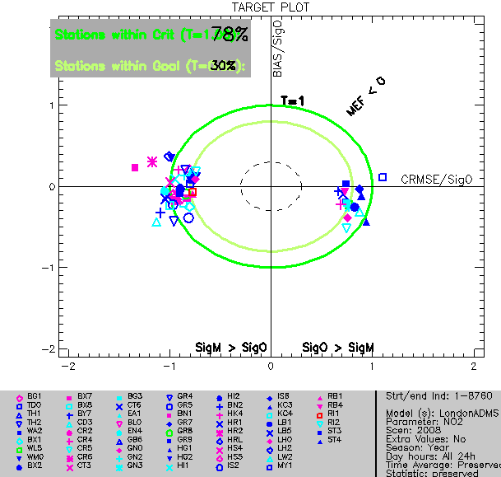
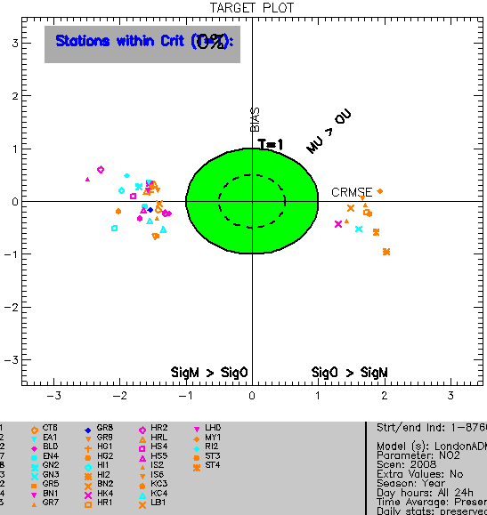
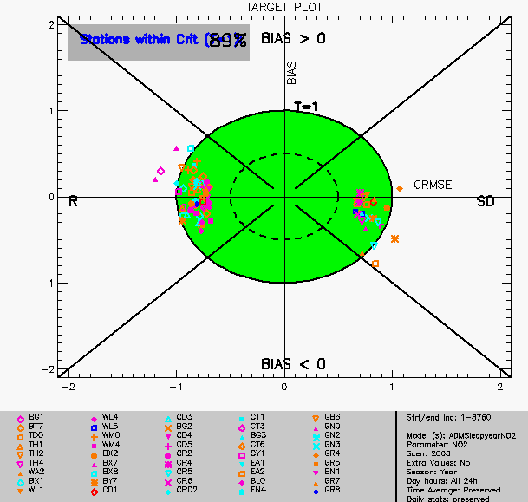
Comments on DELTA version 3.2 with the ADMS-Urban London dataset Comparison of old and new Target plots
Target plots showing ADMS-Urban London 2008 results:
O₃ and PM₁₀ plots look similar in versions 1.2, 2.0 and 3.2 of the DELTA tool.
NO₂ plots have changed significantly
Version 1.2: Results look ok
Version 2.0: Results look terrible
Version 3.2: Results ok again!

Slide 5
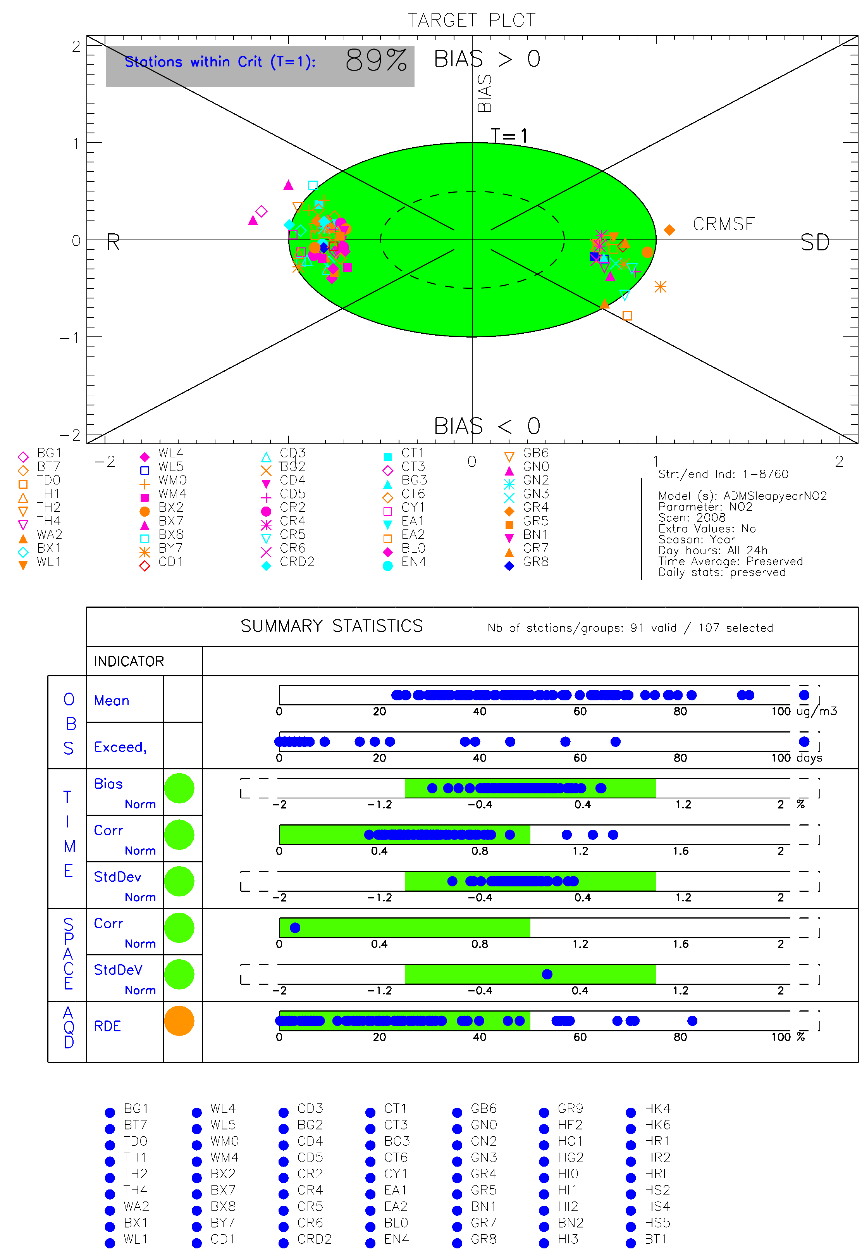
Comments on DELTA version 3.2 with the ADMS-Urban London dataset Using DELTA to investigate model issues
Version 3.2 Target plot for NO₂
BIAS for all monitors is fine
Target plot indicates that there are 5 sites outside the MPC due to correlation (R) and 3 sites outside the MPC due to the standard deviation (SD).
In the TIME section of the SUMMARY STATISTICS, it is only the correlation (R) that has any points outside the range: satisfying the TIME statistics is a necessary but not sufficient condition for the Target criteria to be satisfied.
R
SD
TIME statistics
AQD statistic

Slide 6
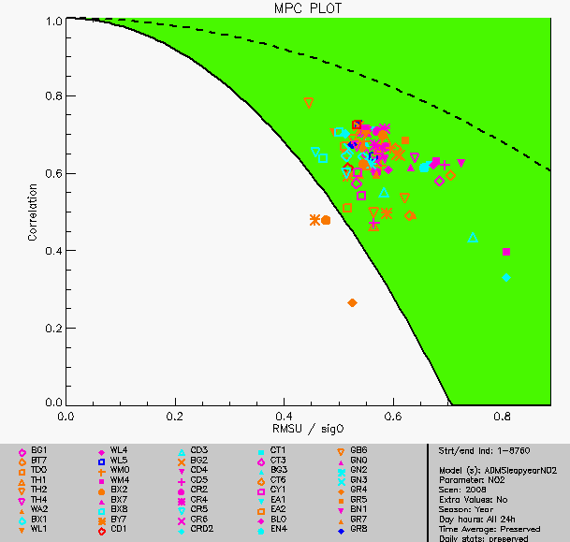
Comments on DELTA version 3.2 with the ADMS-Urban London dataset Using DELTA to investigate model issues
Version 3.2 Correlation, R diagram for NO₂
Target plot
Site indicators only agree for 2/3 sites
SD
Correlation, R
From Target plot description in User Guide:
RMS_{u} / σ_{o}
TIME statistics

Slide 7
Comments on DELTA version 3.2 with the ADMS-Urban London dataset Using DELTA to investigate model issues
Temporal variation of NO₂ at selected sites
Site CD4 (within MPC for R)
Site MY1 (exceeds MPC for R)
80
160
40
60
Site | Type |  | σ_{o} | RMS_{u} | RMS_{u} / σ_{o}
CD4 | Urban background | 60 | 23 | 17 | 0.73
MY1 | Kerbside | 114 | 60 | 31 | 0.53

Slide 8
Comments on DELTA version 3.2 with the ADMS-Urban London dataset Comparison of old and new Target plots
Possible issues:
Most of the modelled data used to test the statistics in the DELTA tool has come from Eulerian grid models (CHIMERE, TCAM, CAMx etc). Is the tool applicable to non-Eulerian models?
Statistical indicators in the DELTA tool seem to work for ADMS-Urban
The hourly NO₂ target is challenging as the models require accurate hourly input data, including large changes, to produce good results. Should there be some allowance in the Model Performance Criteria (MPC) to allow for this?
When looking at the hourly NO₂ statistic, there are many hourly inputs:
If it doesn’t matter within an hour or two when a model correctly predicts an exceedence, should there be some averaging in some of the statistics, for instance the correlation?
Hourly emissions / traffic data
Model
Hourly meteorological data
Hourly background data

Slide 9
Comments on DELTA version 3.2 with the ADMS-Urban London dataset Other minor comments
The NMSD standard deviation plot implies that it is normalised, but the axis is not
There is not enough room for all the London monitors on the keys
No statistics are output, for instance values to .txt files

Slide 10
Updates to the PASODOBLE Myair Model Evaluation Toolkit Background
EU FP7 project PASODOBLE
Myair Model Evaluation Toolkit developed for evaluating local air quality forecasts but can also be used for general model evaluation
A key aim was to build on existing tools and methodologies:
FAIRMODE DELTA tool
openair suite of tools (R software, Carslaw and Ropkins, 2012)
Event-based methods used in weather forecasting evaluation
Myair Toolkit includes:
a questionnaire tool
a data input tool
model evaluation tool (including version 1.2 of the DELTA Target plot)
a model diagnostics tool
Notes:
EU 7th Framework project; tool can also be used for general model evaluation

Slide 11
Updates to the PASODOBLE Myair Model Evaluation Toolkit Incorporating the latest Target plot in the PASODOBLE Toolkit
Myair Toolkit analyses data for any pollutant, so in order to include the DELTA version 3.2 Target plot, we need values of k, u_{r}^{LV} and α for other pollutants, e.g. NO_{x} and PM_{2.5}.

Slide 12
Updates to the PASODOBLE Myair Model Evaluation Toolkit Incorporating the latest Target plot in the PASODOBLE Toolkit
Myair Toolkit analyses data for any pollutant, so in order to include the DELTA version 3.2 Target plot, we need values of k, u_{r}^{LV} and α for other pollutants, e.g. NO_{x} and PM_{2.5}.
If pollutants don’t have limit values, is there any way of generalising the formulation for model evaluation purposes, for instance:
Set the coverage factor k = 2 for NO_{x} and PM_{2.5}?
Set u_{r}^{LV} (NO_{x}) = u_{r}^{LV} (NO₂) and u_{r}^{LV} (PM_{2.5}) = u_{r}^{LV} (PM₁₀) ?
Set α(NO_{x}) = α(NO₂) and α(PM_{2.5}) = α(PM₁₀) ?
Set LV to be a user-input concentration.
What about other pollutants?

Slide 13
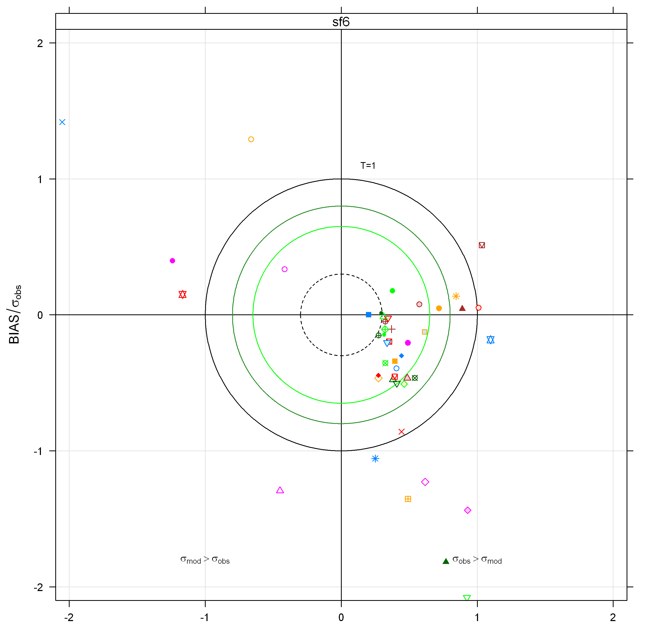
Updates to the PASODOBLE Myair Model Evaluation Toolkit Incorporating the latest Target plot in the PASODOBLE Toolkit
What about other pollutants?
SF6 (tracer)
Version 1.2 Target plot included in the Myair Toolkit
ADMS-Urban results for a model evaluation dataset
CRMSE / 2 RMS_{u} on Target 3.2
CRMSE / σ_{o}

Slide 14
Summary
The new statistical indicators used in DELTA version 3.2 work with the ADMS-Urban London dataset.
Users must be aware of the differences between the results in the target plot and some of the other indicators.
For the hourly NO₂ statistics, could there be an allowance for the uncertainty in the hourly model inputs?
Generalisation of the statistical indicators for all pollutants would make this model evaluation approach more widely applicable, for instance via inclusion in the PASODOBLE Myair Model Evaluation Toolkit.

