Slide 1
ATMOSYS Model Evaluation Tool Online Delta Tool
L. Blyth, N. Castermans, G. Driesen, S. Janssen, W. Lefebvre,
T. Op ‘t Eyndt, W. Peelaerts, N. Smeets, S. Van Looy,
N. Veldeman, P. Viaene, P. Vos and S. Vranckx, … - VITO
D. Celis, S. Mariën, E. Roekens, D. Roet, M.-R. Van den Hende,
K. Decoene, F. Fierens, E. Trimpeneers, … - VMM / IRCEL

Slide 2
ATMOSYS project
Goal: “Generic web-based service for regional and local air quality management”
Where: hotspot region Flanders (Belgium) - can be deployed in other regions as well
Duration: 3.3 year (2010-2013)
Resources
Total budget ~ 2.3 M€
LIFE+ project co-financed by the European Commission
Partners:
VITO Air Quality Modelling Unit
VMM Flemish Environmental Agency
Air Quality Unit - Monitoring and Modelling (Edward Roekens/David Celis)
Air Emission Inventory Unit (Marie-Rose Van den Hende)
Belgian Interregional Environmental Agency (IRCEL, Frans Fierens)
Notes:
ABOUT
ATMOSYS is a LIFE+ Environment Policy & Governance project co-financed by the European Commission. Within this project, a generic web-based service is developed, containing novel elements specifically designed to evaluate and analyse air pollution in European hot spot regions. The system is established for the hotspot region Flanders in the North of Belgium but can be deployed in other regions as well.
The established system is based on advanced technology, including prognostic 3-D atmospheric computer models, results from recent and on-going air pollution measurement campaigns in urban agglomerations and generic OGC-communication protocols to facilitate a fully automated web-based service.
The ATMOSYS system offers the opportunity to explore forecasted as well as historical data records of air pollution at neighborhood scale by means of animated spatial maps, time series or statistics of the relevant air pollution indicators (ozone, particulate matter, NO2, elemental carbon?). Regional scale air pollution simulations are combined with high resolution street level models in order to capture all relevant spatial scales of the air pollution phenomenon. In addition to the well-established fixed monitoring network in Belgium, dedicated measurement campaigns were setup in various Flemish cities in order to assess the air quality differences between urban background, urban and street canyon locations. Near real time monitoring data and model results (including data assimilation techniques) are made available in a web platform by means of INSPIRE compliant ICT technology to offer citizens and policy makers a multitude of data about local air pollution in European cities.

Slide 3
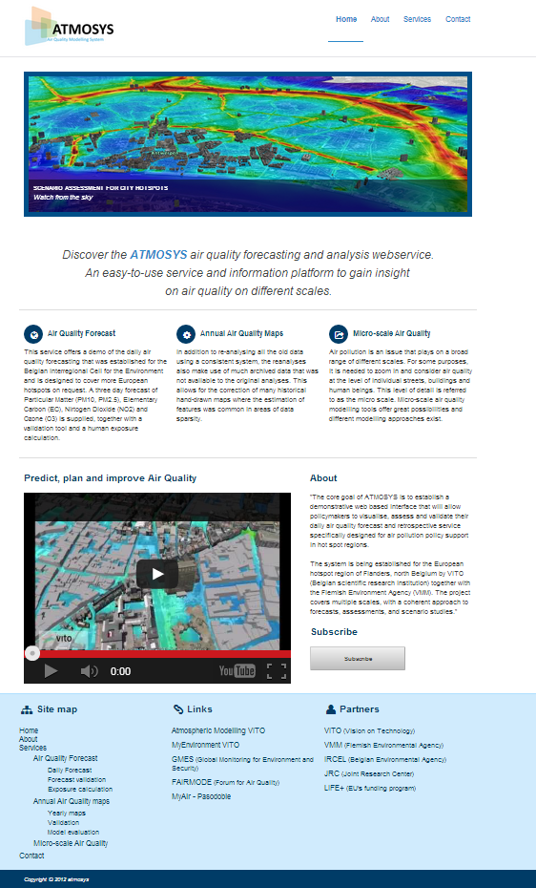
Generic web-based service
Goal: “Generic web-based service for regional and local air quality management”
The service
allows policymakers
to visualize, assess, and validate
their daily air quality forecasts
and retrospective analyses
The platform covers
multiple scales
with a coherent approach to
forecasts
assessments
and scenario studies

Slide 4
Conclusions
ATMOSYS Goal: “Generic web-based service for regional and local AQ management”
Generic – can be deployed in every hot spot region
Web-based – and thus user friendly
Service for regional and local AQ management – can be customized
Model Evaluation Tool (Online Delta Tool)
Online
Synchronized with JRC Delta Tool wrt implemented functionalities
Allows policy makers (and modellers) to easily validate modelling tools
Less functionalities in playing around with parameters
Does (currently) not allow modellers to do research, e.g. to test the impact of different parameters
http://www.atmosys.eu

Slide 5
Thanks for you attention! Comments / Questions / Suggestions?
http://www.atmosys.eu

