Slide 1
Comments from Austria
D. Oettl, A. Kaiser et al.

Slide 2
Two models used
AQA Austria (ALADIN – CAMx) – 10km resol.
GRAMM-GRAL (Eulerian-Lagrangian approach)
Comparison of previous and proposed MQO at some stations for O3, NO2 and PM10

Slide 3
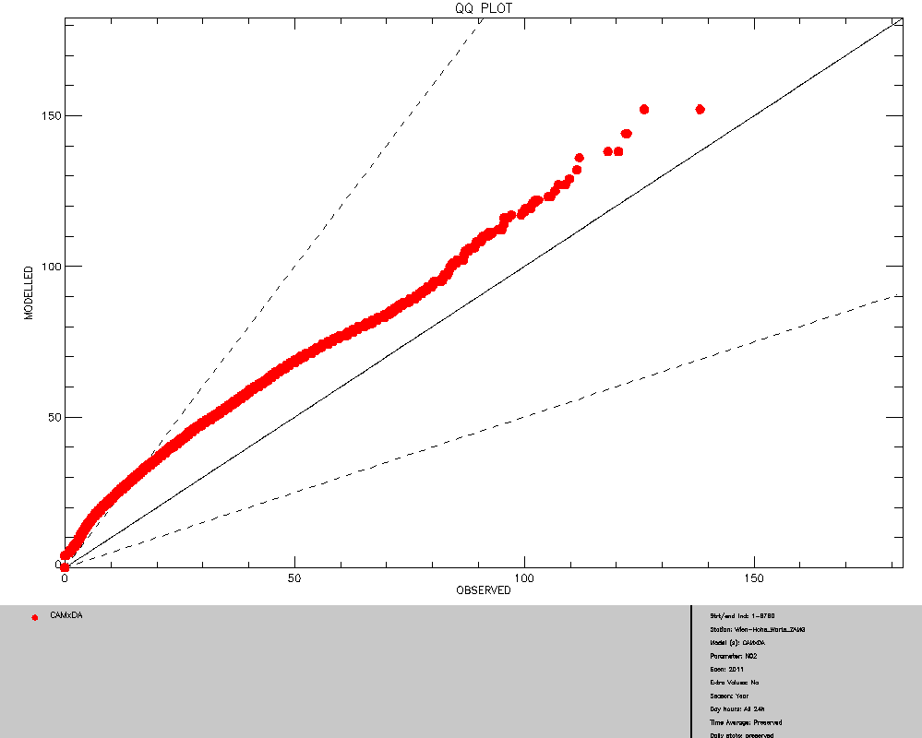
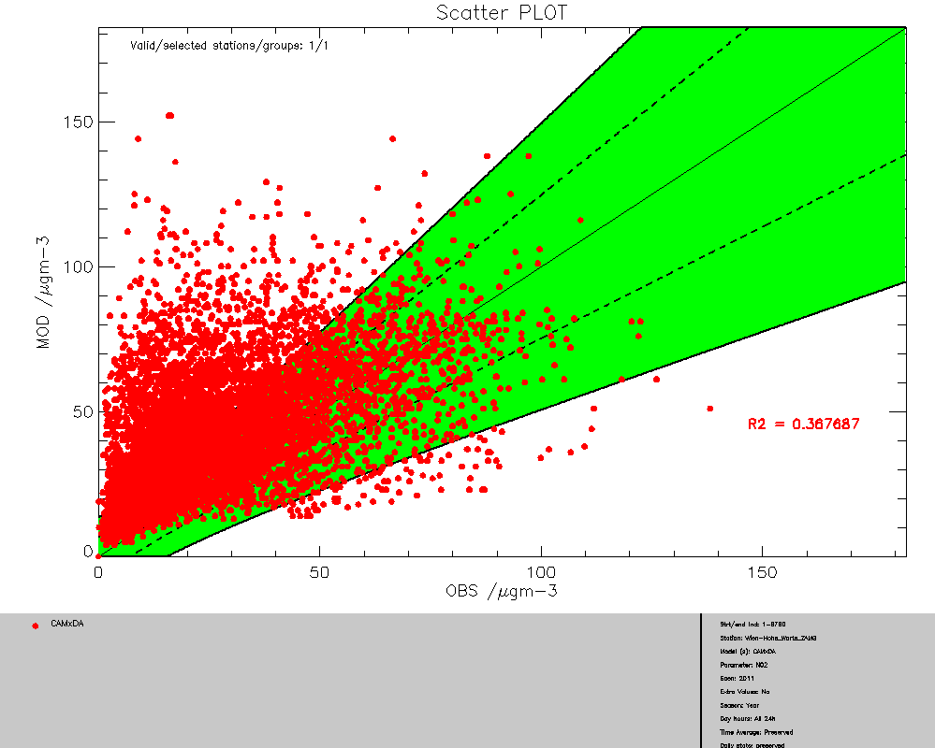
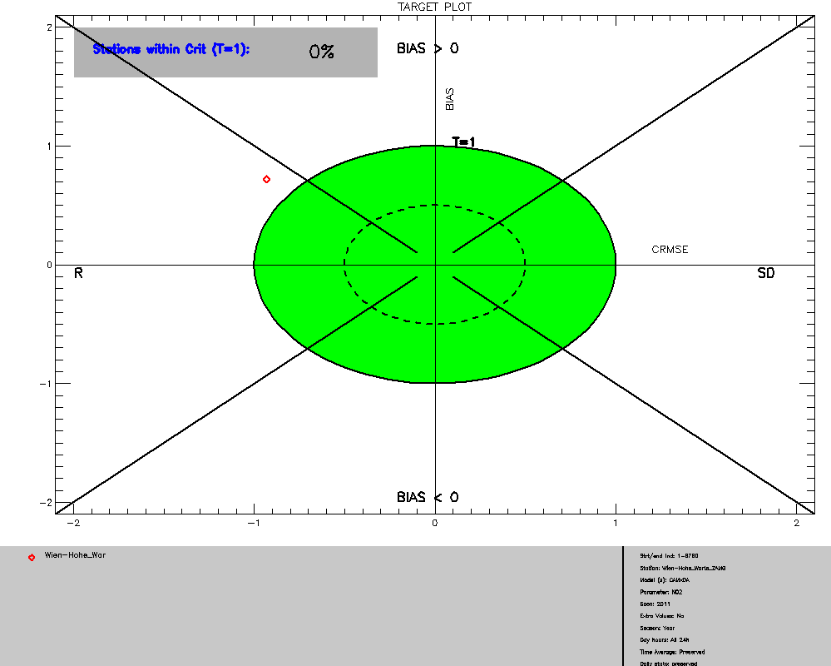
CAMx-ALADIN at Hohe-Warte station

Slide 4
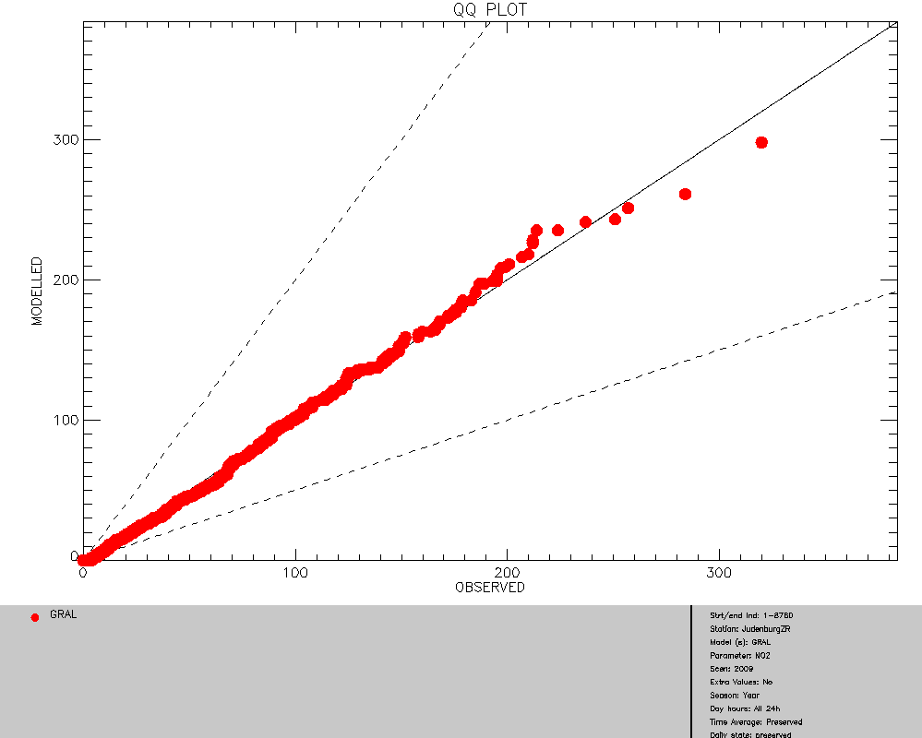
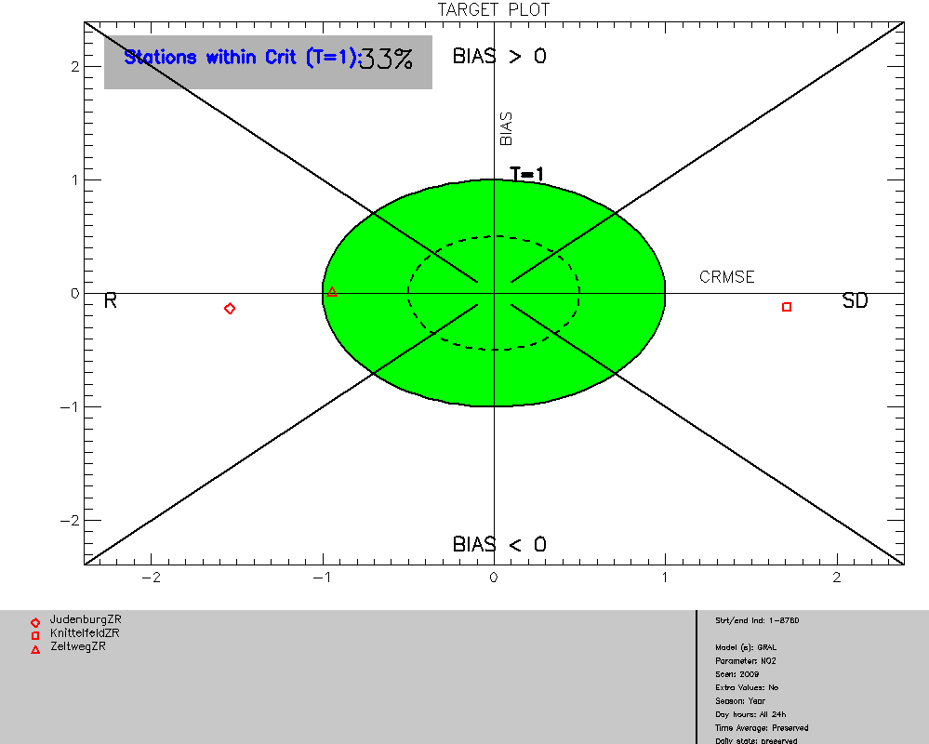
GRAMM - GRAL
RDE fulfilled but not MQO (problem of emission hourly temporal profile)

Slide 5
Conclusions
DELTA tool proves to be very useful in the evaluation process
Proposed MQO stricter than current AQD ones
Main issue: correlation. Possible reason for non fulfillment is the lack of accurate hourly emission profiles. MQO tend to be fulfilled with longer time averages

Slide 6
Comment 1
COST Action 732 demands that “as most of the non-CFD models have a very simple parameterization of the flow (…), evaluation is best done via quantile-quantile plots or a comparison of centerline concentrations and plume width” (Schatzmann et al., 2010). Geometric mean, geometric variance, fractional bias and the normalized mean square error are also well established metrics for comparisons of observations and model results on an hourly basis

Slide 7
Comment 2
PM₁₀ exceedance days can be derived from time-series computations. Another approach is via an empirical relationship between observed annual mean PM₁₀ concentrations and observed exceedance days
We recommend including a statement in the revised AQD, that in such cases model results are acceptable, when they fulfill the MQO defined for annual average PM₁₀ concentrations.

Slide 8
Comment 3:
We urgently suggest a clear definition for the application of the DELTA tool. It should clearly be pointed out that the DELTA tool as a whole is not appropriate to evaluate air pollution models on an hourly basis, except the quantile-quantile plot. The FAIRMODE community should be aware that stricter MQO contradict the support for increased use of air pollution models as intended by FAIRMODE.

